Slide 1

Welcome to Fairlands Primary School
New to Reception transition meeting
While you are waiting...
Please find a family photo on your phone and send it to
Rochelle.free@fairlands.herts.sch.uk
Notes:
ROCHELLE
Good afternoon, thank you for coming to our new to reception meeting
The aim of this meeting is to give you a little bit of information about Reception and some information about Fairlands if you are new to the school

Slide 2
Meet the team…
Notes:
ROCHELLE
First, let's look at the Reception team for September.

Slide 3




Meet our Reception teaching team
Miss Rochelle Free
Senior Teacher of Reception
& Ash Class Teacher
Mrs Katie Kirby
Birch Class Teacher
Mrs Victoria Cousins
(Monday, Tuesday, Wednesday)
Beech Class Teachers
Mrs Faye Moore (Wednesday, Thursday, Friday)
Beech Class Teachers
Notes:
ROCHELLE
Each teacher to introduce themselves

Slide 4
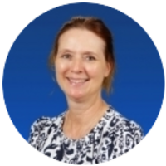
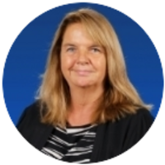
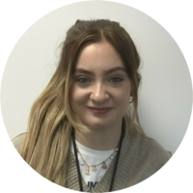

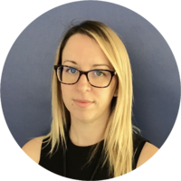


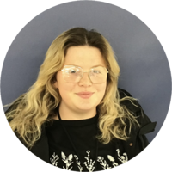
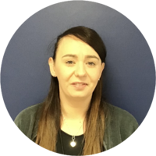
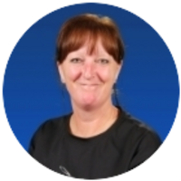
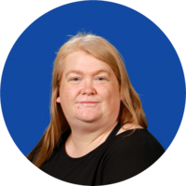
Adults we will see in Reception
Mrs Dendy
Ms Glenister
Miss Bailey
Coming soon!
Miss Chappell
Miss Bradford
Miss Christopher
Miss Cooke
Mrs Taylor
Mrs Craig
Miss Williams
Notes:
ROCHELLE
We are very lucky to have lots of adults supporting in Reception. We work closely with the other classes so that we ensure we are building relationships with all children across Reception.
(Go through each adult)

Slide 5
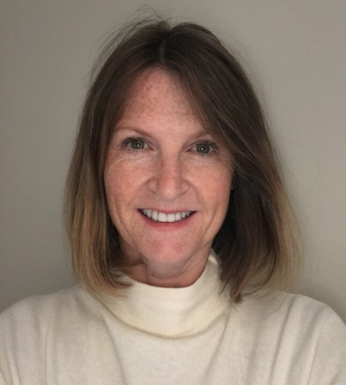
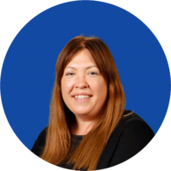


Other staff in the lower site
Mrs Holleran
Communication Assistant
Mrs Simpson
Lower office staff
Miss McDonagh
Lower office staff
Mrs Melarkey – runs games library and uniform swap shop
Notes:
ROCHELLE
Here are some other staff that work in the lower building.
We have a communication assistant here at Fairlands who works with us three days a week.
Mrs Holleran is under the direction of the NHS speech and language therapist.
Mrs Holleran will screen all children in Reception in the first term and will then identify children who may need support. The support ranges from speech sounds, children's understanding, attention and listening, language support. Interventions are then planned and organised in short and regular bursts. If your child is identified as needing some support you will be notified and updated on their progress.

Slide 6
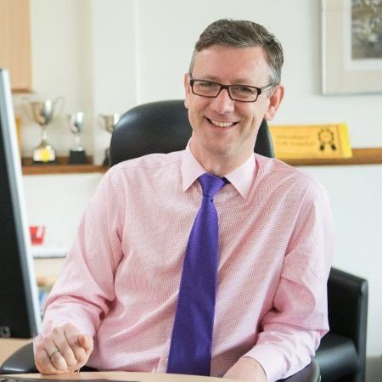
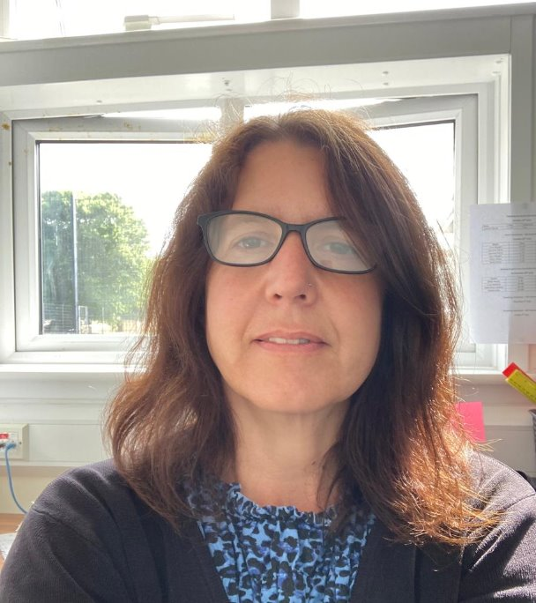
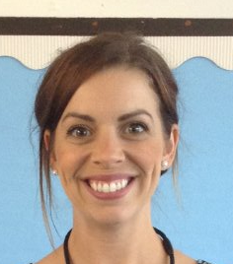
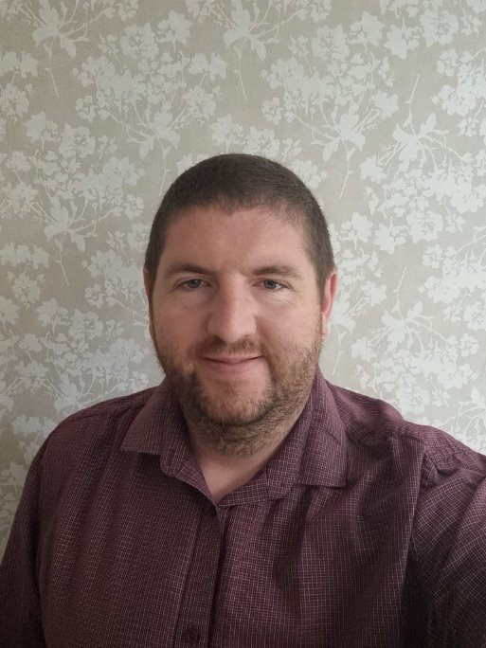
Meet the leadership team
Mr Robert Staples
Headteacher
Miss Michelle Bridge
Senior Deputy Headteacher
Mrs Natalie Sembi
Deputy Headteacher
Mrs Sharon Mullen
Assistant Headteacher and SENDco
Mr Chris Holgate
Assistant Headteacher
Notes:
ROCHELLE
Here is our leadership team. We are a large school split across two sites. We are on the lower site where we have Nursery, Reception and Year 1. On the lower site we have our hall where we will do our P.E, our achievement assemblies and this is where we eat our lunches. On this site we also have our lower site after school club.
On our upper site you will find year 2-6, our other hall, our upper office, dining hall and lots more!

Slide 7
Our Early Years ethos
Notes:
ROCHELLE
Our Early Years Ethos – what we believe in and what we feel is important

Slide 8





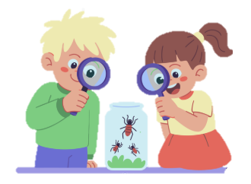
Helping children build confidence, independence and resilience
We believe children learn best through play
Getting to know your child and building strong relationships with families is one of our first priorities. When children feel safe, happy and valued, they are ready to learn!
Whatever the weather!
Every child is encouraged to be curious, have a go, make friends and enjoy learning
Children learn through exploration and hands-on experiences
Notes:
ROCHELLE
Read through each statement

Slide 9
what a typical day looks like...
Notes:
ROCHELLE
What a typical day looks like

Slide 10

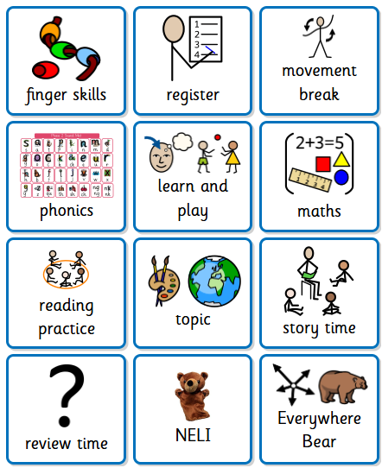

Notes:
This is roughly what our timetable looks like at the minute in Reception.
In the Autumn term, it is slightly different, as we spend the first half-term, teaching the children about the different areas in the classrooms and the outside area.
This helps children to play successfully in each area.
We start with 10 minute finger skills activities. We have a skill of the week which focuses on a different fine motor movement (twisting, flicking, threading, pencil control) These kind of activities helps children to build the muscles ready for writing.
We have regular movement breaks to break up the sitting time.
We have daily phonics learning.
Learn and play time – all three classrooms are open and the outside. Children are free to explore all areas independently. This is also time for them to access snack if they want.
We then will have maths.
Lunch is from 11:30am – 12:30pm.
Every few weeks, we focus on a new book. We then do some writing activities in small groups based from the book.
We then have some more learn and play time.
We have a topic for the half-term which are based off the children's interests.
We will also start reading practice where we read in small groups. In the Autumn term, we will look at wordless books and focus on the comprehension of the story. Answering questions, looking at characters, their feelings etc.
We also do something called review time – where we talk about what we did during our learn and play time. This is a great time to answer wh questions. Where did you play? Who did you play with? What did you make?
We will join in with achievement assemblies in the spring term.
This year we are starting something new called NELI. The children who are from this nursery are familiar with Neli. They have brought out a whole class reception Neli. Neli is a whole class session designed to improve the spoken language, vocabulary, and listening skills of young children.
We also have the Everywhere Bear. We each have a class bear (show the bear) each week the bear will choose someone he wants to go home with. Your child keeps the bear for a week. The bear also comes with a scrapbook for you to put in photos and comments. I will leave it out so you can have a look at this years book if you would like.
Also, if there is a date that you think your child would particularly like the bear – please let us know. Maybe a birthday, a special occasion.

Slide 11
Drop off and collection
Notes:
ROCHELLE

Slide 12
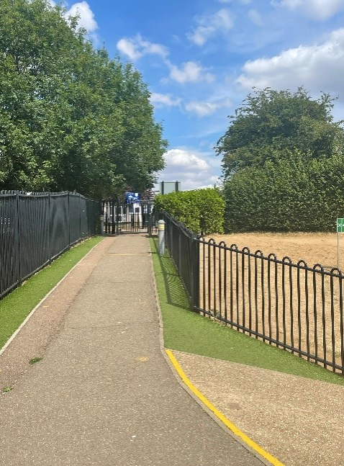
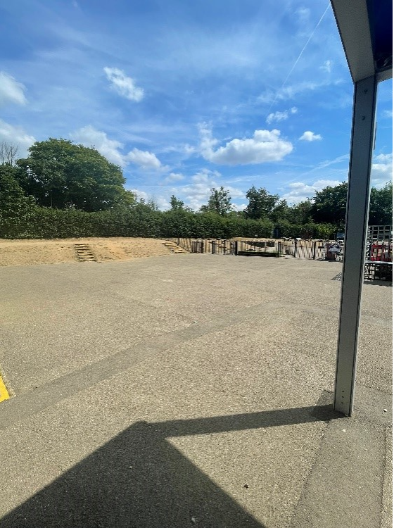
Enter through the lower playground gate.
Wait in the lower playground
Notes:
ROCHELLE
At drop-off and pick up, you will walk down this hill like you did when you came here. You can wait in this lower playground.
If you are in Ash or Beech (so if your teacher is Mrs Cousins and Mrs Moore or myself) in the mornings, an adult will open this gate and we ask that you say goodbye to your child at the gate. The children will walk in by themselves (in the first week, we play a game called 'find your classroom'. So we practise by coming out onto this playground, clapping and then asking the children to find their class door and their classroom) This helps in the mornings with their routine and knowing where to go.
If you are in Birch Class, and your teacher is Mrs Kirby, the door will open (show door) and we ask that you say goodbye to your child at the door. Your child will then walk into class by themselves.
Asking the children to walk in by themself, gives children a sense of confidence, builds independence but also helps with transition as they get older and move up the school.
There is always an adult on the gate. Any messages, please speak to the adult on the gate, who will pass on the message to the teacher.
If the message can wait, you can speak to the class teacher at the end of the day – we just ask that you wait until the majority of children have left to ensure safety.
At the end of the day, for all classes, you can come to the classroom doors, and we will release children from their classrooms.

Slide 13
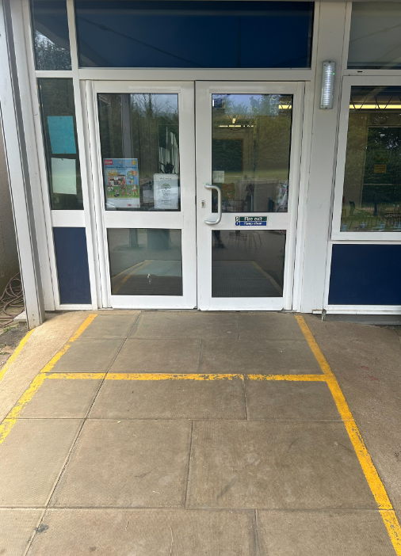
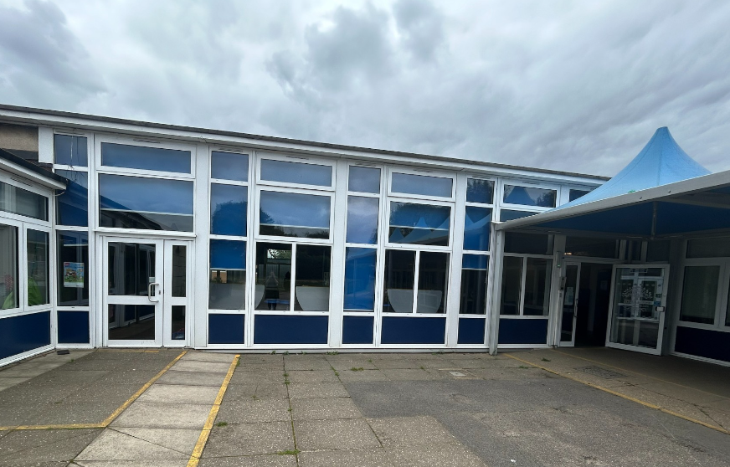
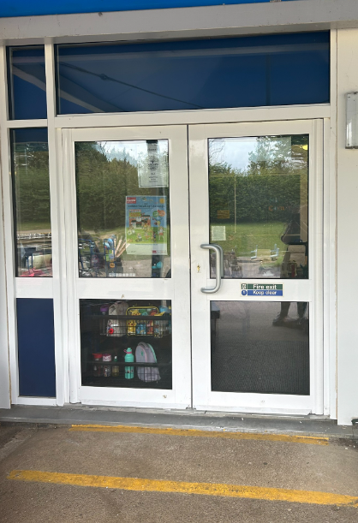

Birch
lower office
Beech
Ash
Notes:
ROCHELLE
At home time, we will open the gate/door at 3:20pm.
Ash and Beech parents can come in through the gate and we will release through the class doors.
Birch Class parents – this door will open and an adult will release the children.

Slide 14


  Morning
  Gates open at 8:40 am
  Gates close at 8:50 am
  After this time, children need to be dropped off at the lower office.
  Afternoon
  Gates open at 3:20pm
  Gates close at 3:30pm
  After this time, children need to be picked up from the lower office.
  Your child may have been taken to after-school club
  After-school club
  Anytime until 6:15pm
  (lower hall)
  Bookable via the Arbor app
  Both breakfast club and after school club is run by familiar staff
  Breakfast Club
  7:45am (upper hall)
  Staff will bring children down to their classrooms
  Bookable via the Arbor app
Notes:
ROCHELLE
Here are the start and finish times of our school day (read through slide)
The children may be upset in the first few days and sometimes weeks of starting school. We know that it is hard leaving them, especially when they are crying.
The children will settle after a few minutes and very rarely need more than 5 minutes. If you would like us to phone you, to reassure you that your child has settled, we are happy to do this. If your child does not settle for any reason, we will always phone you. It is important to give a 'hard goodbye' at the gate. The longer you do your goodbyes, the longer children will feel distressed.

Slide 15
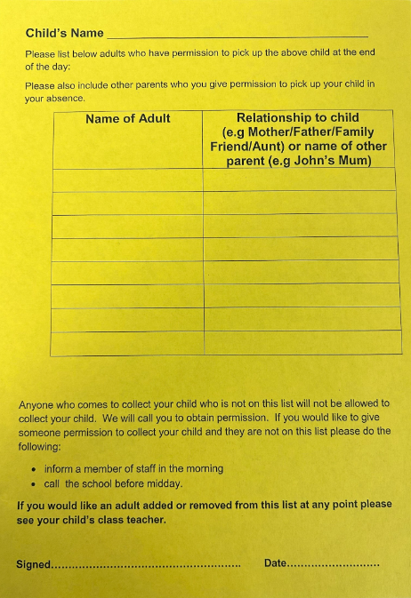
  Yellow collection forms
  Prior to starting in reception, you would have been asked to fill in a Yellow collection form.
  We will release to only those that are on this list.
  If there are any changes, please let us know ASAP.
  You can add/change/take off names at any time.
  If someone is collecting that is not on the yellow forms, please phone the office as soon as you can
  If someone comes to collect that is not on the yellow form, we will phone the first two contacts on Arbor.
  Please bare with us in the first few weeks while we get to know you all !
Notes:
ROCHELLE

Slide 16
communication
Notes:
KATIE

Slide 17

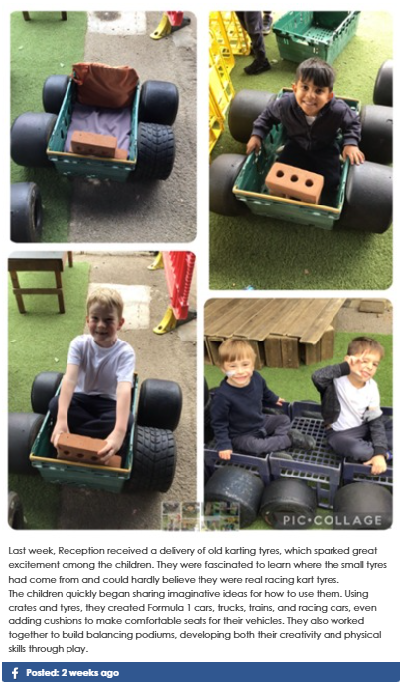


How we communicate with you homework and medical tracker
  parent workshops
Facebook – school blog
Open-door policy.
Arbor App
  Parent consultations
  Email
e-mail
weekly homework flyer
Notes:
KATIE
Communication is so important and children learn best when we work together. Here are some of the ways we may communicate with you.
Parent workshops – Throughout the year, we run various parent workshops. Please let us know if there is a workshop you would like to see run for parents
We will often put on our school blog some of the things we have been doing in Reception. These are posted to Facebook and our new Instagram page!
Every week, a Reception Weekly Information Flyer will be sent through to your e-mail. It will have what learning we have done that week, any important messages and upcoming dates. We will also include some activities that you can do at home to support with the learning that has happened that week at school.
Parent consultations – We have these twice a year; one in October and another in February.
We have come away from paper medical forms. We now use something called medical tracker. If your child has sustained an injury at school, you will receive an email to inform you of what happened and what treatment was given. If your child sustains a head injury, we will always phone you to let you know aswell as send an email letter.

Slide 18
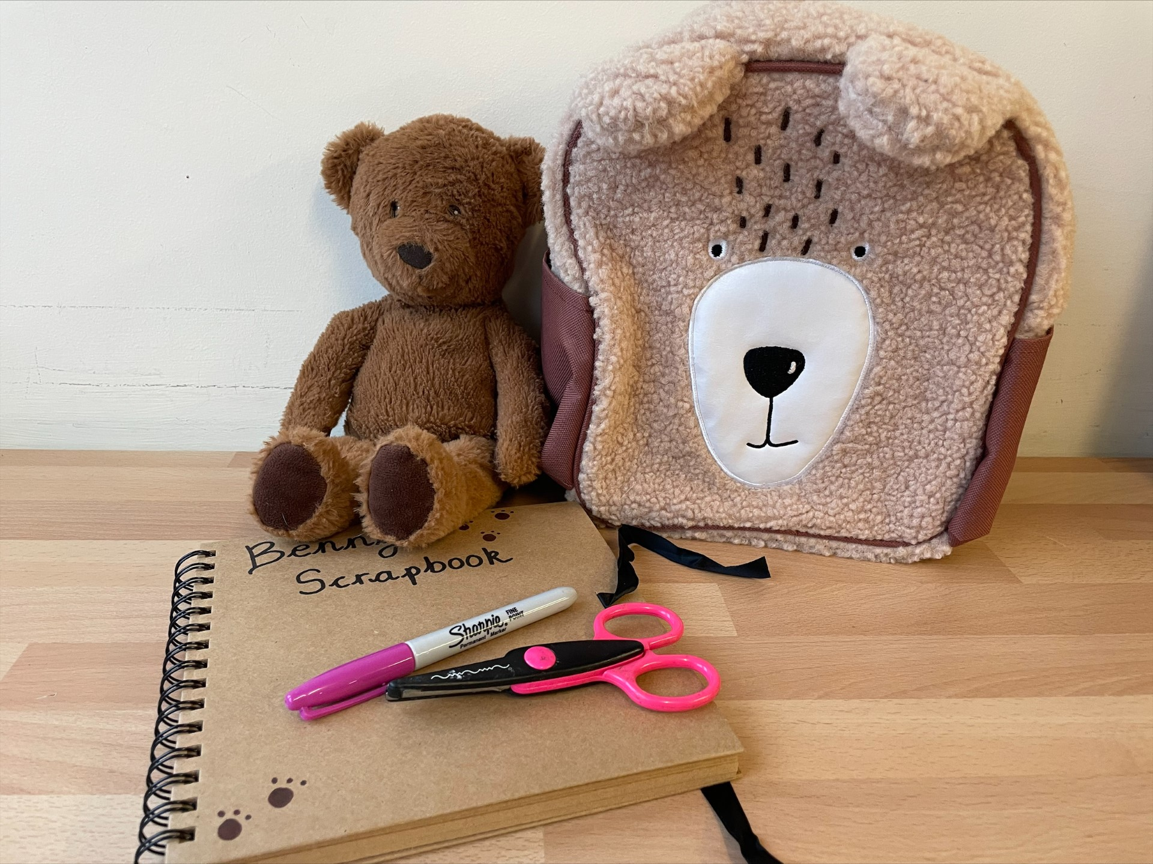


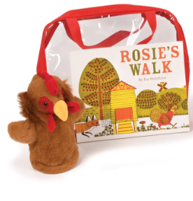




Home / School Opportunities
  Borrow a Book
  Everywhere Bear
  Shared reading
  Festivals!
  Reading at home
  Games Library
  home learning sharing
  Achievement assemblies
Notes:
KATIE
We want to build a good home-school relationship as this is when the best progress is made! Here are some ways we share home and school life!
Everywhere Bear – Your child will have the opportunity to take the Everywhere Bear home for a weekend. The bear has their own scrapbook for you to record what your child and the bear has been up to and stick in any photos you may take. Your child will then have the opportunity to share their photos and what they have been up to in class.
Borrow a book - We have a trolley of books under Ash and Beech canopy. Please feel free to take a book, share it at home and then return it when you are finished.
Shared Reading – parents are invited to join their child in their classrooms between 8.40am – 9:00am for some reading. We normally start this after the october half-term to allow the children some time to settle into their new classrooms and routine. We will let you know what day this is starting.
Games Library – We have a wide selection of amazing resources for you to take home and borrow. (show some examples – books, puppets, sensory, storytelling and games) One day each week; after school, in the hall, we will put these bags out. We would love for you to come along and choose a bag with your child.
If you are celebrating a special festival or celebration at home, please let us know! We would love to learn about and celebrate at school.
In the Autumn term, your child will be given a reading record. We will send home a reading book each week – this may start off as a wordless book. Please do not worry! Most children start off on a wordless book until they are confident with their phonics and can blend sounds together. We will send books home on a Friday and ask that they are back the following Friday, so that they can be changed.
Achievement Assembly – Once a week, we get together for an achievement assembly. When your child is awarded a certificate, we will invite you to join our assembly. We will let you know when this starts!
We love hearing what your child does at home! Whether it be they have learnt to put their trousers on by themselves, they have learnt something new in swimming, they can now cut up food with their knife and fork, they visited their grandma, we would love to hear about it and celebrate it in school.

Slide 19
Medical Information
Notes:
KATIE

Slide 20



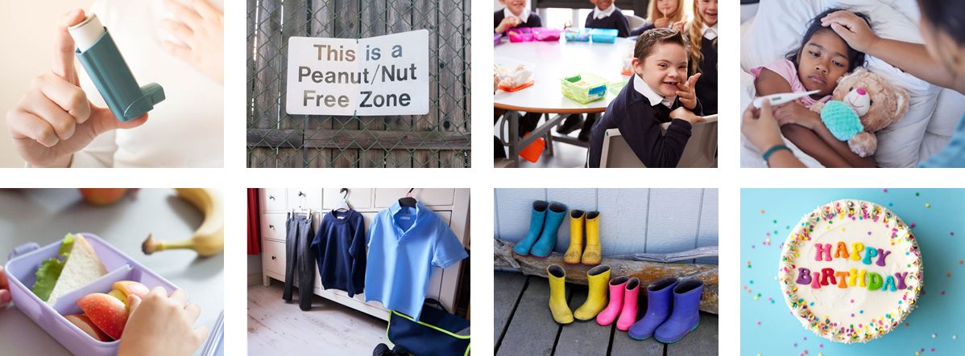

Notes:
KATIE
Allergies - If your child has a food allergy, please let us know. In terms of lunches, this will need to be registered with Herts Catering, before they are able to have a school meal. We have children in the lower building with a severe nut allergy, so we ask that no products containing nuts come into school.
prescribed medication -
We can only administer antibiotics if they are prescribed 4 x daily. Parents must complete a form at the office, medicine will be stored safely.
injuries from home - Please let us know if your child has sustained any injuries at home.
Birthday sweets – We know that children love to bring in sweets for their birthdays. Due to the range of allergies and food intolerances we have in the school, we can not give out sweets or other food items in school.
First Aid – Risk assessments are undertaken to reduce potential hazards but as we know there will always be accidents. If your child has an accident at school you will be informed through the accident information sheet. If your child sustains a head injury and there is a bump/mark, you will be called and your child will receive a red letter. On some occassions, you may be asked if you would like to have a look and decide next steps or whether you are happy for staff to monitor.
Your child will receive a white letter for any other accident they have had at school.

Slide 21
Lunchtime offer
Notes:
VICKY / FAYE

Slide 22
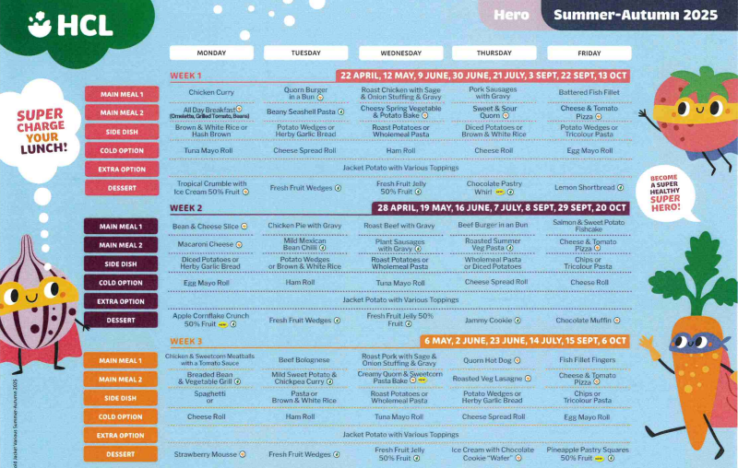
Lunchtime offer
Notes:
VICKY / FAYE
Children in Reception, Year 1 and Year 2 receive a free school lunch (so this is the best time to encourage your child to try new foods)
This is government funded and all children are eligible, respective of parental income or situation
Lunchtime for the Foundation Stage is 11.30am -12.30pm (in the Lower Hall)
Many of the Midday Supervisory Assistants (MSAs) are also Early Years staff. However, your child’s class teacher will also support your child to settle in to the lunchtime routine in the Autumn term
3 week rolling menu
A menu will be provided with a selection of 4 meals, please talk to your child about their preference, to enable your child to independently select their meal choice when they arrive at school.

Slide 23



Healthy lunch
Please:
Refrain from packing too much
Start with less and add more items if they are eating all the items that you send
Let us know if they continue to eat very little
No
Fizzy drinks
Sweets
Chocolate bars
Nut products (including peanut butter and Nutella)
Daily fruit and milk accessible throughout the day
Notes:
VICKY / FAYE

Slide 24
Uniform
Notes:
VICKY / FAYE

Slide 25
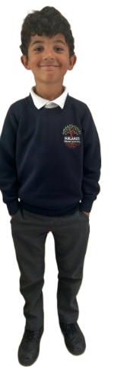
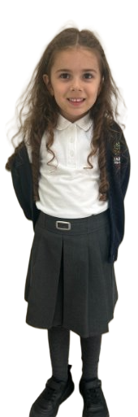
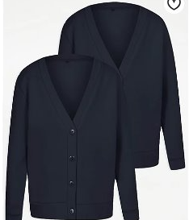
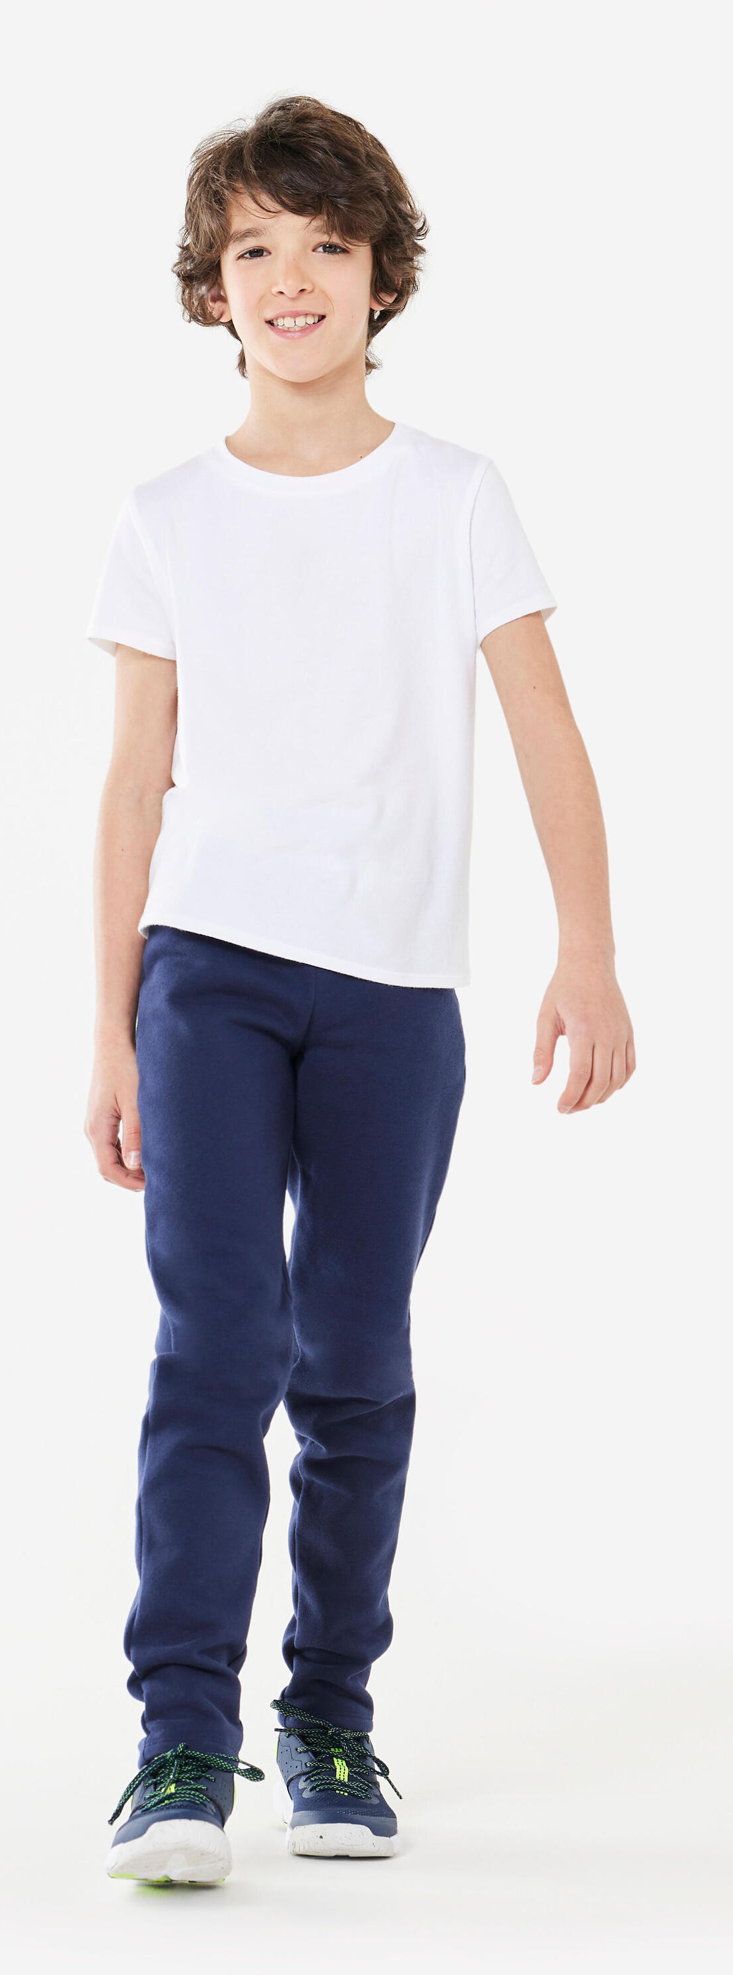

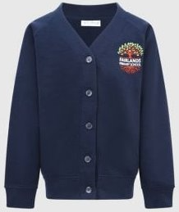
named
www.smartyschoolwear.co.uk
Notes:
VICKY / FAYE
School uniform
Please make sure that absolutely everything is labelled with your child’s name! (Including shoes!)
Grey trousers / dresses / skirts / tailored shorts
White polo shirts / shirts / blouses/polo top
Navy blue sweatshirt / cardigan
Blue gingham summer dresses
We will always do our best to return any belongings to the children. If they are named, it makes it easier.
There is a lost property rail in this lower hall – if there is a time where something has been misplaced. Please check here also.
PE uniform
White top, navy shorts/jogging bottoms and trainers
Children will get changed at home and come into school dressed in their P.E kit.
Please also note that your child’s uniform will get messy at some point! Playing with paint, mud and other sensory materials is great for your child’s brain development and aprons/all in one waterproofs are never perfect.
It is fine to send your child to school in uniform that has been washed but has stains ☺

Slide 26
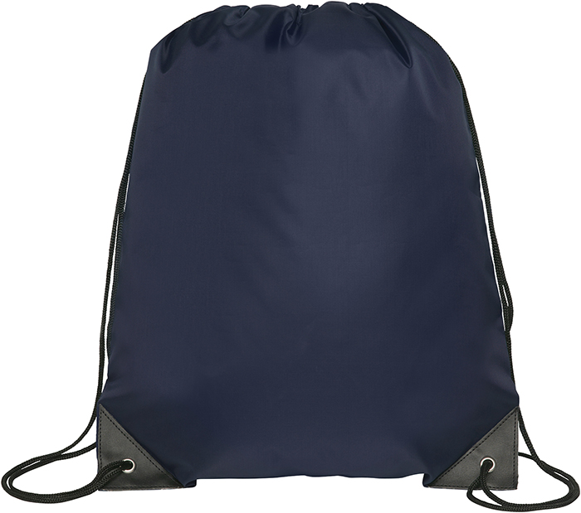

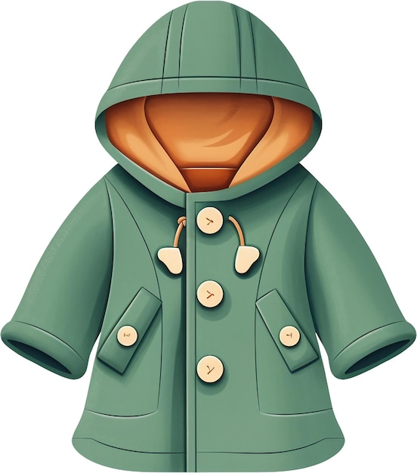

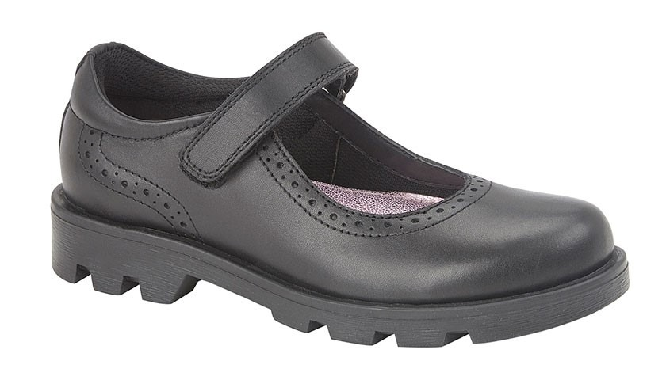
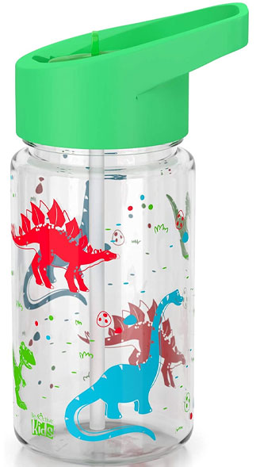
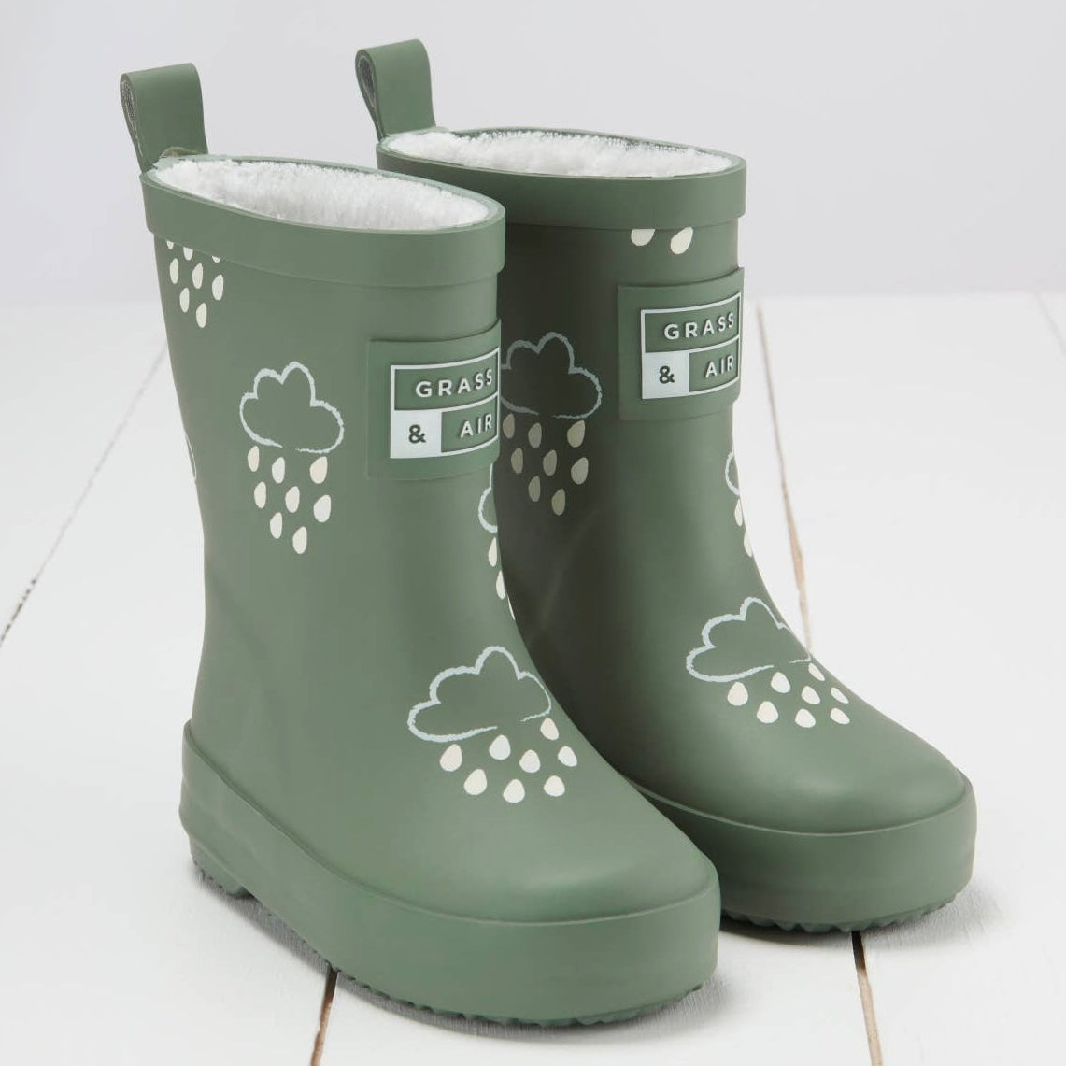
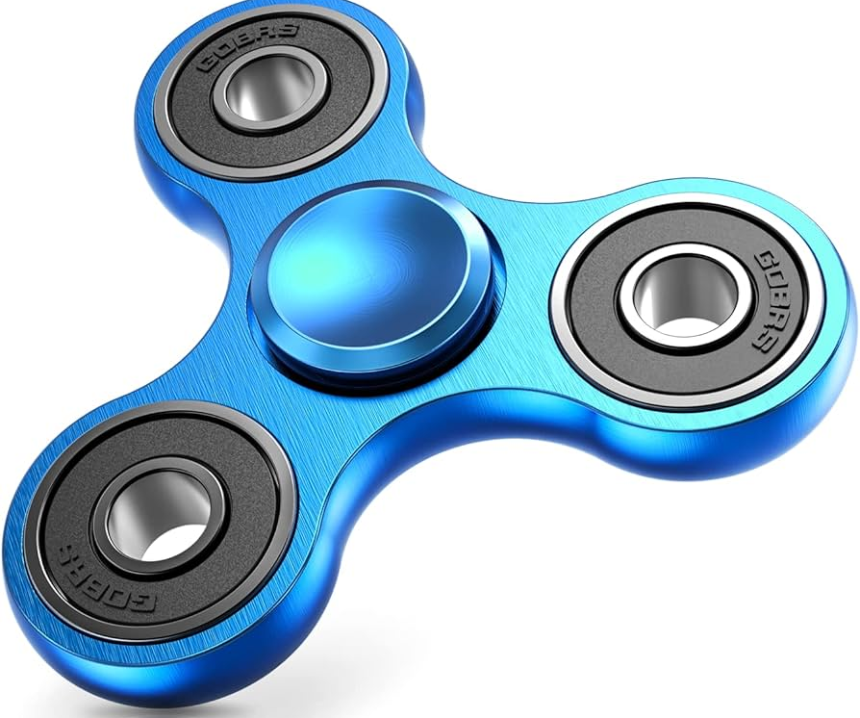
Please remember...
named
Notes:
VICKY /FAYE
Please remember to bring:
A book bag everyday – for letters, accident forms, drawings, reading books etc.
A pair of wellies that can be kept at school for the days where it is raining.
Sturdy shoes with velcro if possible please.
Coat everyday
Sun hat on the days where it is hot.
No toys to be brought to school
Water bottles - just water (no juice)
You will be given a blue drawstring bag. We ask that a spare change of clothes is put into this bag and kept on your child's peg. If your child has an accident or gets wet/muddy outside – we will use these clothes and send home the wet ones.

Slide 27
Dates
Notes:
ROCHELLE

Slide 28
Dates for September
Date | What?
Thursday 3rd September Friday 4th September | 8:40am – 11:30am
Monday 7th September Tuesday 8th September | 8:40am – 12:30am (children stay for lunch)
Wednesday 9th September | All day 8:40am – 3:20pm
Wednesday 9th September onwards | Breakfast Club and After School Club opens
Notes:
ROCHELLE

Slide 29
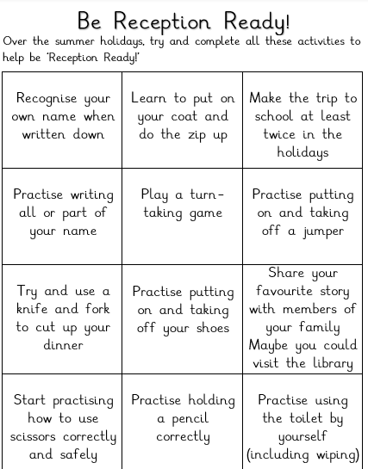

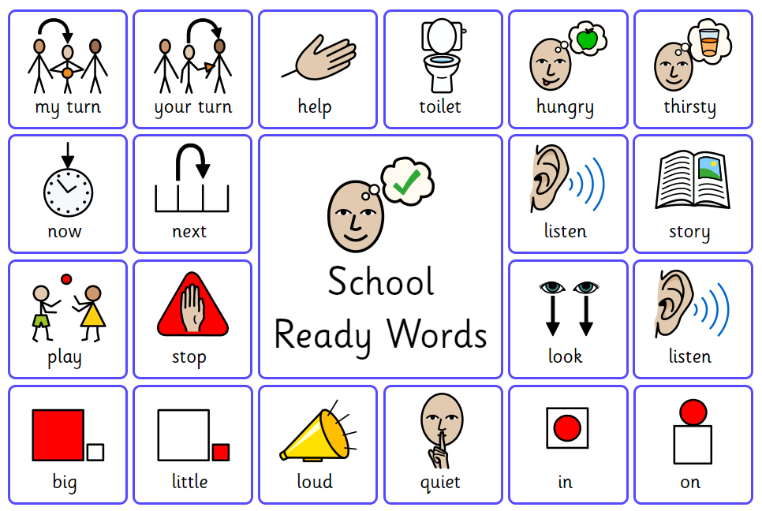

Transition morning booklet ...
Rochelle.free@fairlands.herts.sch.uk
School ready words
Notes:
ROCHELLE
On moving up morning, your child would have received a transition booklet.
Inside there are some ideas of activities you can do to support with getting school ready – things such as practise cutting up your food with a fork and knife, dressing yourself, putting your shoes on the right feet, writing your name, making the journey to school etc.
There is a list of parks and clubs
There are some school ready words, words that children will hear a lot in Reception
We sent home a brown envelope and we ask that over the summer, children fill this envelope with any momentos, photos of what they have been up to in the summer, things they might collect, favourite toy, any drawings etc. We will share these when we are back in September.
We would also love for you to send a photo of your family. We start the year off learning all about the children and families. We would love to display these in our home corners.
Please send these to the following e-mail.
5. Independence Skills to Practise Before September (3 mins)
This is one of the most valuable slides.
Include practical skills such as:
Putting on coat
Using the toilet independently
Washing hands
Opening lunch items
Using cutlery
Recognising own name
Getting dressed for PE
Tidying away belongings
Present this positively:
“Things that really help children feel confident in school.”

Slide 30
We look forward to welcoming you to Fairlands Primary School
Notes:
Thank you for coming. We look forward to seeing you all again in September :)
We are going to hang around for a few minutes, if anyone has any questions – If not, we will see you all in September. Have a lovely Summer!

