Slide 1

Welcome to Fairlands Primary School
New to Nursery transition meeting
Notes:
ROCHELLE
Good afternoon, welcome to our new to reception meeting. The aim of this meeting is to give you a little bit of information about reception and some information about Fairlands if you are new to the school

Slide 2



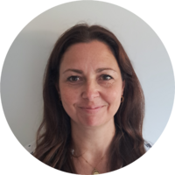


Meet our Leadership Team…
Mr Robert Staples
Headteacher
Miss Michelle Bridge
Senior Deputy Headteacher
Mrs Natalie Sembi
Deputy Headteacher of the Lower Phase
Mrs Sharon Mullan
Assistant Headteacher & SENDco
Mrs Amy McCullagh
Family Support Worker​
Mr Chris Holgate
Assistant Headteacher
Notes:
Mrs Fleck and Mrs Waldron will be teaching in Acorns from September. Acorns is the 35 hour provision.
Miss Kavanagh will be teaching in Conkers, in both the morning and afternoon session.
Teachers to introduce themselves – short speel about themselves / experience

Slide 3
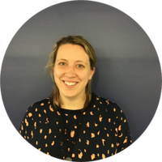

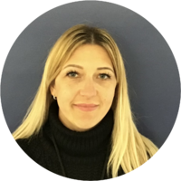

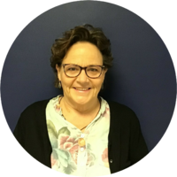
Meet our Nursery Key Workers…
Mrs Nicky Fleck
Nursery Senior Teacher / Hedgehogs Key Worker
Monday - Wednesday
Mrs Tarryn Miller
Nursery Teacher/Hedgehogs Key Worker
Miss Naomi Hyatt
Rabbits Key Worker
Mrs Mandy Glindon
Foxes AM and Owls PM Key Worker
Mrs Sandra Johnson
Owls AM Key Worker
Notes:
Mrs Fleck and Mrs Waldron will be teaching in Acorns from September. Acorns is the 35 hour provision.
Miss Kavanagh will be teaching in Conkers, in both the morning and afternoon session.
Teachers to introduce themselves – short speel about themselves / experience

Slide 4

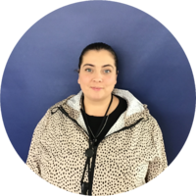
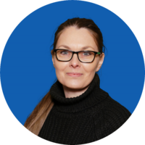
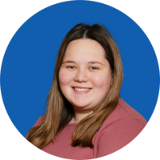
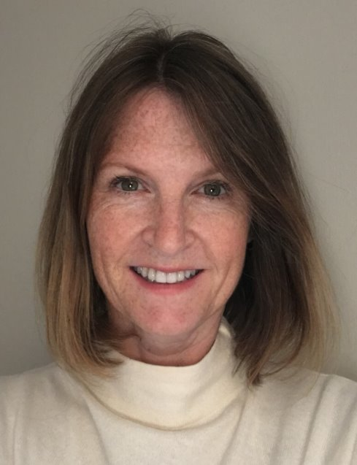
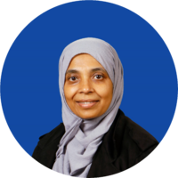
Meet our Nursery team…
Mrs Donna Hitchcock
Teaching Assistant
Mrs Lisa Angel
Teaching Assistant
Mrs Diana Bercia
Teaching Assistant
Miss Molly Mitchell
Teaching Assistant
Mrs Gaye Holloran
Communication and Intervention Lead
Mrs Moriom Kamali
Mealtime Supervisory Assistant
Notes:
Mrs Fleck and Mrs Waldron will be teaching in Acorns from September. Acorns is the 35 hour provision.
Miss Kavanagh will be teaching in Conkers, in both the morning and afternoon session.
Teachers to introduce themselves – short speel about themselves / experience

Slide 5
Information Pack
- Received via email
- Please return as soon as possible
- Include as much as possible

Slide 6

Arbor
You can...
- Book breakfast and after school clubs
- Book Nursery Lunch Club and pay for school meals
- Purchase book bags
- Pay for school trips

Slide 7


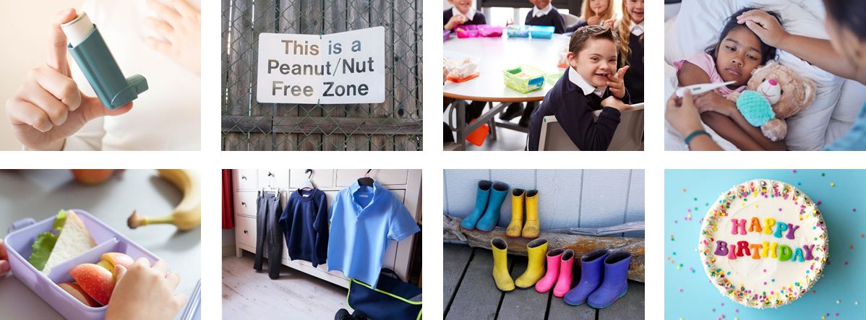
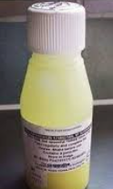


Medical information

Slide 8
Uniform
Notes:
KATIE

Slide 9
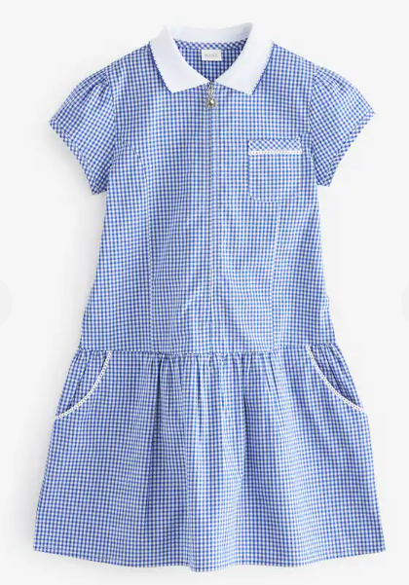
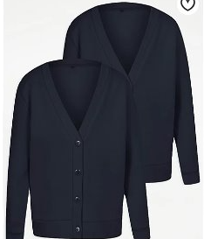
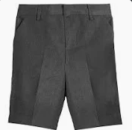
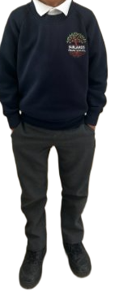
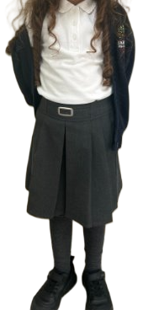
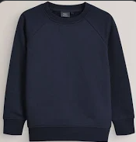
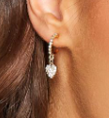

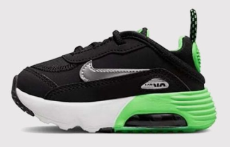
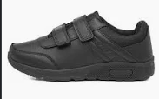
www.smartyschoolwear.co.uk
Notes:
KATIE
School uniform
Please make sure that absolutely everything is labelled with your child’s name! (Including shoes!)
Grey trousers / dresses / skirts / tailored shorts
White polo shirts / shirts / blouses/polo top
Navy blue sweatshirt / cardigan
Blue gingham summer dresses
We will always do our best to return any belongings to the children. If they are named, it makes it easier.
There is a lost property rail in this lower hall – if there is a time where something has been misplaced. Please check here also.
PE uniform
White top, navy shorts/jogging bottoms and trainers
Children will get changed at home and come into school dressed in their P.E kit.
Please also note that your child’s uniform will get messy at some point! Playing with paint, mud and other sensory materials is great for your child’s brain development and aprons/all in one waterproofs are never perfect.
It is fine to send your child to school in uniform that has been washed but has stains ☺

Slide 10
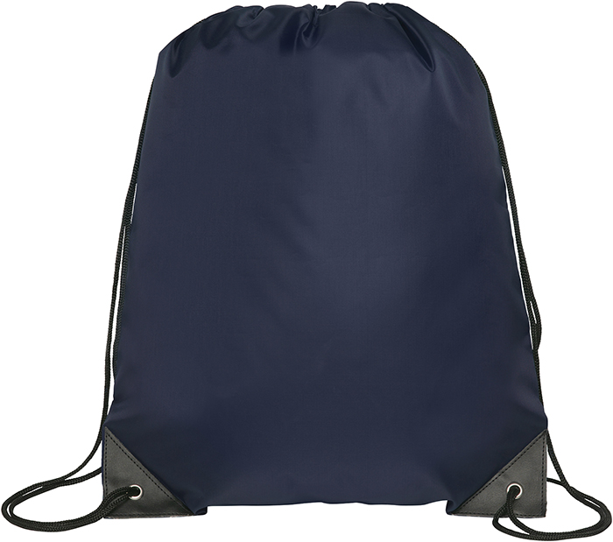


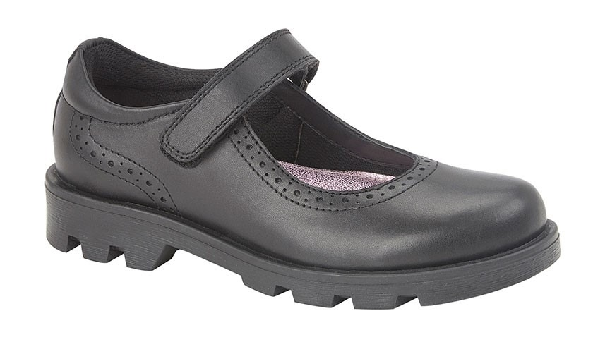
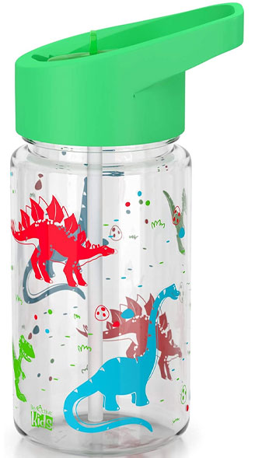

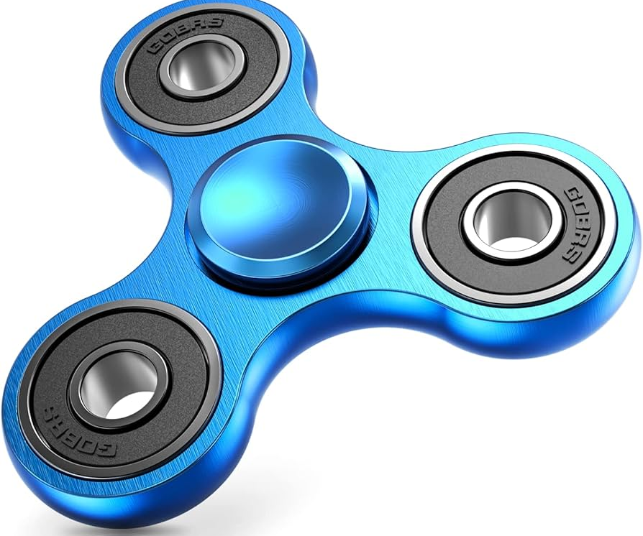
Please remember...
Notes:
KATIE
Please remember to bring:
A book bag everyday – for letters, accident forms, drawings, reading books etc.
A pair of wellies that can be kept at school for the days where it is raining.
Sturdy shoes with velcro if possible please.
Coat everyday
Sun hat on the days where it is hot.
No toys to be brought to school
Water bottles - just water (no juice)
You will be given a blue drawstring bag. We ask that a spare change of clothes is put into this bag and kept on your child's peg. If your child has an accident or gets wet/muddy outside – we will use these clothes and send home the wet ones.

Slide 11
Drop off and collection
Notes:
FAYE

Slide 12
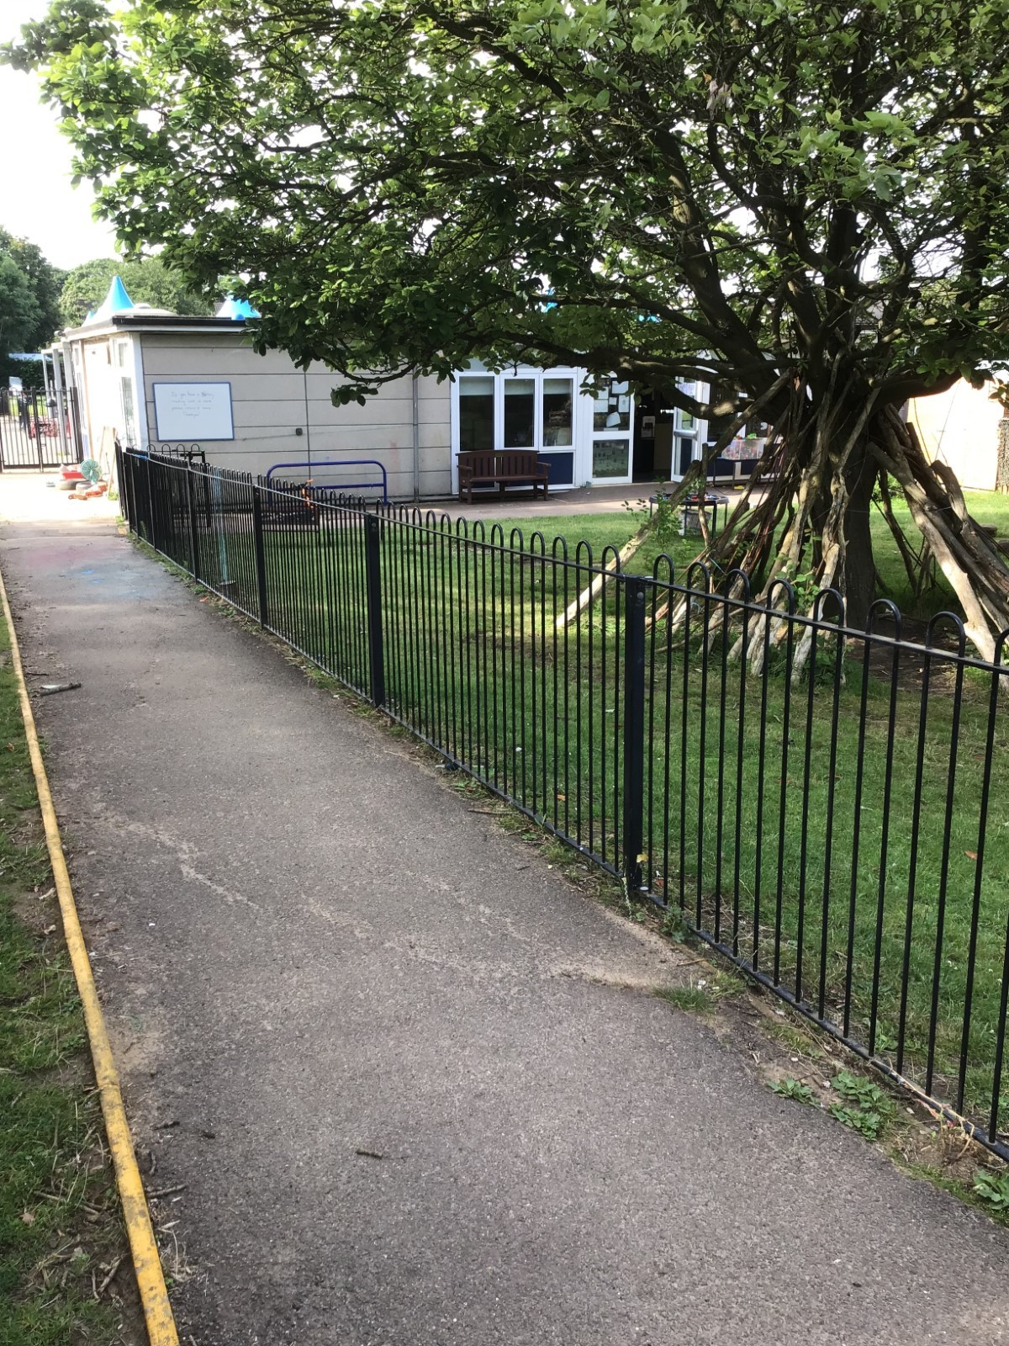
  Morning Nursery Session
  Gates open at 8:30 am
  Gates close at 8:50 am
  After this time, children need to be dropped off at the lower office.
  Collection for AM children- 11:20-11:30am
  Nursery Lunch Club
  Runs from 11:30am to 12:30pm
  Price for 15 hour children is £3 if you bring a packed lunch and £5.60 if they also have a school dinner
  For 30 hour children, school dinner is £2.60
  Afternoon Nursery Session
  Gates open for PM children at 12:30pm
  Gates close at 12:50pm
  Collection- 3:20-3:30pm
  After this time, children need to be picked up from the lower office/after school club

Slide 13
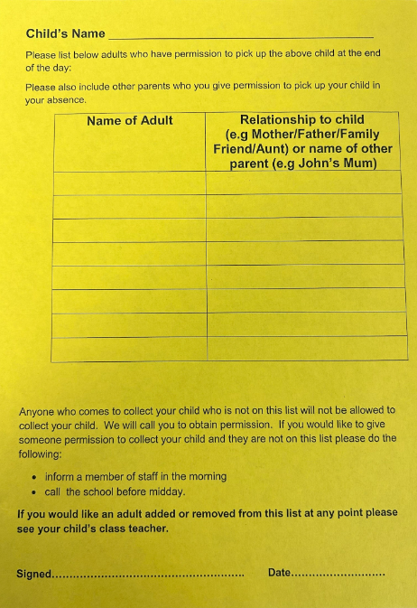
  Yellow collection forms
Notes:
Please fill in the yellow collection form in your pack.
We will only release to adults on this list.
If there are any changes, please let us know ASAP.
You can add/change/delete at any time.
If someone comes to collect that is not on the yellow form, we will need to ring you to receive verbal consent.
If the person is not on the yellow form they will be asked a password. Make sure you let the office know the person collecting. If someone comes to collect and they are not on the yellow form or we have not had a message – we will phone the first two contacts.

Slide 14


Wrap Around Care...
  Breakfast Club
  7:45am - 8:30am (upper cafeteria )
  Staff will bring children down to their classrooms
  Bookable via Arbor
  After-school club
  3:30pm until 6:15pm
  (lower family room)
  Run by familiar adults in the lower building.
  Bookable via Arbor
Notes:
Mrs Fleck and Mrs Waldron will be teaching in Acorns from September. Acorns is the 35 hour provision.
Miss Kavanagh will be teaching in Conkers, in both the morning and afternoon session.
Teachers to introduce themselves – short speel about themselves / experience

Slide 15
Nursery Lunch Club

Slide 16
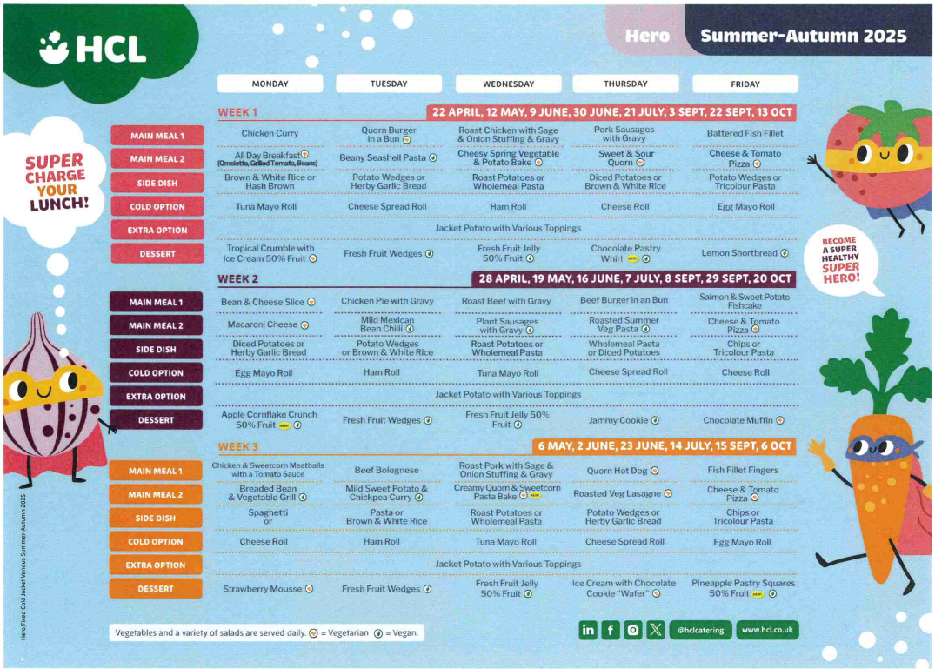
Lunchtime offer
Notes:
KATIE
Children in Reception, Year 1 and Year 2 receive a free school lunch (so this is the best time to encourage your child to try new foods)
This is government funded and all children are eligible, respective of parental income or situation
Lunchtime for the Foundation Stage is 11.30am -12.30pm (in the Lower Hall)
Many of the Midday Supervisory Assistants (MSAs) are also Early Years staff. However, your child’s class teacher will also support your child to settle in to the lunchtime routine in the Autumn term
3 week rolling menu
A menu will be provided with a selection of 4-5 meals, please talk to your child about their preference, to enable your child to independently select their meal choice when they arrive at school.

Slide 17


Healthy lunch
Please:
Include a range of items but don't pack too much!
Start with less and add more items if they are eating everything you send
Let us know if they continue to eat very little
No
Nut products (including peanut butter and Nutella)
Fizzy drinks
Sweets
Chocolate bars
Notes:
KATIE

Slide 18



Snack time in Nursery
Daily fruit accessible throughout the day
Bagels through the breakfast programme
Milk provided every day
Own water bottle
Notes:
KATIE

Slide 19
Dates
Notes:
FAYE

Slide 20
Dates for the diary
Date | Timings
Tuesday 1st September 2026 Wednesday 2nd September 2026 | INSET days
Thursday 4th September 2026 | Home Visits – you will be able to book on Arbor soon
Friday 5th September 2026 | Home Visits
Monday 7th September 2026 | Home Visits AM only
Monday 7th September 2026 | Stay and Play sessions - booked via Arbor 11.30-12.30am 1.45-2.45pm
Notes:
FAYE
Here are the dates for September. As you can see it is a staggered start.
The children will start on Wednesday 4th September. They will stay until 11:30am for two days. They will not have lunch on these days.
On the Friday and Monday - they will stay for lunch. Our lunch is 11:30-12:30. They will then go home at 1:00pm.
On the following Tuesday 10th – they will stay for the whole day. 8:40am – 3:20pm.

Slide 21
First week of school!
Date | Timings
Tueday 8th September 2026 | 15 hour children start, 3 hour sessions 30 hour children- 8.30am - 11:30am
Wednesday 9th September 2026 | 30 hour children- 8.30am - 11:30am
Thursday 10th September 2026 | 30 hour children- collection at 1pm (staying for lunch)
Friday 11th September 2026 | 30 hour children- collection at 3.20-3.30pm (first full day)
Monday 14th September 2026 | Breakfast and After School Club open to Nursery Nursery Lunch Club opens to 15 hours children
Notes:
FAYE
Here are the dates for September. As you can see it is a staggered start.
The children will start on Wednesday 4th September. They will stay until 11:30am for two days. They will not have lunch on these days.
On the Friday and Monday - they will stay for lunch. Our lunch is 11:30-12:30. They will then go home at 1:00pm.
On the following Tuesday 10th – they will stay for the whole day. 8:40am – 3:20pm.

Slide 22
Communication
Notes:
ROCHELLE

Slide 23


How we communicate with you
Nursery Newsletter weekly - via email
  Email
Open-door policy
Arbor App
  Parent consultations
  parent workshops
Social media
Notes:
ROCHELLE
Communication is so important and children learn best when we work together
It plays a huge role in ensuring that you are regularly sharing information with us to best support your child
How we may communicate to you:
Through the Arbor app – school communication system
Homework flyer which is sent via the Arbor App
Homework Flyer includes – learning that has taken place that week, learning that will take place the following week, any important messages or dates
School website / School Blog
Facebook page
School notice boards
Parent workshops
Open-door policy - Best time to talk to teachers is at the end of the day when all children have been released. If there is an urgent issue, please talk to the adult on the gate/door who will pass on the message.
If you have any concerns about your child’s education, these should first be raised with your child’s class teacher. If the issue is not resolved, it may be raised with Miss Free (Senior Teacher) or Miss Bridge (Deputy Headteacher). Appointments to see staff can be made via the school office.

Slide 24
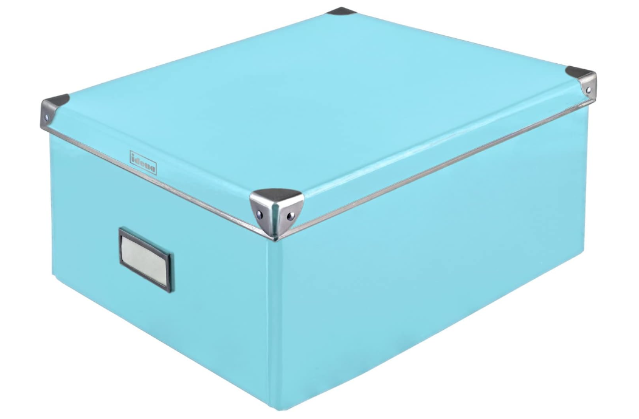



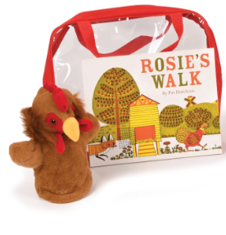
Home / School Opportunities
  Nursery Library
  Shared reading
  My Story in a Box
  Lending Library
  Activities for home
Notes:
ROCHELLE
Everywhere Bear – Your child will have the opportunity to take the Everywhere Bear on a weekend adventure. There is a scrap book, your child is asked to complete a page, this is then shared in a show and tell activity.
Borrow a book - We have a trolley of books that we will wheel out at the end of each day. Please feel free to take a book, share it at home and then return it when you are finished.
Shared Reading – After October half term, parents are invited to join their child for a reading session from 8.40am – 8.50am.
Games Library – We have a wide selection of lending library bags, we encourage you to come and choose a bag with your child and change this every week! We will let you know the day of the week that this will happen each week.
Achievement Assembly – Every Friday, we celebrate your child’s hard work in assembly. When your child is awarded a certificate, we will invite you to join our assembly.
Homework – each week we will send a flyer via Arbor that has any important messages, dates, what we have been learning etc.
Half-termly topics - each half-term we will send out a topic planner which highlights what objectives from the EYFS curriculum we will be covering during that topic. On the back, we will give some active hands-on activities you can do at home to support your child that half-term

Slide 25
What will my child be learning?
Notes:
ROCHELLE

Slide 26

Before you go...
Complete/take a yellow form...
Take a menu home
School ready words

Slide 27

In the summer...

Slide 28

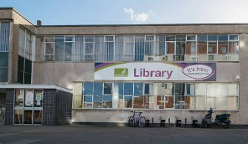


In the summer...
Look at your transition booklet regularly
Join the library!
Book a time for the stay and play on 7th September!
Book a home visit!

Slide 29
We look forward to welcoming you to Fairlands Primary School
Notes:
Thank you for coming. We look forward to seeing you all again in September :)

