Slide 1

Welcome to Fairlands Primary School
New to Year 6 transition meeting

Slide 2
Meet the team…

Slide 3
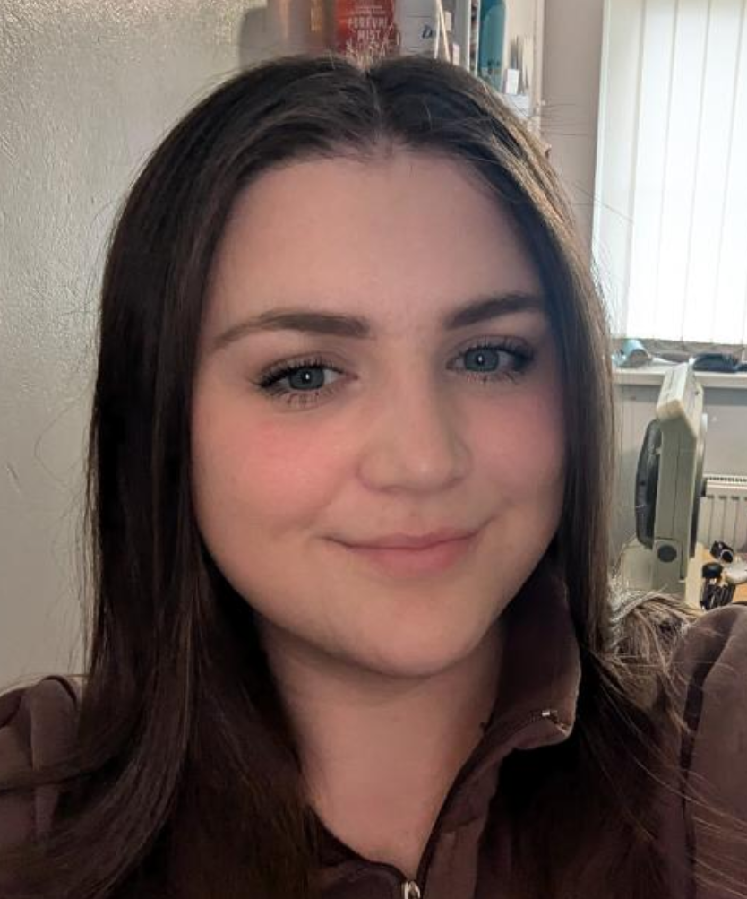
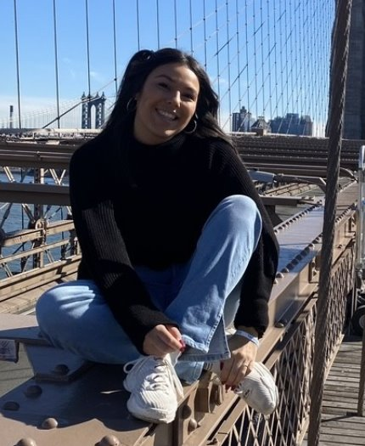
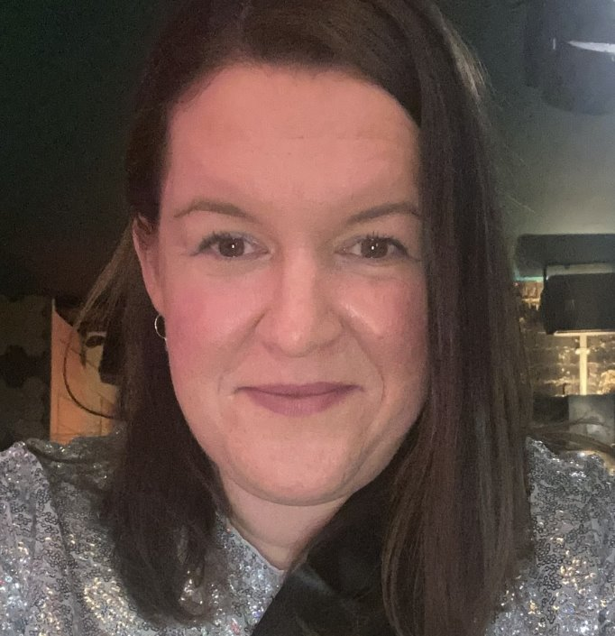
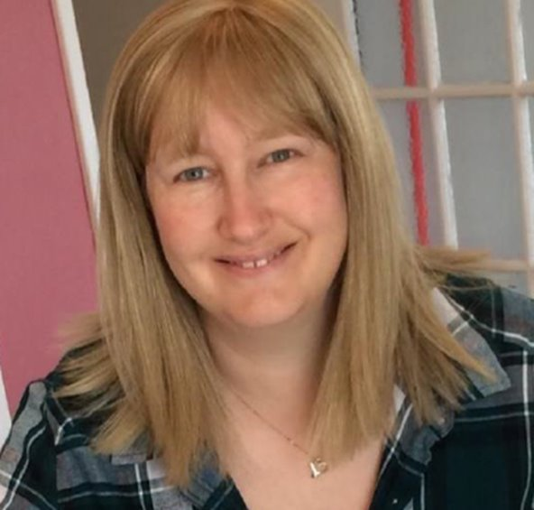
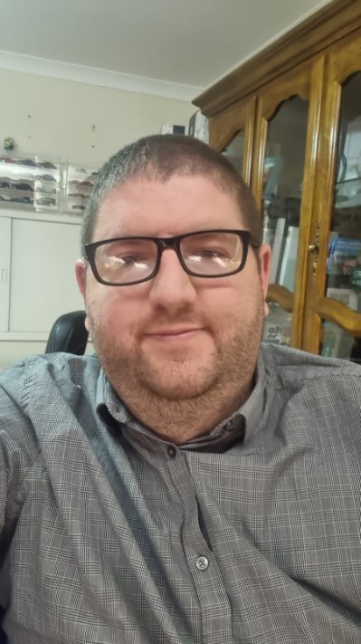
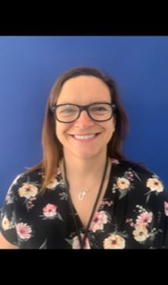
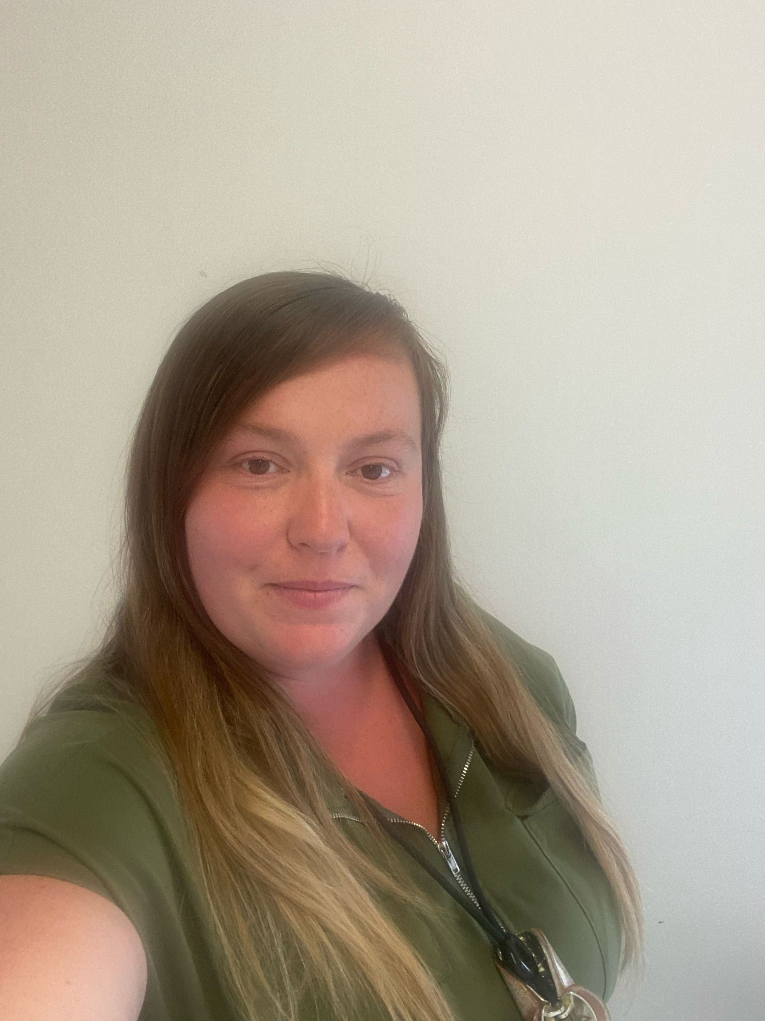
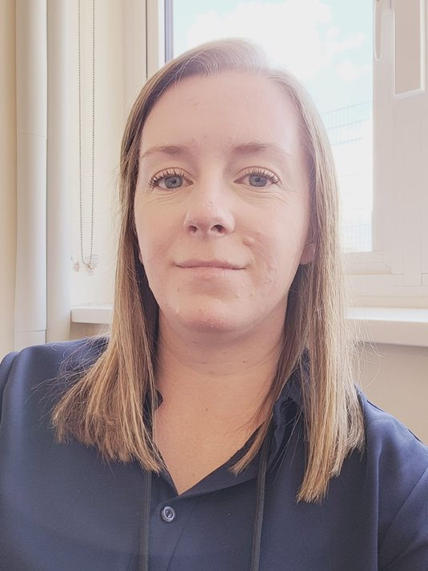

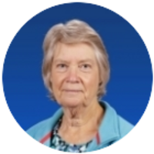
Meet our Year 6 teaching team
Miss Shields
Mrs Barnett​
Miss Madden
Mrs Payne
Mr Holgate
Mrs Oliver
Mrs Whitehair​
Miss
McQuillan
Mrs Biggs​
Miss Guy

Slide 4
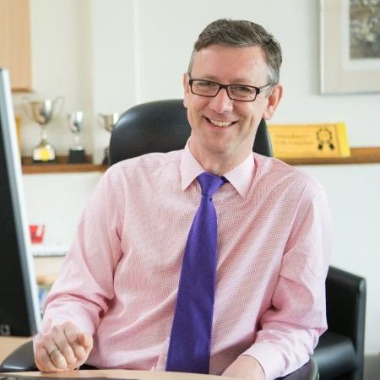
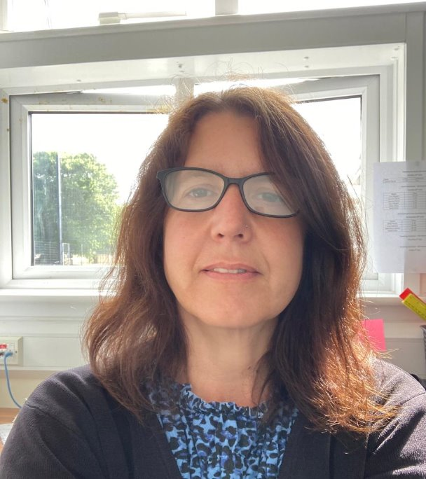
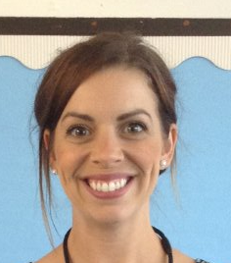
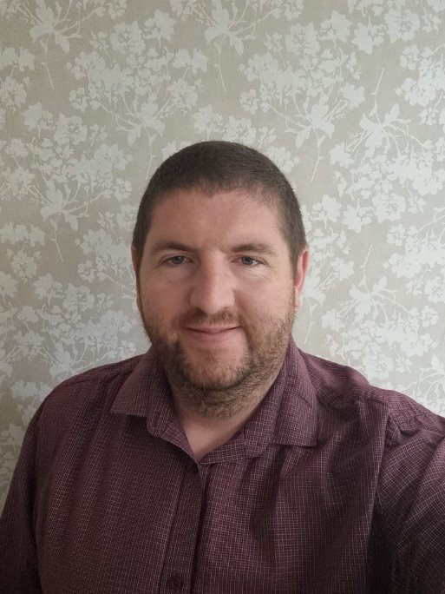
Meet the leadership team
Mr Robert Staples
Headteacher
Miss Michelle Bridge
Senior Deputy Headteacher
Mrs Natalie Sembi
Deputy Headteacher
Mrs Sharon Mullan
Assistant Headteacher and SENDco
Mr Chris Holgate
Assistant Headteacher

Slide 5
Start and end of the day – Year 6
The Greydells gate is unlocked at 8:40 am by a Year 6 adult
Children enter via their external classroom doors and start a learning activity straight away
Any urgent messages for teachers can be passed on via a Year 6 adult at the gate
Children are encouraged to be increasingly independent – please encourage your child to pass on messages to their class teacher if they feel able to
The gate is locked at 8:50 am
Children arriving after 8.50am are late!
The Greydells gate will be unlocked at 3.20 pm
Year 6 children are permitted to walk to meet an adult in arranged location. We do not keep yellow sheets for Year 6 children

Slide 6
Walking home – Year 6
If/when you would like your child to be released without an adult then you need to update this on Arbor.
Permissions will carry across from Year 5
It will be "I give consent for my child to walk home after school"
If this is 'declined' we will keep them here until collected
You can update this through the year but let us know when you have.
Notes:
Alongside the Early Years Foundation Stage curriculum, we use the characteristics of effective learning.
The characteristics of effective learning describe behaviors children use in order to learn.
The focus of these is on how children learn rather than what they learn.
Effective learning must be meaningful to a child, so that they are able to use what they have learned and apply it in new situations

Slide 7

Mobile Phones
If you feel your child needs a mobile phone for safety reasons in supporting them coming to or from school, then they can bring a mobile phone in.
They will need to sign a phone contract.
They give to their teacher as soon as they come in.
They are not to be used on school site – turned off.

Slide 8



How we communicate with you
  parent workshops
  Email
Open-door policy.
Facebook
Year 6 weekly homework flyer
  Parent consultations
Arbor App
Medical Tracker emails
Notes:
Communication is so important and children learn best when we work together
It plays a huge role in ensuring that you are regularly sharing information with us to best support your child
How we may communicate to you:
Through the Arbor app – school communication system
Homework flyer which is sent via the Arbor App
Homework Flyer includes – learning that has taken place that week, learning that will take place the following week, any important messages or dates
School website / School Blog
Facebook page
School notice boards
Parent workshops
Open-door policy - Best time to talk to teachers is at the end of the day when all children have been released. If there is an urgent issue, please talk to the adult on the gate/door who will pass on the message.
If you have any concerns about your child’s education, these should first be raised with your child’s class teacher. If the issue is not resolved, it may be raised with Miss Free (Senior Teacher) or Miss Bridge (Deputy Headteacher). Appointments to see staff can be made via the school office.

Slide 9
Homework
Every Friday your child will be set homework. It will be sent out via Arbor.
This will include information on:
•The spelling patterns they have been investigating in class and words to learn
•Maths objectives from the week to discuss and 'Learn-it' facts to learn
•General information on what is going on in the week ahead
Children will also be encouraged to reflect on their learning from that week.
We expect and encourage children to read at least 4x a week.
There will also be mini-topics set for homework twice each half term.

Slide 10


  Morning
  Gates open at 8:40 am
  (Greydells at 8.30am)
  Gates close at 8:50 am
  After this time, children need to be dropped off at the upper office.
  Afternoon
  Gates open at 3:15pm
  Children exit at 3:20pm
  After this time, children need to be picked up from the upper office.
  Your child may have been taken to after-school club (you will be charged for this)
  Breakfast Club
  7:45am (upper hall)
  Staff will supervise children to the school gate
  Bookable via Arbor
  After-school club
  Anytime until 6:15pm
  (upper hall)
  Run by familiar adults in the upper building.
  Bookable via Arbor

Slide 11
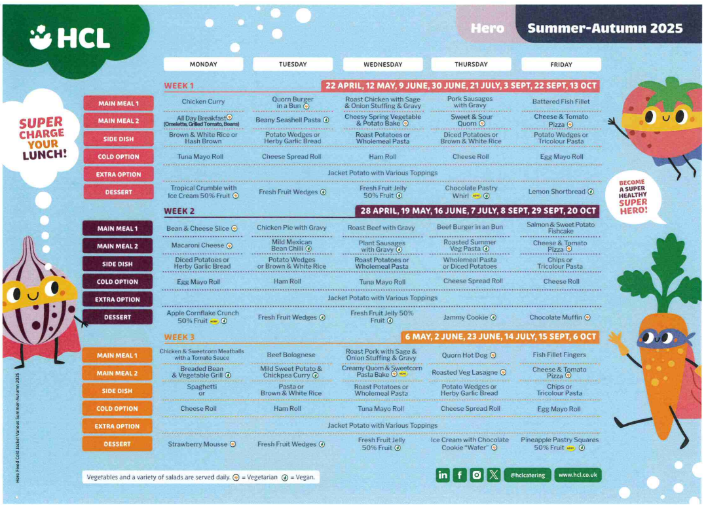
Lunchtime offer

Slide 12
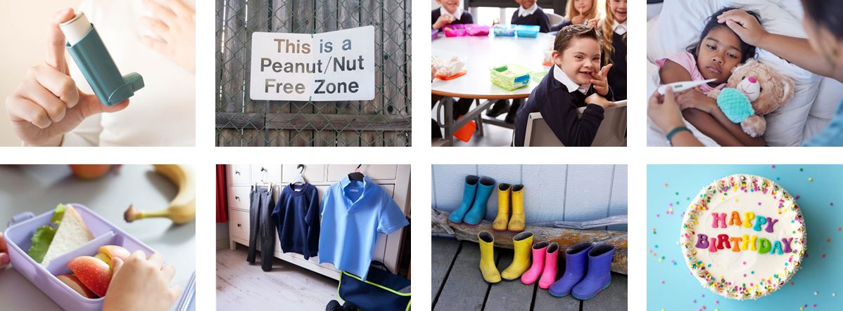

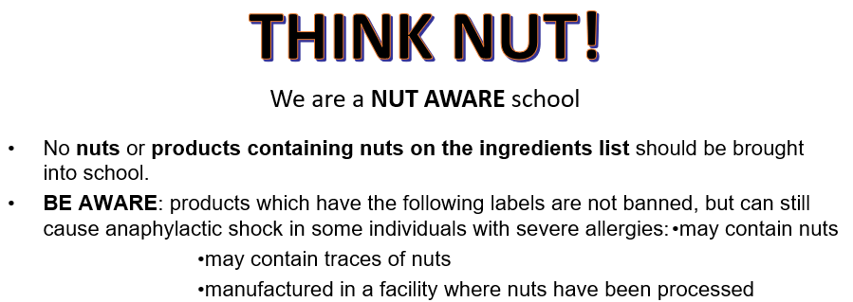
Healthy lunch
No
Fizzy drinks
Sweets
Chocolate bars
Nut products (including peanut butter and Nutella)
Hot food or drinks

Slide 13
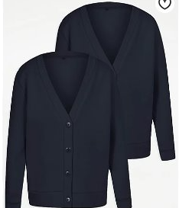
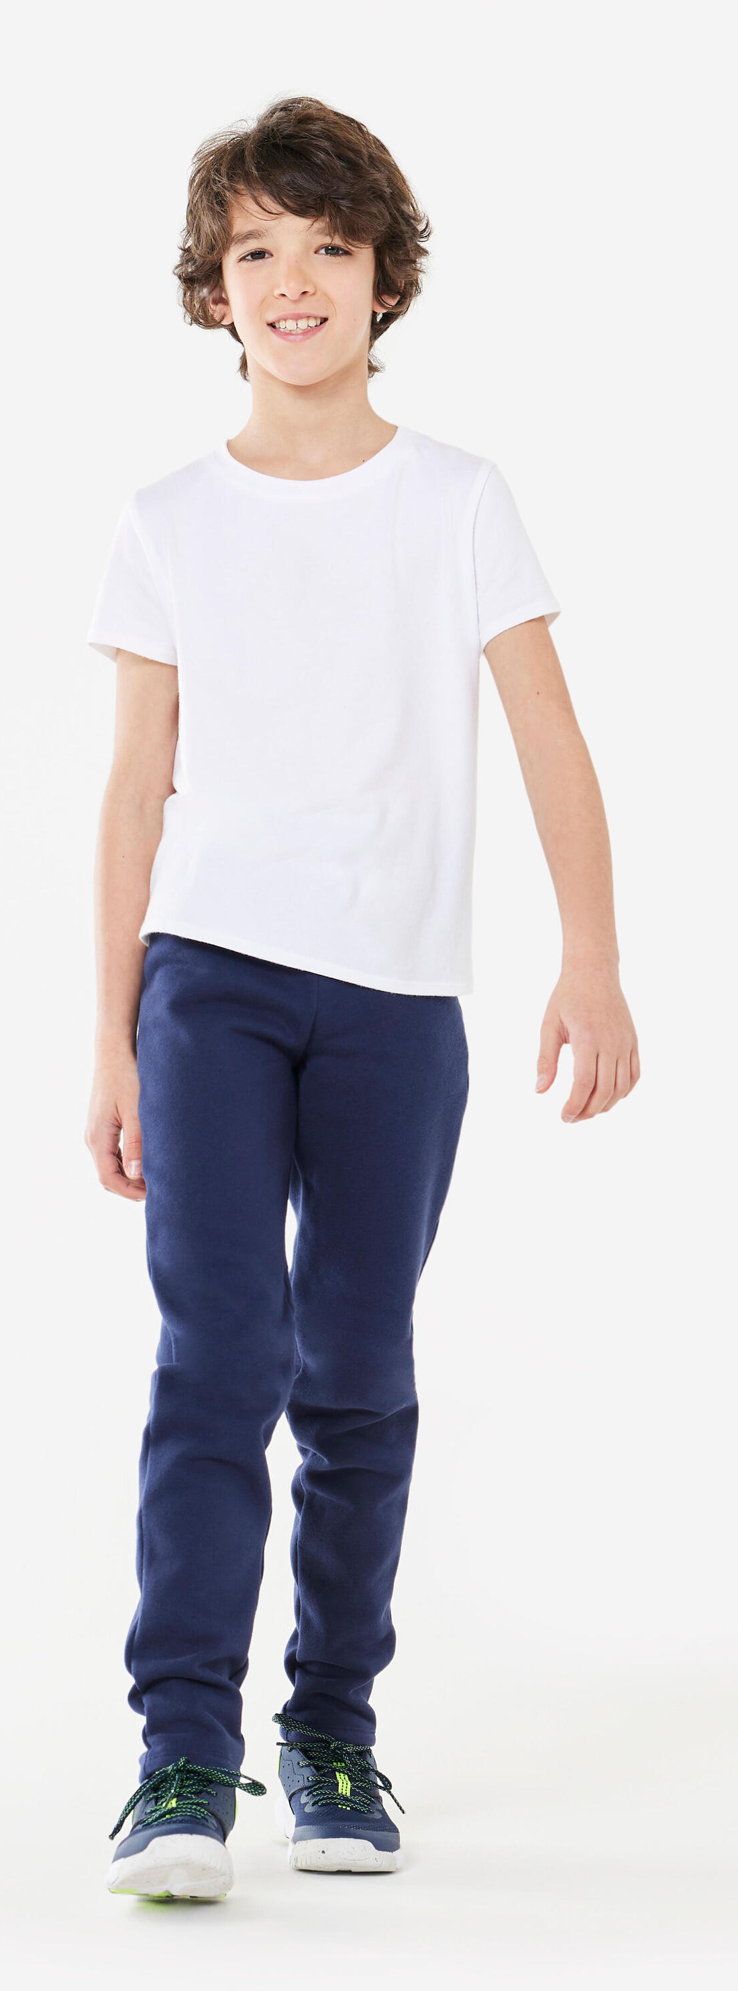
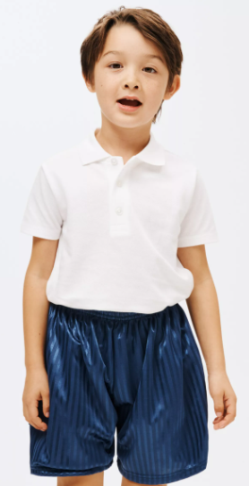
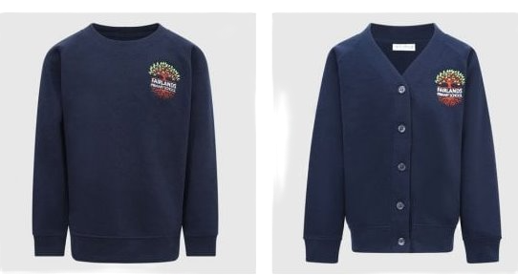
Grey trousers / dresses / skirts / tailored shorts
White polo shirts / shirts / blouses
Navy blue sweatshirt / cardigan
Blue gingham summer dresses
PLAIN black shoes or trainers
NO HOODIES!
Please ensure
Long hair should be tied back at all times
PE kits in school!!!
https://www.smartyschoolwear.co.uk/find-your-club-school-c1/fairlands-primary-school-c502

Slide 14

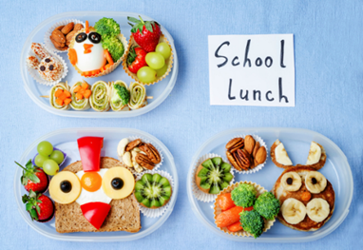
Break time arrangements
Year group | Break time
Year 6 | 11.30 - 12.00
Year Group | Lunch break time | Playing time | Eating time
Year 6 | 1.30 – 2.15 | 1.45 – 2.15 | 1.30 – 1.45

Slide 15
Medical Information

Slide 16

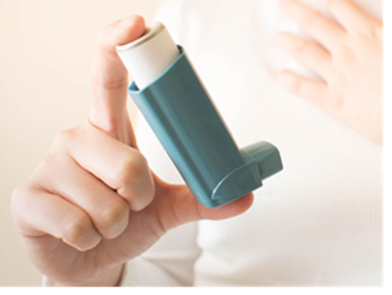
Health and medical
All accidents and administering of medicines (including inhalers) are reported to you immediately via Medical Tracker.
All health care plans, asthma care plans and information about dietary needs are held on Medical Tracker and you can update these when needed.
You will receive emails from donotreply@medicaltracker.co.uk Add this address to your email address books so the emails do not go to your spam/junk folder.
If your child has a food allergy or intolerance (diagnosed or undiagnosed), complete the consents on Arbor and inform the office. Our family worker, Mrs McCullagh will be able to help you.
All medicines must go through the school office where correct paperwork will be signed. Any brought in directly to class will result in a call home for you to come in and complete relevant forms. We must make sure that medication is stored securely and not in childrens’ bags due to allergies.
We are a NUT AWARE school and kindly remind you that no nuts or nut products are allowed onsite.
Notes:
Allergies - If your child has a food allergy, you will need to register your them with HCL before they are able to have a school meal, our family worker can help with this. Due to severe nut allergies, we ask that no nuts are brought into school. If your child does have an allergy or an intolerance, please call the school as soon as possible to inform us. We will discuss the needs with you and determine if a care plan is required.
prescribed medication -
We can only administer antibiotics if they are prescribed 4 x daily. Parents must complete a form at the office, medicine will be stored in the Lower Office.
injuries from home - let staff know (normal procedure) Make us aware of any injuries they have before coming into school, in line with our safeguarding policy
Birthday sweets – no
. Talk about the policy regarding bringing in food for a child’s birthday – allergies
First Aid – Staff are first aid trained. If your child has an accident at school you will be informed through the accident information sheet. Your child will receive a white letter for an accident they have had. If your child sustains a head injury, you will usually be called and your child will receive a red letter.
Ensure that we always have up to date contact numbers
Accidents - explain how the school manage accidents and that first aid is administered in line with the school/setting policy. Talk about the fact that accidents are recorded and how risk assessments are undertaken to manage potential hazards.

Slide 17
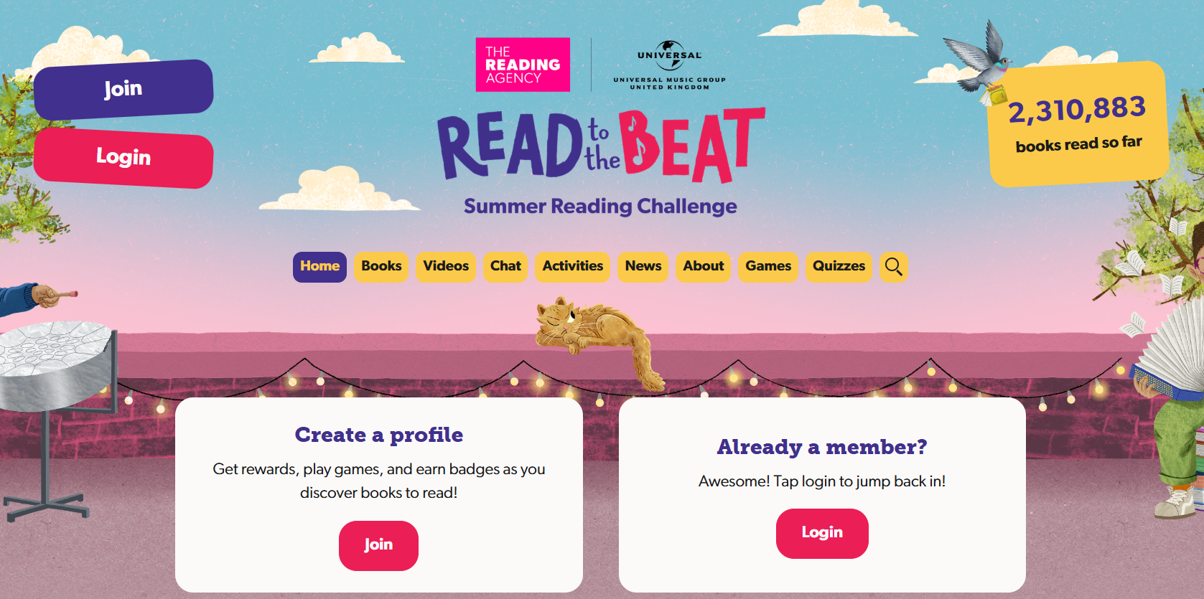


https://summerreadingchallenge.org.uk/
Assembly
Years 1, 2 & 3 – Monday 13th July 9:30am
Years 4, 5 & 6 – Monday 13th July 10:00am

Slide 18
Topics
Autumn | Science – Light History – What can the census tell us about the local areas? Science – Electricity Geography – Why does the population change?
Spring | Science – Circulatory system History – What was the impact of World War 2 on the people of Britain? Science - Circulatory system Geography – Where does energy come from?
Summer | Science – Classification History – What was the Sikh Empire? Science – Evolution and inheritance Geography – Can I carry out an independent fieldwork enquiry?

Slide 19

What is No Outsiders?
We all want our children to feel wanted and included. To feel like they belong. This needs to be taught.
It aims to teach that difference is not a barrier to friendship but is something positive that make us all unique. It aims to help children to explore differences and enable them to feel proud of who they are, to know that they are accepted without judgement, and to realise that they do not have to change in order to ‘fit in’.

Slide 20
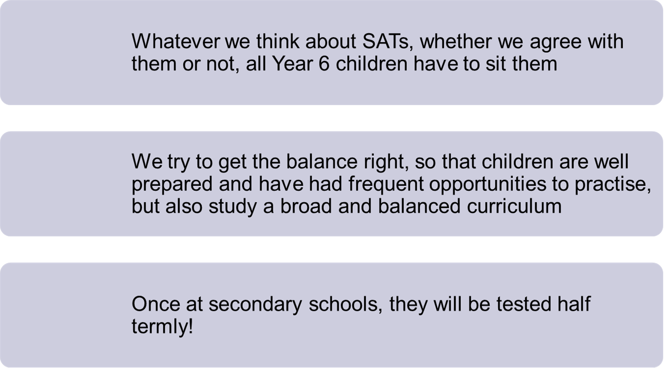
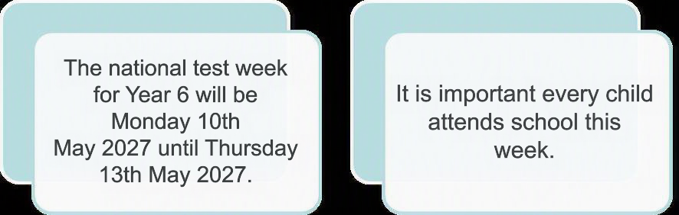
SATS

Slide 21
Have you considered being a school governor?
Would you like to help shape the future for the next generation?
Do you have a valuable/professional skill you can offer?
Are you committed to contributing to your local community?
If you answer YES to any of the above, please get in touch
We are keen to recruit governors who reflect our diverse community and the school
We welcome anyone who is interested in school governance, but especially those with skills and expertise in health & safety, communications, social care and education.
All new governors with full training and support
Please get in touch if interested to
admin@fairlands.herts.sch.uk

