Slide 1

Welcome to Fairlands Primary School
New to Year 4 transition meeting
Notes:
Good afternoon, welcome to our new to reception meeting. The aim of this meeting is to give you a little bit of information about reception and some information about Fairlands if you are new to the school

Slide 2

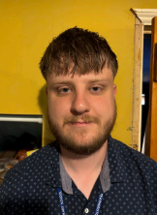

Meet our Year 4 teaching team
Mr Will Barnett
Senior Teacher & Laburnum Class Teacher
Mr Stephen Goodall
Larch Class Teacher
Mr Ollie Fisher
Lime Class Teacher
Notes:
Each teacher to introduce themselves

Slide 3

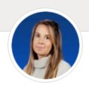

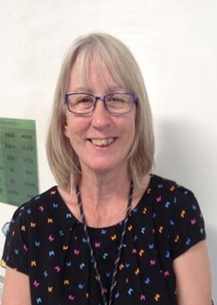
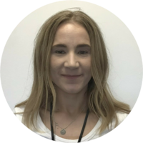

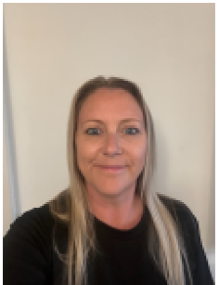
Adults you will see in Year 4
Sam Waight
Sammie Perry
Aylee Theron
Sophie Mikiel
Zoe Smith
Karen Oakley
Katrina McInerney

Slide 4
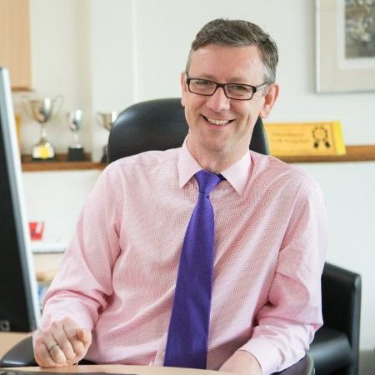
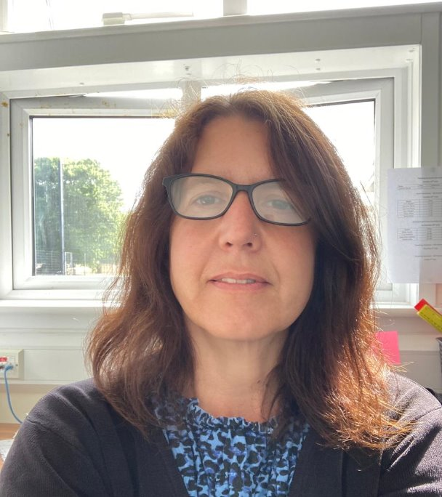
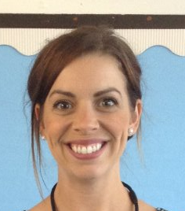
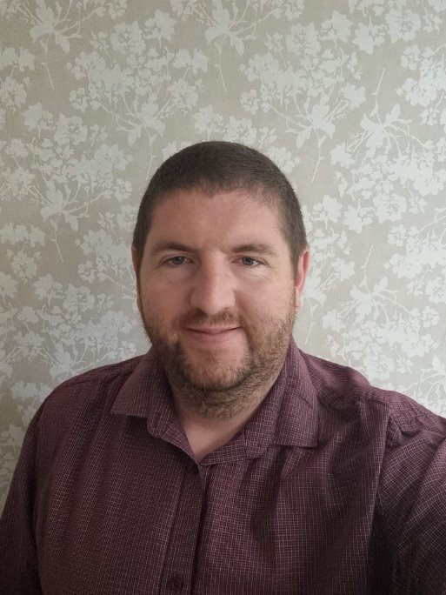
Meet the leadership team
Mr Robert Staples
Headteacher
Miss Michelle Bridge
Senior Deputy Headteacher
Mrs Natalie Sembi
Deputy Headteacher
Mrs Sharon Mullan
Assistant Headteacher and SENDco
Mr Chris Holgate
Assistant Headteacher
Notes:
Explain school structure and headship team

Slide 5
Drop off and collection
Notes:
FAYE

Slide 6
Start and end of the day – Year 4
The statue gate is unlocked at 8:40 am
Children enter via their external classroom doors and start a learning activity straight away
Any urgent messages for teachers can be passed on via the adult at the gate
Children are encouraged to be increasingly independent – please encourage your child to pass on messages to their class teacher if they feel able to
The gate is locked at 8:50 am
Children arriving after 8.50am are late.
The statue gate will be unlocked at 3.20 pm
6

Slide 7


  Morning
  Gates open at 8:40 am
  Gates close at 8:50 am
  After this time, children need to be dropped off at the lower office.
  Afternoon
  Gates open at 3:20pm
  Gates close at 3:30pm
  After this time, children need to be picked up from the office.
  Your child may have been taken to after-school club (you will be charged for this)
  Breakfast Club
  7:45am (upper hall)
  Staff will bring children down to their classrooms
  Bookable via Arbor
  After-school club
  Anytime until 6:15pm
  (lower hall)
  Run by familiar adults in the upper building.
  Bookable via Arbor

Slide 8
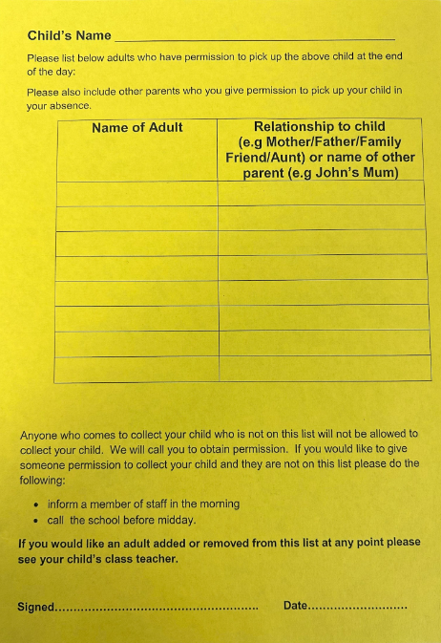
  Yellow collection forms
  Prior to starting in reception, you would have been asked to fill in a Yellow collection form.
  We will release to only those that are on this list.
  If there are any changes, please let us know ASAP.
  You can add/change/delete at any time.
  If someone comes to collect that is not on the yellow form, we will phone the first two contacts on Arbor.
Notes:
Explain yellow forms. Write all people on there who can collect (including yourself) if someone else collecting – phone office ASAP.
If the person is not on the yellow form they will be asked a password. Make sure you let the office know the person collecting. If someone comes to collect and they are not on the yellow form or we have not had a message – we will phone the first two contacts.

Slide 9
What will my child be learning?

Slide 10
The Year 4 Curriculum
Guided reading
Extended Writing
Spelling
Handwriting
Maths
Maths Fluency
Computing
RSHE
MFL
Science
RE
PE
Art/D&T
Geography/History
Music
Notes:
In the Early Years we follow the Early Years Foundation Stage Curriculum which is split into 'Prime areas' and 'Specific areas'
The prime areas cover: Communication and language, Personal, social and emotional development and physical development
The specific areas cover: Liteacy, Maths, Understanding the World and Expressive Arts and Design
Alongside the Early Years Foundation Stage curriculum, we use the characteristics of effective learning.
The characteristics of effective learning describe behaviors children use in order to learn.
The focus of these is on how children learn rather than what they learn.
Effective learning must be meaningful to a child, so that they are able to use what they have learned and apply it in new situations

Slide 11
The Year 4 Curriculum
 | Year 4
Autumn 1 | History - How have children’s lives changed? | DT-Textiles and fastenings
Autumn 2 | Geography - Why are Rainforests important to us? | ART-Craft and design- fabric of nature
Spring 1 | History- How hard was it to invade and settle in Britian? | DT-Structure- pavilions
Spring 2 | Geography - What are rivers and how are they used? (Train to Hitchin?) | ART-Painting and mixed media: light and dark
Summer 1 | History - How did the achievements of the Ancient Maya impact their society and beyond? | DT-Cooking and nutrition- adapting a recipe rials
Summer 2 | Geography - Where does our food come from? | ART-Sculpture and 3D-Mega mate
Notes:
In the Early Years we follow the Early Years Foundation Stage Curriculum which is split into 'Prime areas' and 'Specific areas'
The prime areas cover: Communication and language, Personal, social and emotional development and physical development
The specific areas cover: Liteacy, Maths, Understanding the World and Expressive Arts and Design
Alongside the Early Years Foundation Stage curriculum, we use the characteristics of effective learning.
The characteristics of effective learning describe behaviors children use in order to learn.
The focus of these is on how children learn rather than what they learn.
Effective learning must be meaningful to a child, so that they are able to use what they have learned and apply it in new situations

Slide 12
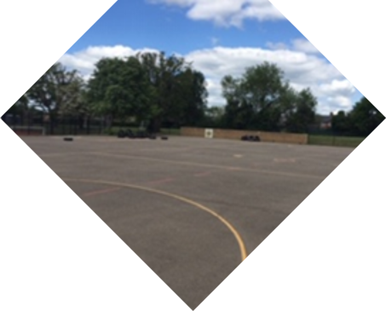
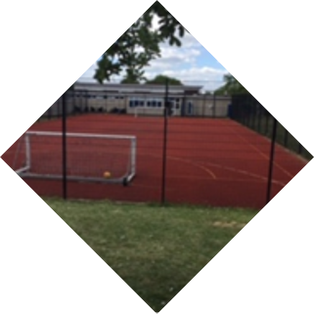
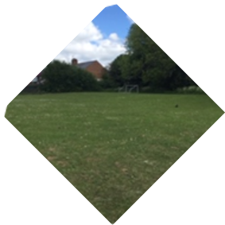
PE and Outdoor areas
Notes:
You would have noticed that the children have a big chunk of time in the morning and in the afternoon called 'independent time'.
The purpose of this is to emphasis learning through play and how high-quality play will involve many of the areas of learning.
Explain the adult role’s in supporting and extending learning through play.
Outdoor learning clothes
Weather expectations

Slide 13


Swimming
Year 4 children will have a weekly swimming lesson during the Spring Term.
Clothing: a one-piece swimming suit, swimming trunks or shorts (which must be above knee height to comply with the pool’s policy), a hair band or swimming cap.
All children must bring their own towel, preferably a waterproof bag to carry their kit with them.
Children may bring goggles if they wish.
Earrings must be removed prior to swimming and NO deodorant sprays are permitted under any circumstances.
Notes:
You would have noticed that the children have a big chunk of time in the morning and in the afternoon called 'independent time'.
The purpose of this is to emphasis learning through play and how high-quality play will involve many of the areas of learning.
Explain the adult role’s in supporting and extending learning through play.
Outdoor learning clothes
Weather expectations

Slide 14

Year 4 Times Table Check
Over 3 weeks from the start of June.
All children will complete a times table test.
There will be plenty of practise throughout the year. Please practise at home too!
Notes:
You would have noticed that the children have a big chunk of time in the morning and in the afternoon called 'independent time'.
The purpose of this is to emphasis learning through play and how high-quality play will involve many of the areas of learning.
Explain the adult role’s in supporting and extending learning through play.
Outdoor learning clothes
Weather expectations

Slide 15
Uniform Expectations

Slide 16
Uniform
The school uniform policy sets out clearly the expectations.
Grey trousers / dresses / skirts / tailored shorts
White polo shirts / shirts / blouses
Navy blue sweatshirt / cardigan
Blue gingham summer dresses
PLAIN black shoes or trainers
If you child is not appropriately dressed, they will be given suitable clothing to wear. They will be told to remove jewellery, and a letter will be sent home with a reminder of school policy.
Notes:
You would have noticed that the children have a big chunk of time in the morning and in the afternoon called 'independent time'.
The purpose of this is to emphasis learning through play and how high-quality play will involve many of the areas of learning.
Explain the adult role’s in supporting and extending learning through play.
Outdoor learning clothes
Weather expectations

Slide 17
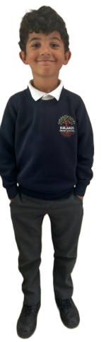
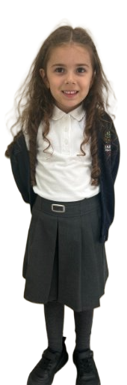
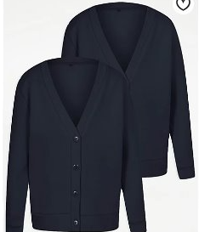
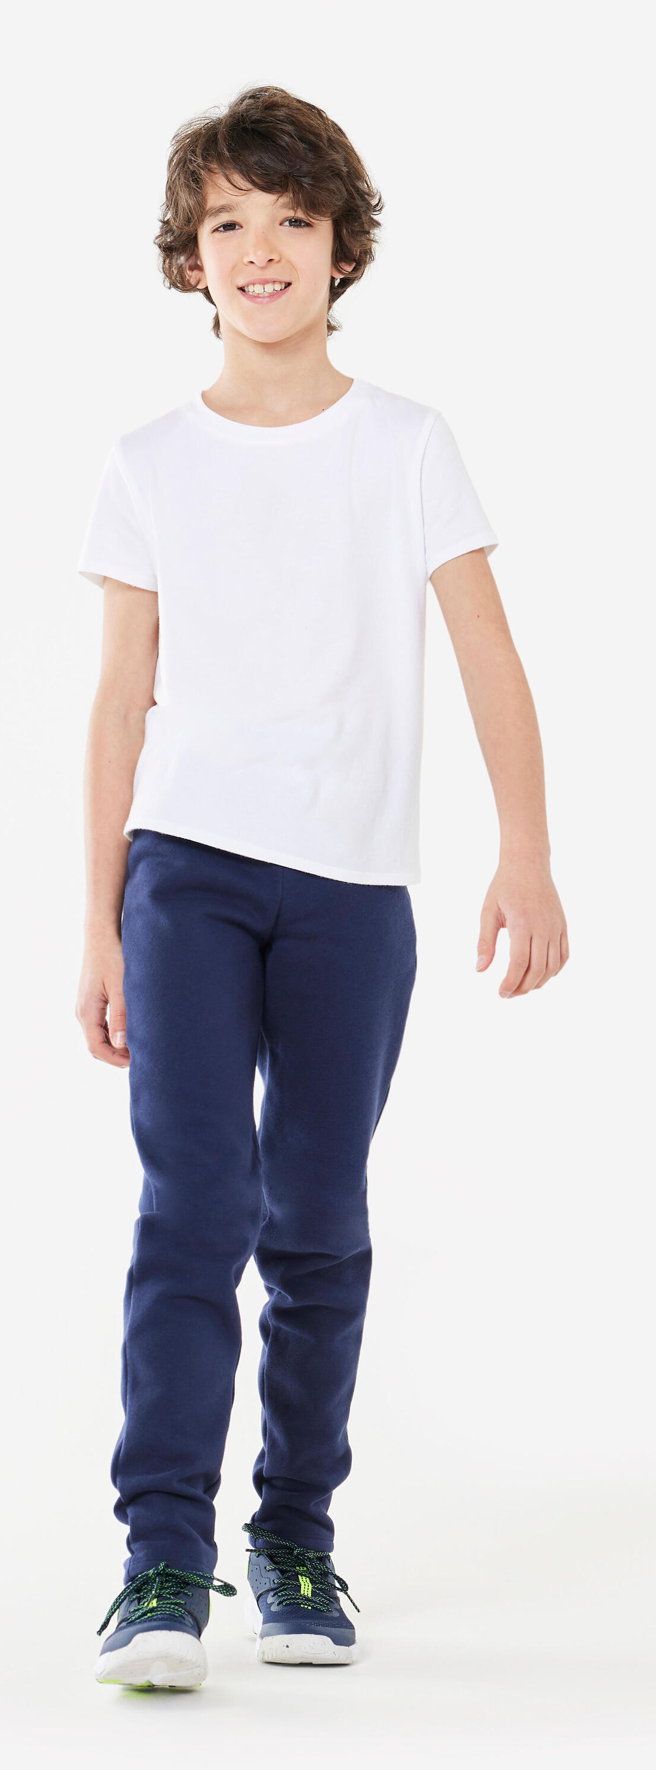

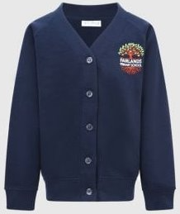
www.smartyschoolwear.co.uk
Notes:
School uniform
Please make sure that absolutely everything is labelled with your child’s name! (Including shoes!)
Grey trousers / dresses / skirts / tailored shorts
White polo shirts / shirts / blouses/polo top
Navy blue sweatshirt / cardigan
Blue gingham summer dresses
We will always do our best to return any belongings to the children. If they are named, it makes it easier.
There is a lost property rail in this lower hall – if there is a time where something has been misplaced. Please check here also.
PE uniform
White top, navy shorts/jogging bottoms and trainers
Children will get changed at home and come into school dressed in their P.E kit.
Please also note that your child’s uniform will get messy at some point! Playing with paint, mud and other sensory materials is great for your child’s brain development and aprons/all in one waterproofs are never perfect.
It is fine to send your child to school in uniform that has been washed but has stains ☺

Slide 18
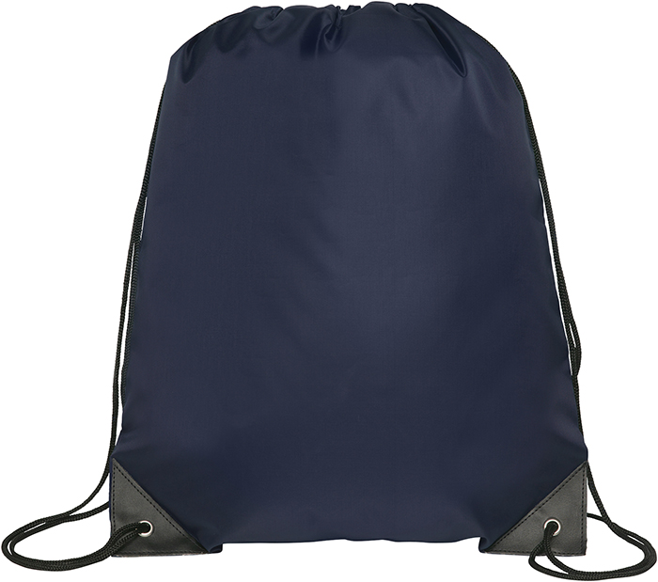
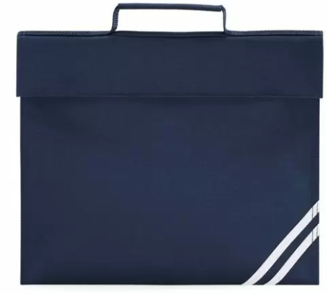
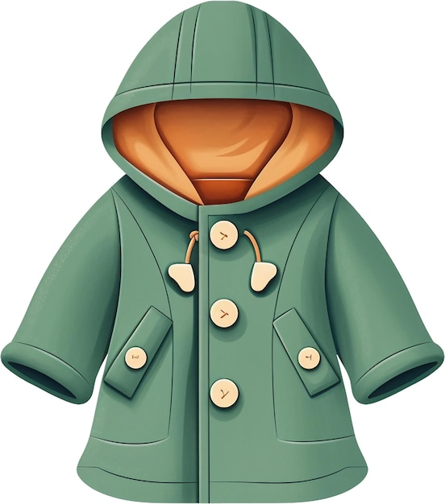
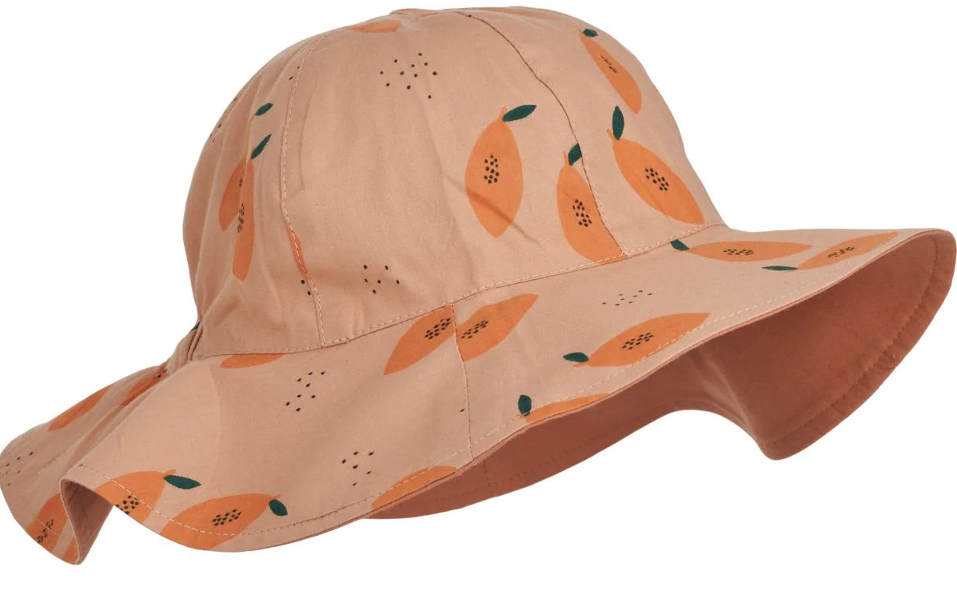
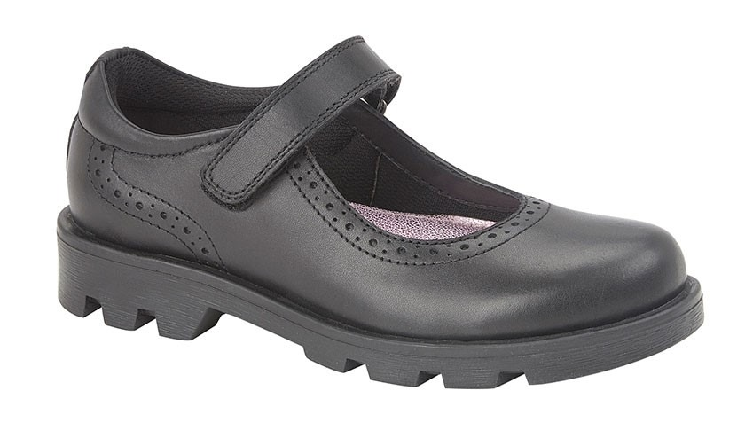
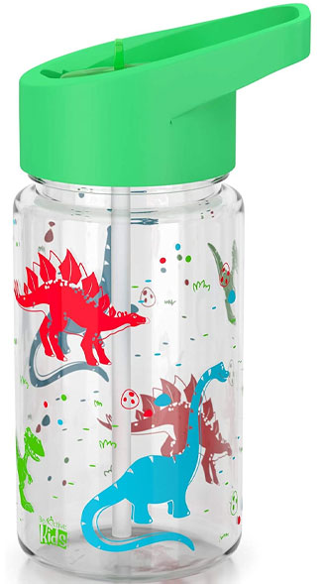
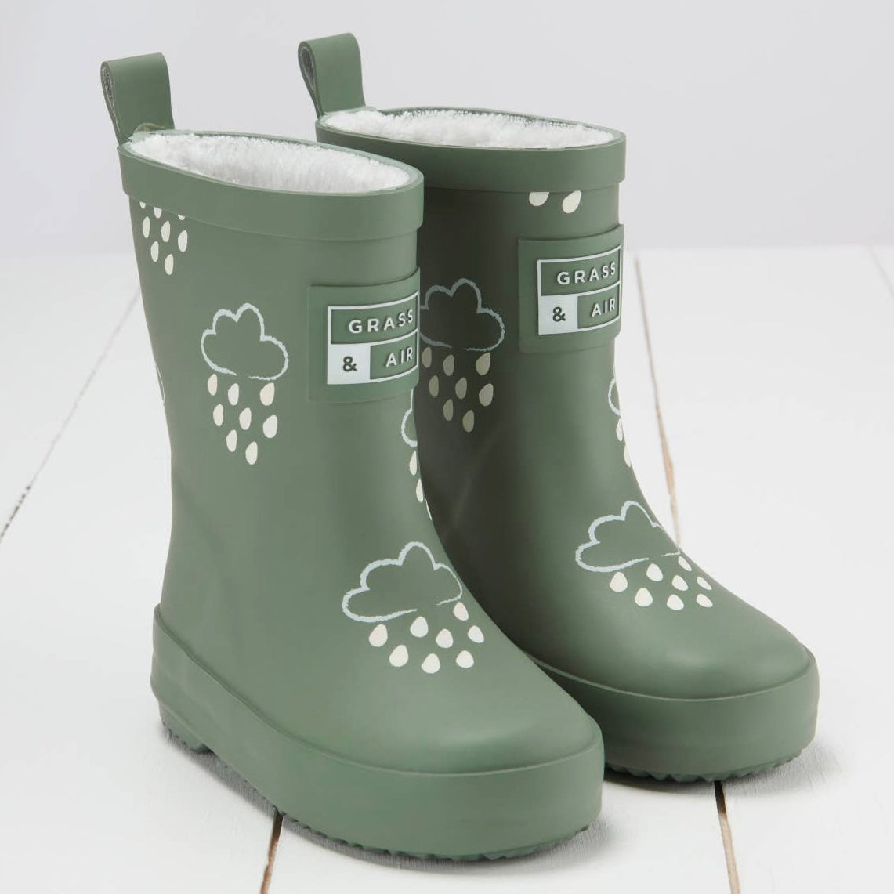
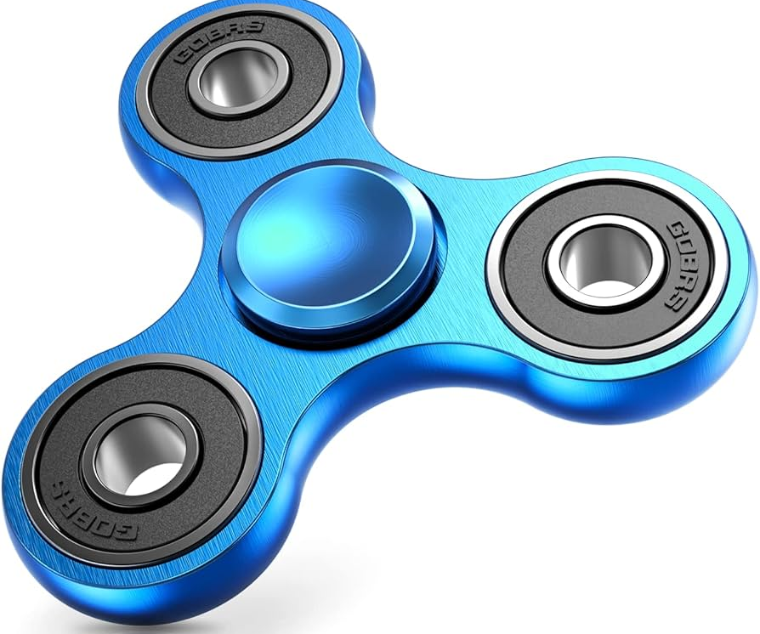
Please remember...
Notes:
Please remember to bring:
A book bag everyday – for letters, accident forms, drawings, reading books etc.
A pair of wellies that can be kept at school for the days where it is raining.
Sturdy shoes with velcro if possible please.
Coat everyday
Sun hat on the days where it is hot.
No toys to be brought to school
Water bottles - just water (no juice)
You will be given a blue drawstring bag. We ask that a spare change of clothes is put into this bag and kept on your child's peg. If your child has an accident or gets wet/muddy outside – we will use these clothes and send home the wet ones.

Slide 19
Communication

Slide 20



How we communicate with you
  parent workshops
  Email
Open-door policy.
Facebook
Weekly homework flyer
Arbor App
  Parent consultations
Medical Tracker emails
Notes:
Communication is so important and children learn best when we work together
It plays a huge role in ensuring that you are regularly sharing information with us to best support your child
How we may communicate to you:
Through the Arbor app – school communication system
Homework flyer which is sent via the Arbor App
Homework Flyer includes – learning that has taken place that week, learning that will take place the following week, any important messages or dates
School website / School Blog
Facebook page
School notice boards
Parent workshops
Open-door policy - Best time to talk to teachers is at the end of the day when all children have been released. If there is an urgent issue, please talk to the adult on the gate/door who will pass on the message.
If you have any concerns about your child’s education, these should first be raised with your child’s class teacher. If the issue is not resolved, it may be raised with Miss Free (Senior Teacher) or Miss Bridge (Deputy Headteacher). Appointments to see staff can be made via the school office.

Slide 21
Medical Information

Slide 22


Health and medical
All accidents and administering of medicines (including inhalers) are reported to you immediately via Medical Tracker.
All health care plans, asthma care plans and information about dietary needs are held on Medical Tracker and you can update these when needed.
You will receive emails from donotreply@medicaltracker.co.uk Add this address to your email address books so the emails do not go to your spam/junk folder.
If your child has a food allergy or intolerance (diagnosed or undiagnosed), complete the consents on Arbor and inform the office. Our family worker, Mrs McCullagh will be able to help you.
All medicines must go through the school office where correct paperwork will be signed. Any brought in directly to class will result in a call home for you to come in and complete relevant forms. We must make sure that medication is stored securely and not in childrens’ bags due to allergies.
We are a NUT AWARE school and kindly remind you that no nuts or nut products are allowed onsite.
Notes:
Allergies - If your child has a food allergy, you will need to register your them with HCL before they are able to have a school meal, our family worker can help with this. Due to severe nut allergies, we ask that no nuts are brought into school. If your child does have an allergy or an intolerance, please call the school as soon as possible to inform us. We will discuss the needs with you and determine if a care plan is required.
prescribed medication -
We can only administer antibiotics if they are prescribed 4 x daily. Parents must complete a form at the office, medicine will be stored in the Lower Office.
injuries from home - let staff know (normal procedure) Make us aware of any injuries they have before coming into school, in line with our safeguarding policy
Birthday sweets – no
. Talk about the policy regarding bringing in food for a child’s birthday – allergies
First Aid – Staff are first aid trained. If your child has an accident at school you will be informed through the accident information sheet. Your child will receive a white letter for an accident they have had. If your child sustains a head injury, you will usually be called and your child will receive a red letter.
Ensure that we always have up to date contact numbers
Accidents - explain how the school manage accidents and that first aid is administered in line with the school/setting policy. Talk about the fact that accidents are recorded and how risk assessments are undertaken to manage potential hazards.

Slide 23
Lunchtime offer

Slide 24
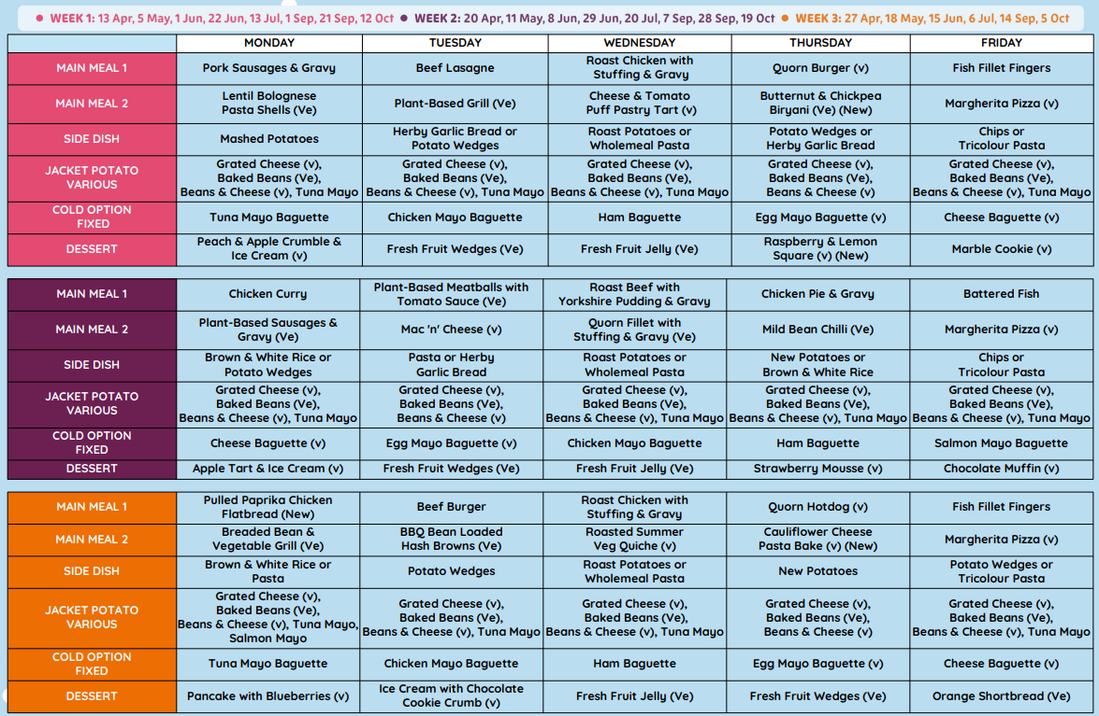
Lunchtime offer
Notes:
Children in Reception, Year 1 and Year 2 receive a free school lunch (so this is the best time to encourage your child to try new foods)
This is government funded and all children are eligible, respective of parental income or situation
Lunchtime for the Foundation Stage is 11.30am -12.30pm (in the Lower Hall)
Many of the Midday Supervisory Assistants (MSAs) are also Early Years staff. However, your child’s class teacher will also support your child to settle in to the lunchtime routine in the Autumn term
3 week rolling menu
A menu will be provided with a selection of 4-5 meals, please talk to your child about their preference, to enable your child to independently select their meal choice when they arrive at school.

Slide 25
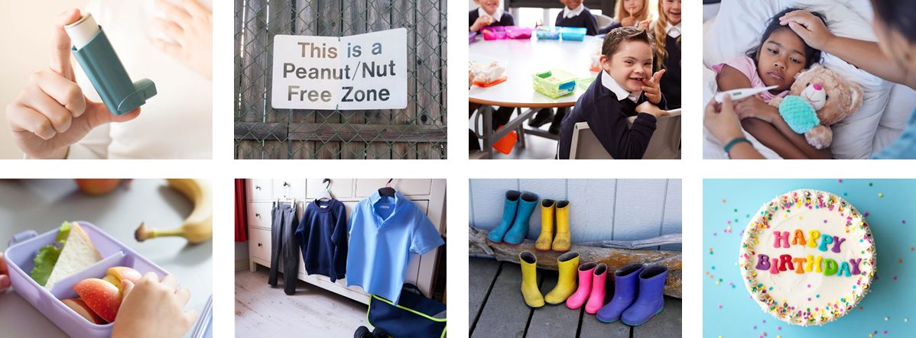

Healthy lunch
Please:
Refrain from packing too much
Start with less and add more items if they are eating all the items that you send
Let us know if they continue to eat very little
No
Fizzy drinks
Sweets
Chocolate bars
Nut products (including peanut butter and Nutella)

Slide 26


In classrooms
Daily fruit accessible throughout the day
Bagels through the breakfast programme

Slide 27
Have you considered being a school governor?
Would you like to help shape the future for the next generation?
Do you have a valuable/professional skill you can offer?
Are you committed to contributing to your local community?
If you answer YES to any of the above, please get in touch
We are keen to recruit governors who reflect our diverse community and the school
We welcome anyone who is interested in school governance, but especially those with skills and expertise in health & safety, communications, social care and education.
All new governors with full training and support
Please get in touch if interested to
admin@fairlands.herts.sch.uk

Slide 28
We look forward to seeing you in September!
Notes:
Thank you for coming. We look forward to seeing you all again in September :)

