Slide 1

Welcome to Year 3 transition meeting
Notes:
Good afternoon, welcome to our new to reception meeting. The aim of this meeting is to give you a little bit of information about reception and some information about Fairlands if you are new to the school

Slide 2
Meet the team…
Notes:
ROCHELLE

Slide 3
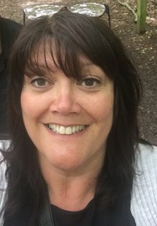
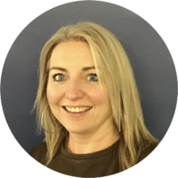

Meet our Year 3 teaching team
Miss Kim Ferguson
Senior Teacher &
Hazel Class Teacher
Mrs Jo Marlow
Holly Class Teacher
Mrs Gemma Allan
Hornbeam Class Teachers
Notes:
Each teacher to introduce themselves

Slide 4


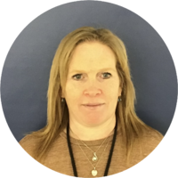

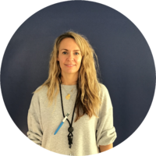

Other supporting
Adults you will see in Year 3
Josie Adaway
Shweta Samras
Louise Boon
Keri Lohan
Amy Arbon
Ayesha Bibi

Slide 5

Other supporting
Adults you will see in Year 3

Slide 6
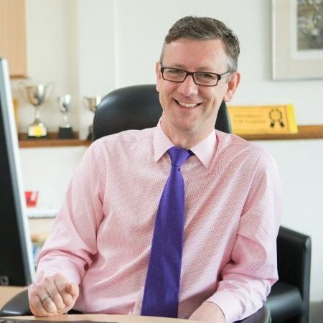
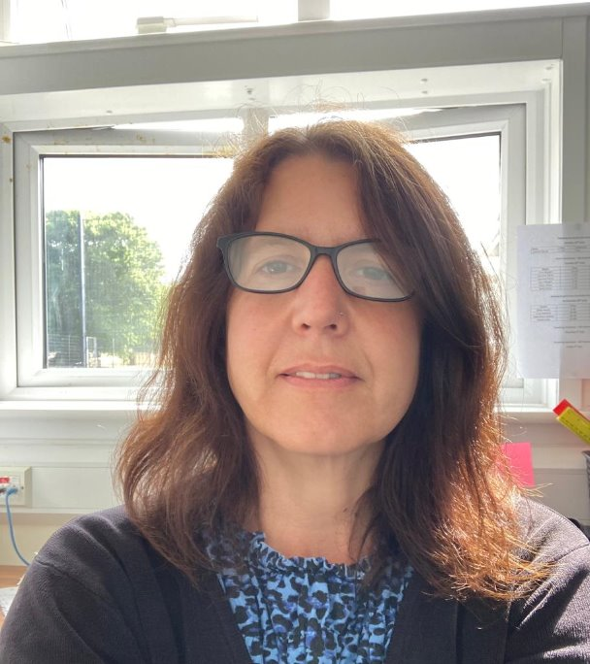
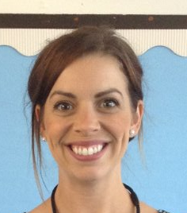
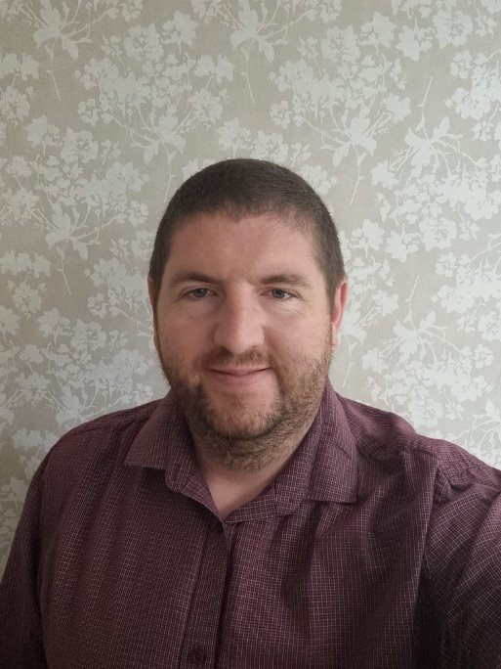
Meet the leadership team
Mr Robert Staples
Headteacher
Miss Michelle Bridge
Senior Deputy Headteacher
Mrs Natalie Sembi
Deputy Headteacher
Mrs Sharon Mullen
Assistant Headteacher and SENDco
Mr Chris Holgate
Assistant Headteacher
Notes:
Explain school structure and headship team

Slide 7
What will my child be learning?

Slide 8
The Year 3
Curriculum
Guided reading
Extended Writing
Spelling
Handwriting
Maths
Maths fluency
RSHE
MFL
Science
RE
PE
Art/D&T
Geography/History
Music
Computing
Notes:
In the Early Years we follow the Early Years Foundation Stage Curriculum which is split into 'Prime areas' and 'Specific areas'
The prime areas cover: Communication and language, Personal, social and emotional development and physical development
The specific areas cover: Liteacy, Maths, Understanding the World and Expressive Arts and Design
Alongside the Early Years Foundation Stage curriculum, we use the characteristics of effective learning.
The characteristics of effective learning describe behaviors children use in order to learn.
The focus of these is on how children learn rather than what they learn.
Effective learning must be meaningful to a child, so that they are able to use what they have learned and apply it in new situations

Slide 9

Homework
Expectations
Every Friday
Homework will be emailed.
Spellings
This will contain information on the spelling patterns they have been investigating in class and words to learn.
Reading
Please listen to your child read at least 3 times per week, remember to sign your child's reading record as they will be checked on Fridays.
Maths
'Learn-it' facts to learn and
TT Rock stars (daily 10 mins)
History & Geography
There will also be mini-topics set for homework once each half term.

Slide 10

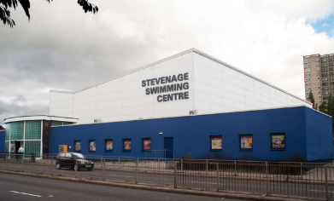
Swimming
Year 3 children will have a weekly swimming lesson during the summer term.
Clothing: a one-piece swimming suit, swimming trunks or shorts (which must be above knee height to comply with the pool’s policy), a hair band or swimming cap.
All children must bring their own towel, preferably a waterproof bag to carry their kit with them.
Children may bring goggles if they wish.
Earrings must be removed prior to swimming and NO deodorant sprays are permitted under any circumstances.
Notes:
You would have noticed that the children have a big chunk of time in the morning and in the afternoon called 'independent time'.
The purpose of this is to emphasis learning through play and how high-quality play will involve many of the areas of learning.
Explain the adult role’s in supporting and extending learning through play.
Outdoor learning clothes
Weather expectations

Slide 11
Drop off and collection
Notes:
FAYE

Slide 12
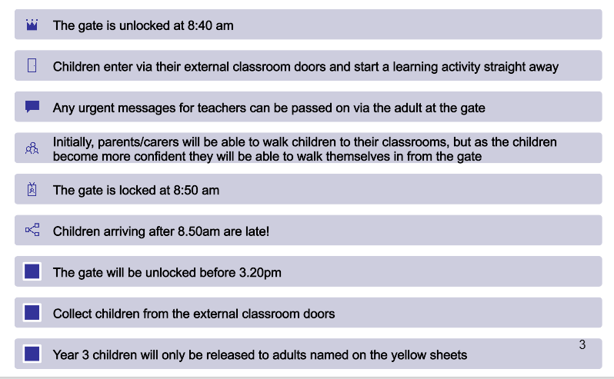
Start and end of the day – Year 3

Slide 13
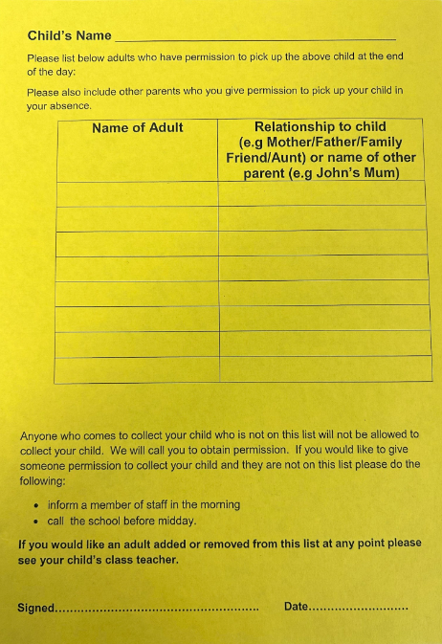
  Yellow collection forms
  We will only release your child to those who are documented on this list.
  If there are any changes, please let us know ASAP.
  You can add/change/delete at any time.
  (Yellow forms are forwarded to Year 3 from the previous class teacher)
Notes:
Explain yellow forms. Write all people on there who can collect (including yourself) if someone else collecting – phone office ASAP.
If the person is not on the yellow form they will be asked a password. Make sure you let the office know the person collecting. If someone comes to collect and they are not on the yellow form or we have not had a message – we will phone the first two contacts.

Slide 14
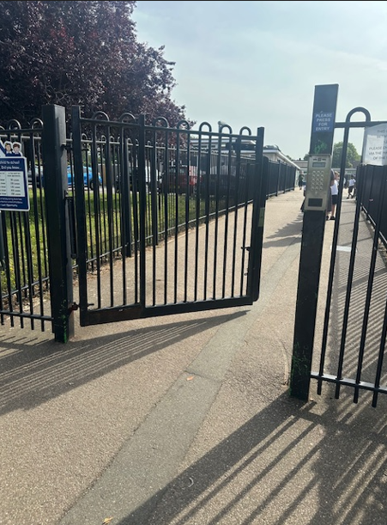
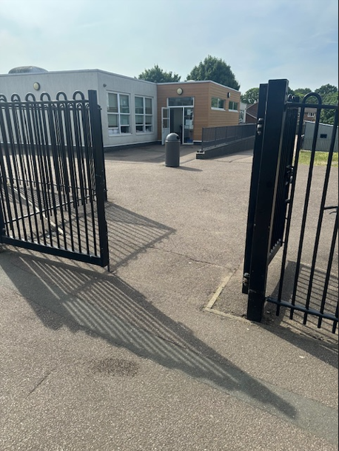
Enter through the upper site gate.
Leave your child at the year 2/3 gate for them to walk to their class independently.
Any messages are to be given to the staff member on the gate and will be passed to your class child's class teacher.

Slide 15


  After-school club
  Anytime until 6:15pm
  (upper dining room)
  Run by familiar adults in the upper building.
  Children are collected from the classroom and taken to after-school club.
  Bookable via Arbor
  Breakfast Club
  7:45am (upper hall)
  Staff will supervise children to the school gate.
  Bookable via Arbor

Slide 16
Lunch time

Slide 17
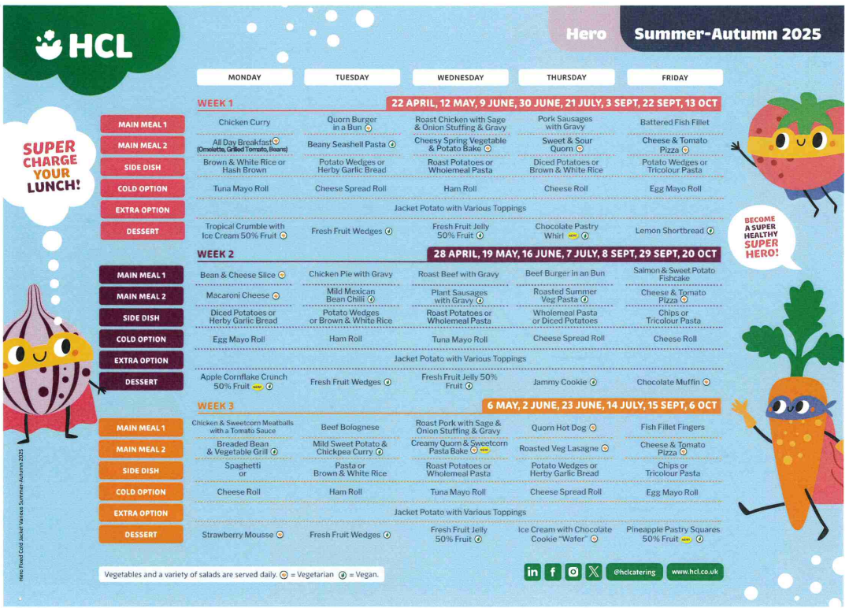
Lunchtime offer
Notes:
Children in Reception, Year 1 and Year 2 receive a free school lunch (so this is the best time to encourage your child to try new foods)
This is government funded and all children are eligible, respective of parental income or situation
Lunchtime for the Foundation Stage is 11.30am -12.30pm (in the Lower Hall)
Many of the Midday Supervisory Assistants (MSAs) are also Early Years staff. However, your child’s class teacher will also support your child to settle in to the lunchtime routine in the Autumn term
3 week rolling menu
A menu will be provided with a selection of 4-5 meals, please talk to your child about their preference, to enable your child to independently select their meal choice when they arrive at school.

Slide 18
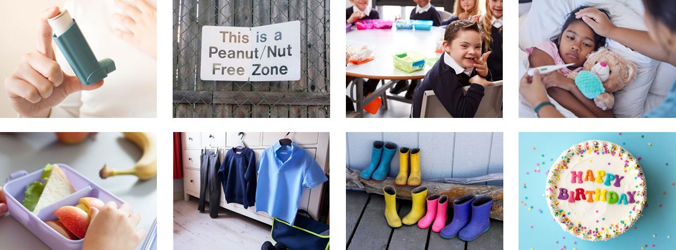
Healthy lunch
Please:
A Healthy Packed lunch
Starchy foods like bread, rice, potatoes or pasta
Protein foods like meat, fish, eggs or beans
A dairy item, like cheese or yogurt
Vegetables or salad and a portion of fruit
No
Fizzy drinks
Sweets
Chocolate bars
Nut products (including peanut butter and Nutella)

Slide 19


In classrooms
Daily fruit accessible during morning break
Access to fresh cold water
(water bottles needed in class)

Slide 20
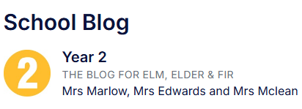



How we communicate with you
  parent workshops
  Email
Open-door policy.
  School Blog
Facebook
Year 2 weekly homework flyer
Arbor App
  Parent consultations
Medical Tracker emails
Notes:
Communication is so important and children learn best when we work together
It plays a huge role in ensuring that you are regularly sharing information with us to best support your child
How we may communicate to you:
Through the Arbor app – school communication system
Homework flyer which is sent via the Arbor App
Homework Flyer includes – learning that has taken place that week, learning that will take place the following week, any important messages or dates
School website / School Blog
Facebook page
School notice boards
Parent workshops
Open-door policy - Best time to talk to teachers is at the end of the day when all children have been released. If there is an urgent issue, please talk to the adult on the gate/door who will pass on the message.
If you have any concerns about your child’s education, these should first be raised with your child’s class teacher. If the issue is not resolved, it may be raised with Miss Free (Senior Teacher) or Miss Bridge (Deputy Headteacher). Appointments to see staff can be made via the school office.

Slide 21
Medical Information

Slide 22


Health and medical
All accidents and administering of medicines (including inhalers) are reported to you immediately via Medical Tracker.
All health care plans, asthma care plans and information about dietary needs are held on Medical Tracker and you can update these when needed.
You will receive emails from donotreply@medicaltracker.co.uk Add this address to your email address books so the emails do not go to your spam/junk folder.
If your child has a food allergy or intolerance (diagnosed or undiagnosed), complete the consents on Arbor and inform the office. Our family worker, Mrs McCullagh will be able to help you.
All medicines must go through the school office where correct paperwork will be signed. Any brought in directly to class will result in a call home for you to come in and complete relevant forms. We must make sure that medication is stored securely and not in childrens’ bags due to allergies.
We are a NUT AWARE school and kindly remind you that no nuts or nut products are allowed onsite.
Notes:
Allergies - If your child has a food allergy, you will need to register your them with HCL before they are able to have a school meal, our family worker can help with this. Due to severe nut allergies, we ask that no nuts are brought into school. If your child does have an allergy or an intolerance, please call the school as soon as possible to inform us. We will discuss the needs with you and determine if a care plan is required.
prescribed medication -
We can only administer antibiotics if they are prescribed 4 x daily. Parents must complete a form at the office, medicine will be stored in the Lower Office.
injuries from home - let staff know (normal procedure) Make us aware of any injuries they have before coming into school, in line with our safeguarding policy
Birthday sweets – no
. Talk about the policy regarding bringing in food for a child’s birthday – allergies
First Aid – Staff are first aid trained. If your child has an accident at school you will be informed through the accident information sheet. Your child will receive a white letter for an accident they have had. If your child sustains a head injury, you will usually be called and your child will receive a red letter.
Ensure that we always have up to date contact numbers
Accidents - explain how the school manage accidents and that first aid is administered in line with the school/setting policy. Talk about the fact that accidents are recorded and how risk assessments are undertaken to manage potential hazards.

Slide 23




Notes:
Allergies - If your child has a food allergy, you will need to register your them with HCL before they are able to have a school meal. Due to severe nut allergies, we ask that no nuts are brought into school. If your child does have a nut allergy please call the school as soon as possible to inform us. We can organise for a Health Care Plan!
prescribed medication -
We can only administer antibiotics if they are prescribed 4 x daily. Parents must complete a form at the office, medicine will be stored in the Lower Office.
injuries from home - let staff know (normal procedure) Make us aware of any injuries they have before coming into school, in line with our safeguarding policy
Birthday sweets – no
. Talk about the policy regarding bringing in food for a child’s birthday – allergies
First Aid – Staff are first aid trained. If your child has an accident at school you will be informed through the accident information sheet. Your child will receive a white letter for an accident they have had. If your child sustains a head injury, you will usually be called and your child will receive a red letter.
Ensure that we always have up to date contact numbers
Accidents - explain how the school manage accidents and that first aid is administered in line with the school/setting policy. Talk about the fact that accidents are recorded and how risk assessments are undertaken to manage potential hazards.

Slide 24
Uniform

Slide 25
Uniform
The school uniform policy sets out clearly the expectations.
Grey trousers / dresses / skirts / tailored shorts
White polo shirts / shirts / blouses
Navy blue sweatshirt / cardigan
Blue gingham summer dresses
PLAIN black shoes or trainers
If you child is not appropriately dressed, they will be given suitable clothing to wear. They will be told to remove jewellery, and a letter will be sent home with a reminder of school policy.
Notes:
You would have noticed that the children have a big chunk of time in the morning and in the afternoon called 'independent time'.
The purpose of this is to emphasis learning through play and how high-quality play will involve many of the areas of learning.
Explain the adult role’s in supporting and extending learning through play.
Outdoor learning clothes
Weather expectations

Slide 26
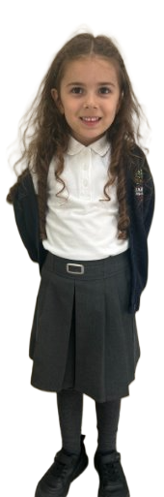
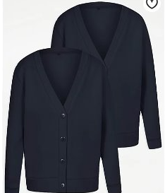
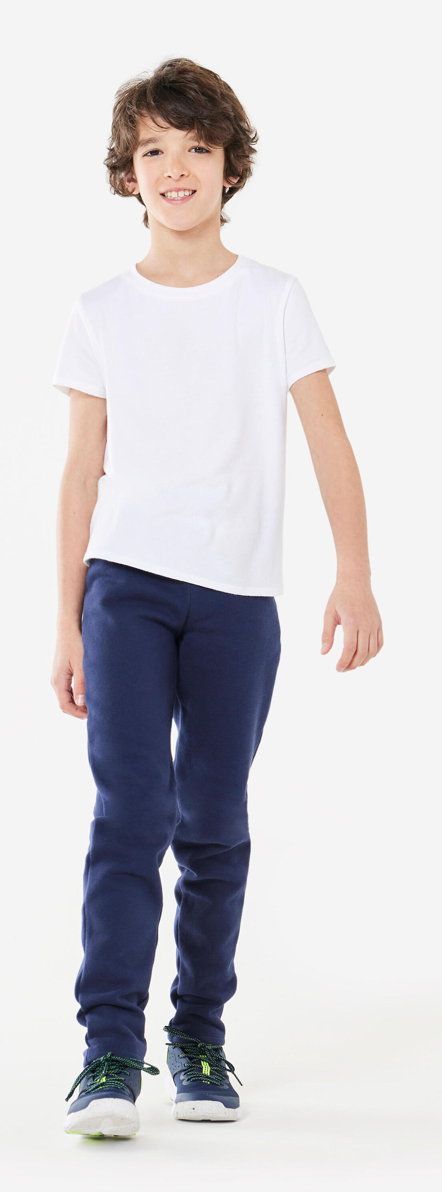
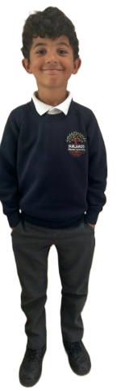
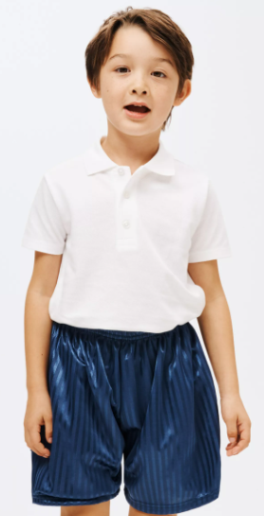
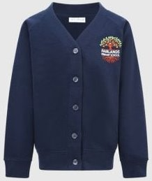
www.smartyschoolwear.co.uk
Notes:
School uniform
Please make sure that absolutely everything is labelled with your child’s name! (Including shoes!)
Grey trousers / dresses / skirts / tailored shorts
White polo shirts / shirts / blouses/polo top
Navy blue sweatshirt / cardigan
Blue gingham summer dresses
We will always do our best to return any belongings to the children. If they are named, it makes it easier.
There is a lost property rail in this lower hall – if there is a time where something has been misplaced. Please check here also.
PE uniform
White top, navy shorts/jogging bottoms and trainers
Children will get changed at home and come into school dressed in their P.E kit.
Please also note that your child’s uniform will get messy at some point! Playing with paint, mud and other sensory materials is great for your child’s brain development and aprons/all in one waterproofs are never perfect.
It is fine to send your child to school in uniform that has been washed but has stains ☺

Slide 27
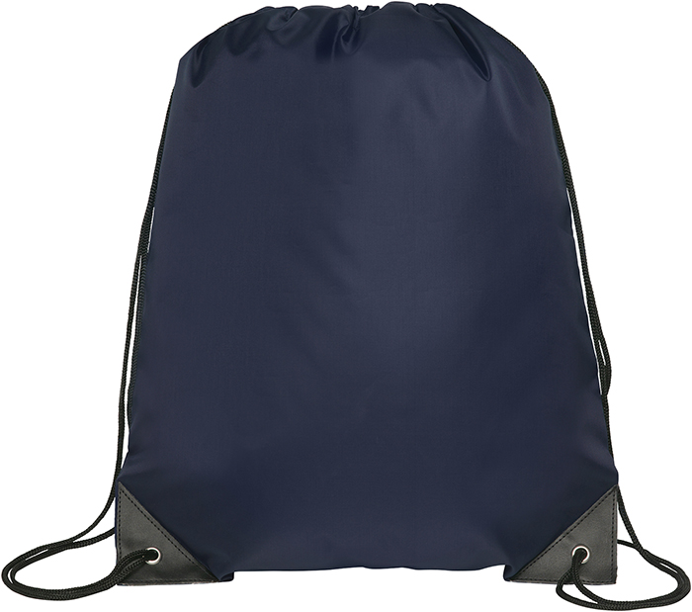
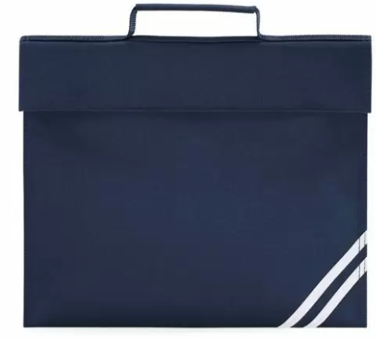
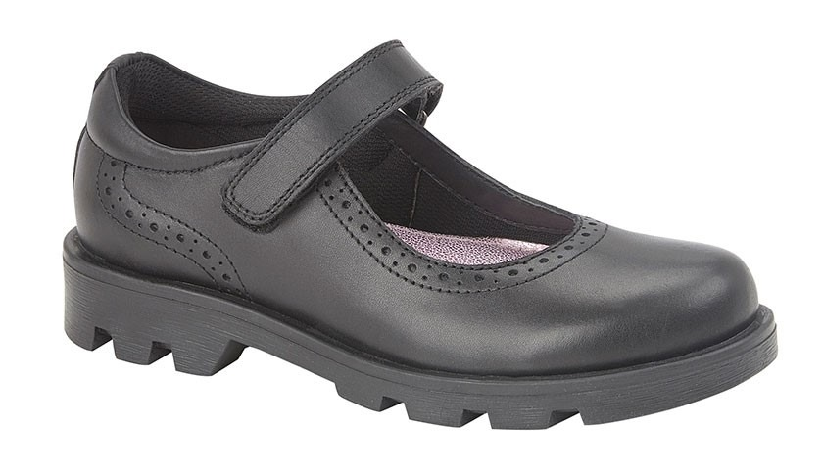
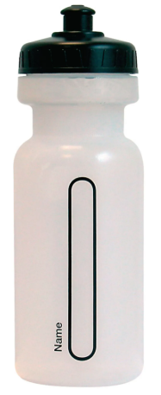

Please remember...
Always name your child's property.
Notes:
Please remember to bring:
A book bag everyday – for letters, accident forms, drawings, reading books etc.
A pair of wellies that can be kept at school for the days where it is raining.
Sturdy shoes with velcro if possible please.
Coat everyday
Sun hat on the days where it is hot.
No toys to be brought to school
Water bottles - just water (no juice)
You will be given a blue drawstring bag. We ask that a spare change of clothes is put into this bag and kept on your child's peg. If your child has an accident or gets wet/muddy outside – we will use these clothes and send home the wet ones.

Slide 28

Governors

Slide 29
We look forward to welcoming you to Fairlands Primary School
Notes:
Thank you for coming. We look forward to seeing you all again in September :)

