Slide 1

Welcome to Year 2 transition meeting
Notes:
Good afternoon, welcome to our new to reception meeting. The aim of this meeting is to give you a little bit of information about reception and some information about Fairlands if you are new to the school

Slide 2
Meet the team…
Notes:
ROCHELLE

Slide 3
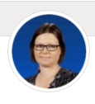
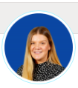
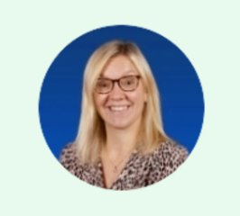
Meet our Year 2 teaching team
Fir
Elm
Elder
Mrs Harnett
Fir Class
Teacher
Mrs Mclean
Senior Teacher
& Elm Class Teacher
Mrs Johnson
Elder Class Teacher
Notes:
Each teacher to introduce themselves

Slide 4
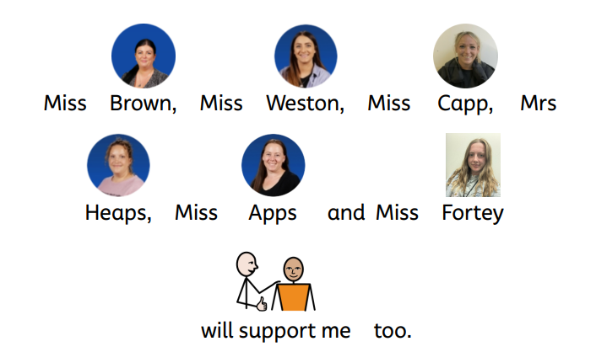
Adults you will see in Year 2

Slide 5
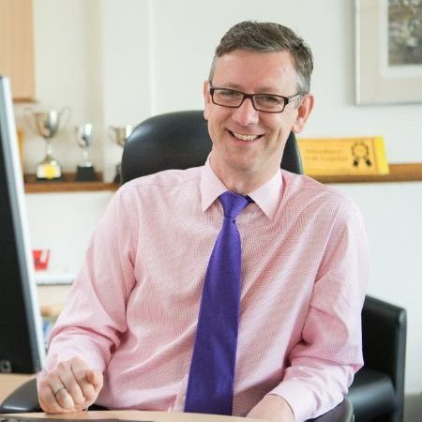
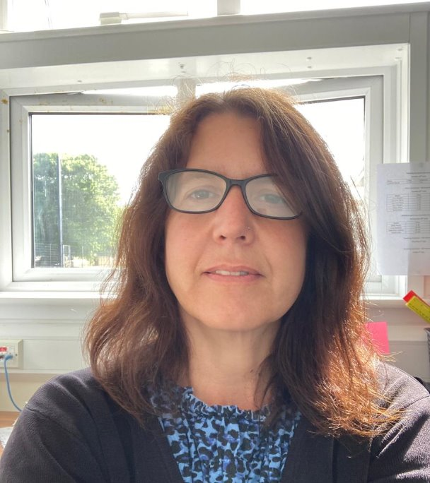
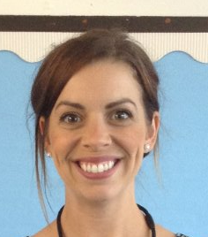
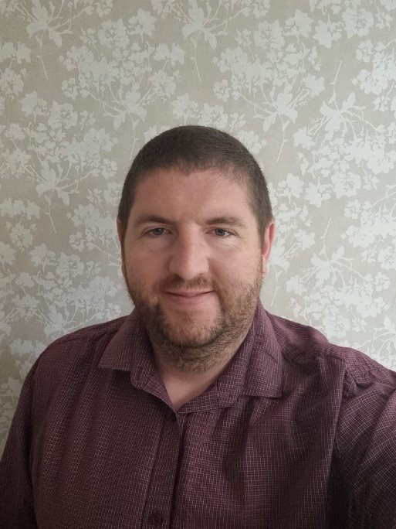
Meet the leadership team
Mr Robert Staples
Headteacher
Miss Michelle Bridge
Senior Deputy Headteacher
Mrs Natalie Sembi
Deputy Headteacher
Mrs Sharon Mullen
Assistant Headteacher and SENDco
Mr Chris Holgate
Assistant Headteacher
Notes:
Explain school structure and headship team

Slide 6
What will my child be learning?

Slide 7
The Year 2
Curriculum
Guided reading
Comprehension
Spelling/handwriting/grammar
Extended writing
Maths
Mental maths/CLIC maths
Computing
Jigsaw – SRHE and Values
Phonics
Science
RE
PE

Slide 8

Homework
Expectations
Every Friday
Homework will be emailed.
Spellings
This will contain information on the spelling patterns they have been investigating in class and words to learn.
Reading
Please listen to your child read at least 3 times per week, remember to sign your child's reading record as they will be checked on Fridays.
Maths
Number facts to learn
History & Geography
There will also be mini-topics set for homework once each half term.

Slide 9
Drop off and collection
Notes:
FAYE

Slide 10
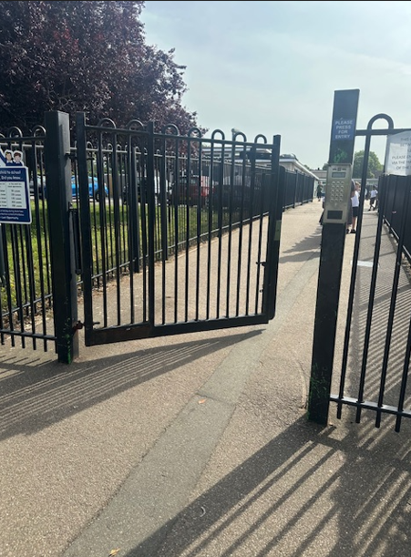
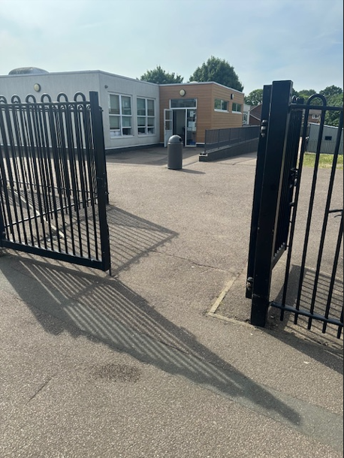
Enter through the upper site gate.
Leave your child at the year 2/3 gate for them to walk to their class independently.
Any messages are to be given to the staff member on the gate and will be passed to your class child's class teacher.

Slide 11
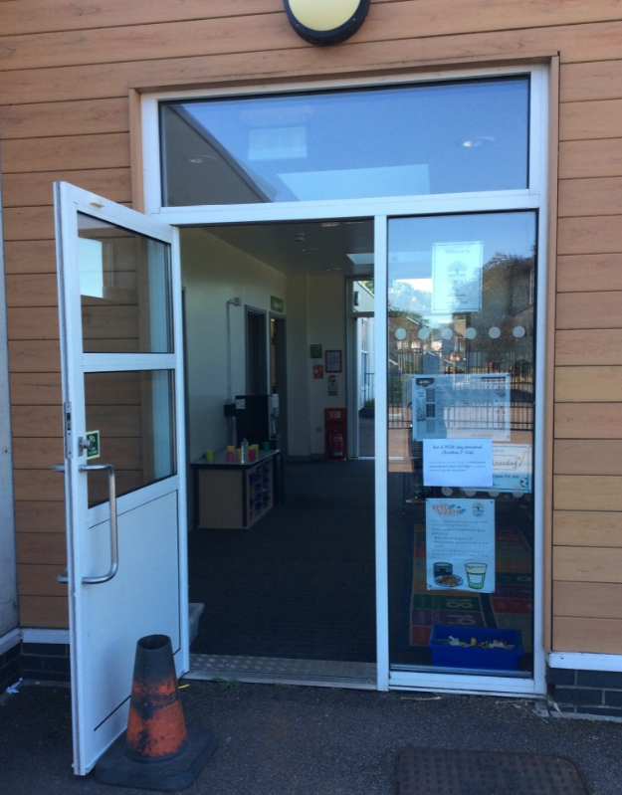
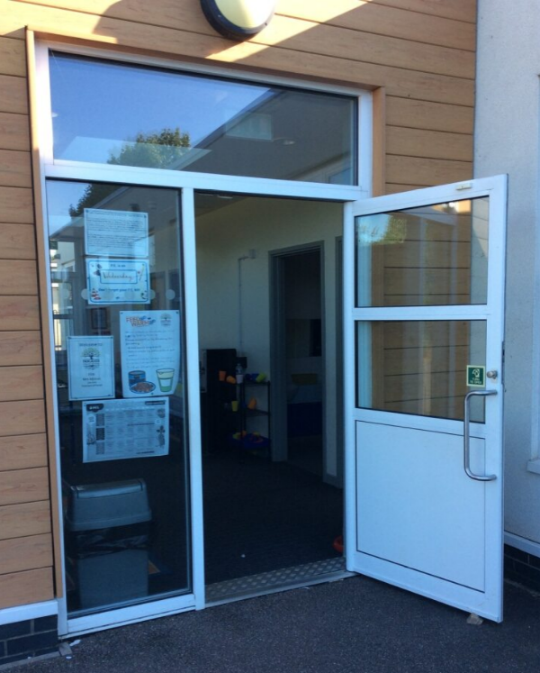
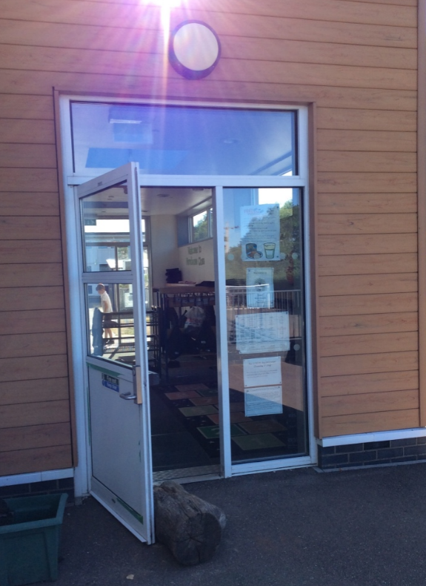
Classroom Entrances
Fir's classroom entrance
Elm's classroom entrance
Elder's classroom entrance

Slide 12


  Morning
  Gates open at 8:40 am
  Gates close at 8:50 am
  After this time, children need to be dropped off at the upper office.
  Afternoon
  Gates open at 3:15pm
  Children exit at 3:20pm
  After this time, children need to be picked up from the upper office.
  Your child may have been taken to after-school club (you will be charged for this)
  Breakfast Club
  7:45am (upper hall)
  Staff will supervise children to the school gate
  Bookable via Arbor
  After-school club
  Anytime until 6:15pm
  (upper hall)
  Run by familiar adults in the upper building.
  Bookable via Arbor

Slide 13
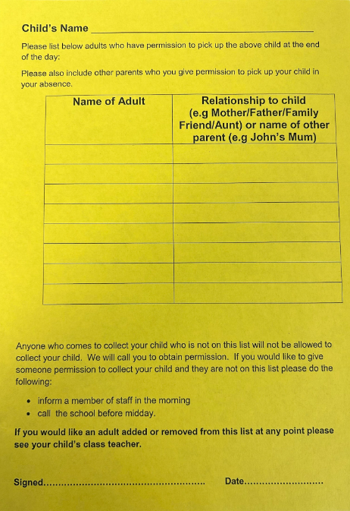
  Yellow collection forms
  Prior to starting at Fairlands, you would have been asked to fill in a Yellow collection form.
  We will release to only those that are on this list.
  If there are any changes, please let us know ASAP.
  You can add/change/delete at any time.
  If someone comes to collect that is not on the yellow form, we will phone the first two contacts on Arbor.
Notes:
Explain yellow forms. Write all people on there who can collect (including yourself) if someone else collecting – phone office ASAP.
If the person is not on the yellow form they will be asked a password. Make sure you let the office know the person collecting. If someone comes to collect and they are not on the yellow form or we have not had a message – we will phone the first two contacts.

Slide 14
communication

Slide 15
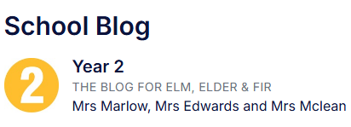


How we communicate with you
  parent workshops
  Email
Open-door policy.
  School Blog
Facebook
Year 2 weekly homework flyer
  Parent consultations
Arbor App
Notes:
Communication is so important and children learn best when we work together
It plays a huge role in ensuring that you are regularly sharing information with us to best support your child
How we may communicate to you:
Through the Arbor app – school communication system
Homework flyer which is sent via the Arbor App
Homework Flyer includes – learning that has taken place that week, learning that will take place the following week, any important messages or dates
School website / School Blog
Facebook page
School notice boards
Parent workshops
Open-door policy - Best time to talk to teachers is at the end of the day when all children have been released. If there is an urgent issue, please talk to the adult on the gate/door who will pass on the message.
If you have any concerns about your child’s education, these should first be raised with your child’s class teacher. If the issue is not resolved, it may be raised with Miss Free (Senior Teacher) or Miss Bridge (Deputy Headteacher). Appointments to see staff can be made via the school office.

Slide 16
Lunchtime

Slide 17
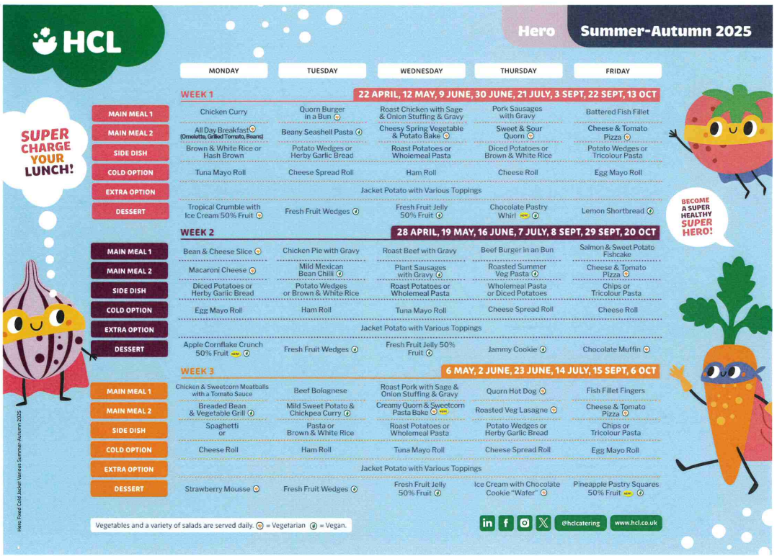
Lunchtime offer
Notes:
Children in Reception, Year 1 and Year 2 receive a free school lunch (so this is the best time to encourage your child to try new foods)
This is government funded and all children are eligible, respective of parental income or situation
Lunchtime for the Foundation Stage is 11.30am -12.30pm (in the Lower Hall)
Many of the Midday Supervisory Assistants (MSAs) are also Early Years staff. However, your child’s class teacher will also support your child to settle in to the lunchtime routine in the Autumn term
3 week rolling menu
A menu will be provided with a selection of 4-5 meals, please talk to your child about their preference, to enable your child to independently select their meal choice when they arrive at school.

Slide 18
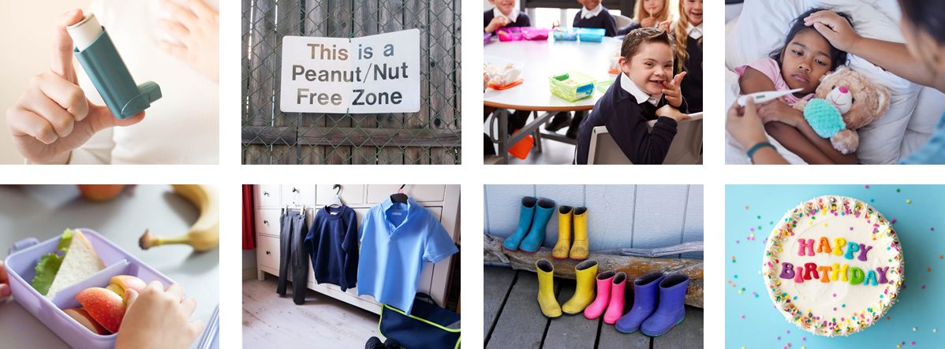

Healthy lunch
Year 2 Lunchtime
11.45-12.45
Refrain from packing too much
Please:
Refrain from packing too much
Start with less and add more items if they are eating all the items that you send
Let us know if they continue to eat very little
No
Fizzy drinks
Sweets
Chocolate bars
Nut products (including peanut butter and Nutella)

Slide 19


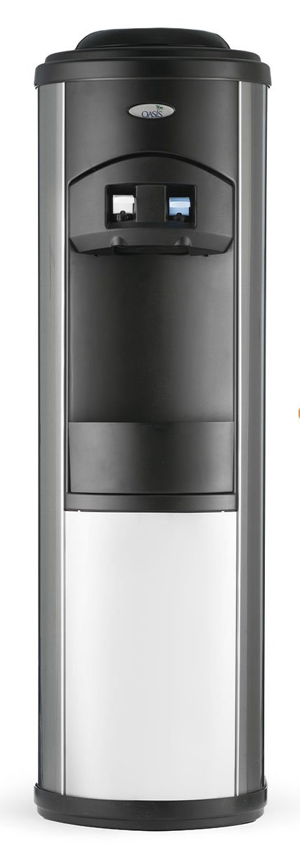

In classrooms
Daily fruit accessible throughout the day
Bagels through the breakfast programme
Water cooler – access to fresh cold water
(water bottles needed in class)
Milk available

Slide 20
Medical Information

Slide 21





Notes:
Allergies - If your child has a food allergy, you will need to register your them with HCL before they are able to have a school meal. Due to severe nut allergies, we ask that no nuts are brought into school. If your child does have a nut allergy please call the school as soon as possible to inform us. We can organise for a Health Care Plan!
prescribed medication -
We can only administer antibiotics if they are prescribed 4 x daily. Parents must complete a form at the office, medicine will be stored in the Lower Office.
injuries from home - let staff know (normal procedure) Make us aware of any injuries they have before coming into school, in line with our safeguarding policy
Birthday sweets – no
. Talk about the policy regarding bringing in food for a child’s birthday – allergies
First Aid – Staff are first aid trained. If your child has an accident at school you will be informed through the accident information sheet. Your child will receive a white letter for an accident they have had. If your child sustains a head injury, you will usually be called and your child will receive a red letter.
Ensure that we always have up to date contact numbers
Accidents - explain how the school manage accidents and that first aid is administered in line with the school/setting policy. Talk about the fact that accidents are recorded and how risk assessments are undertaken to manage potential hazards.

Slide 22
Uniform

Slide 23
Uniform
The school uniform policy sets out clearly the expectations.
Grey trousers / dresses / skirts / tailored shorts
White polo shirts / shirts / blouses
Navy blue sweatshirt / cardigan
Blue gingham summer dresses
PLAIN black shoes or trainers
If you child is not appropriately dressed, they will be given suitable clothing to wear. They will be told to remove jewellery, and a letter will be sent home with a reminder of school policy.
Notes:
You would have noticed that the children have a big chunk of time in the morning and in the afternoon called 'independent time'.
The purpose of this is to emphasis learning through play and how high-quality play will involve many of the areas of learning.
Explain the adult role’s in supporting and extending learning through play.
Outdoor learning clothes
Weather expectations

Slide 24
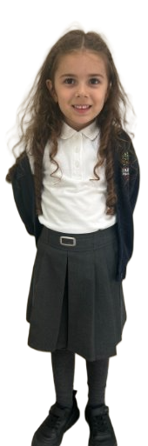
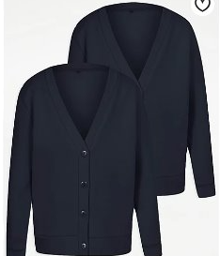
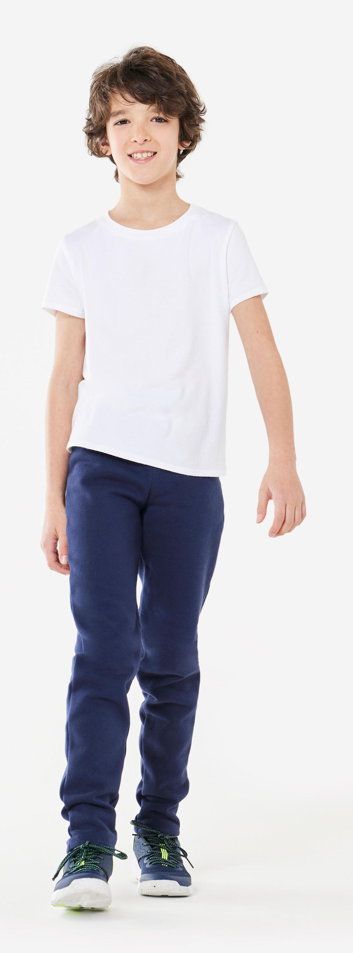
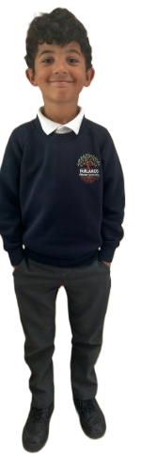
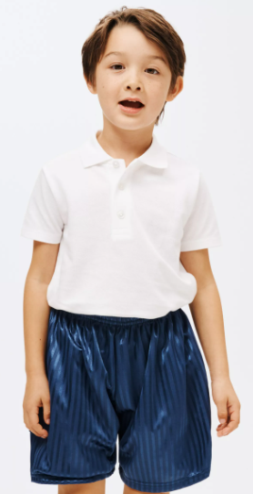
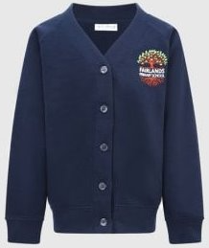
www.smartyschoolwear.co.uk
Notes:
School uniform
Please make sure that absolutely everything is labelled with your child’s name! (Including shoes!)
Grey trousers / dresses / skirts / tailored shorts
White polo shirts / shirts / blouses/polo top
Navy blue sweatshirt / cardigan
Blue gingham summer dresses
We will always do our best to return any belongings to the children. If they are named, it makes it easier.
There is a lost property rail in this lower hall – if there is a time where something has been misplaced. Please check here also.
PE uniform
White top, navy shorts/jogging bottoms and trainers
Children will get changed at home and come into school dressed in their P.E kit.
Please also note that your child’s uniform will get messy at some point! Playing with paint, mud and other sensory materials is great for your child’s brain development and aprons/all in one waterproofs are never perfect.
It is fine to send your child to school in uniform that has been washed but has stains ☺

Slide 25
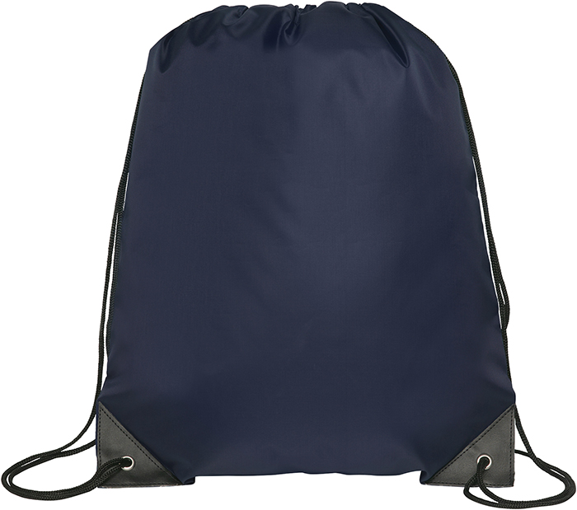
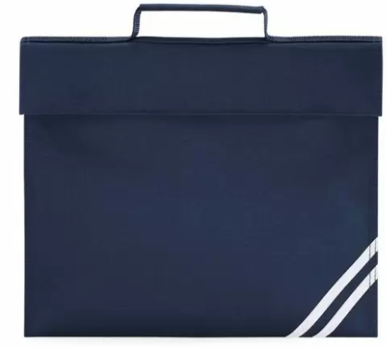
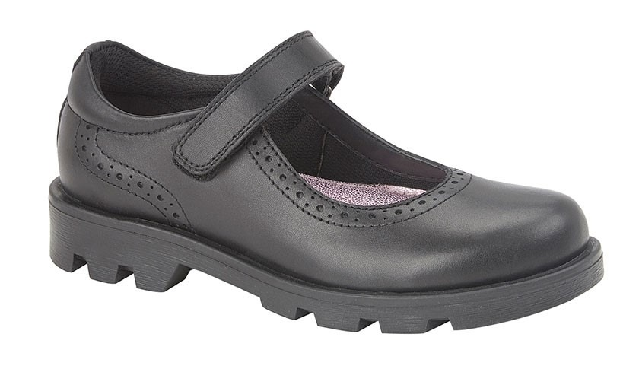
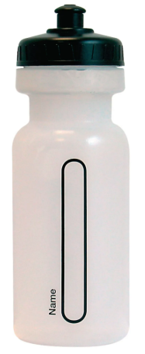
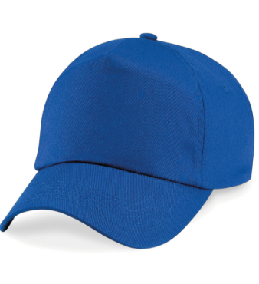
Please remember...
Always name your child's property.
Notes:
Please remember to bring:
A book bag everyday – for letters, accident forms, drawings, reading books etc.
A pair of wellies that can be kept at school for the days where it is raining.
Sturdy shoes with velcro if possible please.
Coat everyday
Sun hat on the days where it is hot.
No toys to be brought to school
Water bottles - just water (no juice)
You will be given a blue drawstring bag. We ask that a spare change of clothes is put into this bag and kept on your child's peg. If your child has an accident or gets wet/muddy outside – we will use these clothes and send home the wet ones.

Slide 26
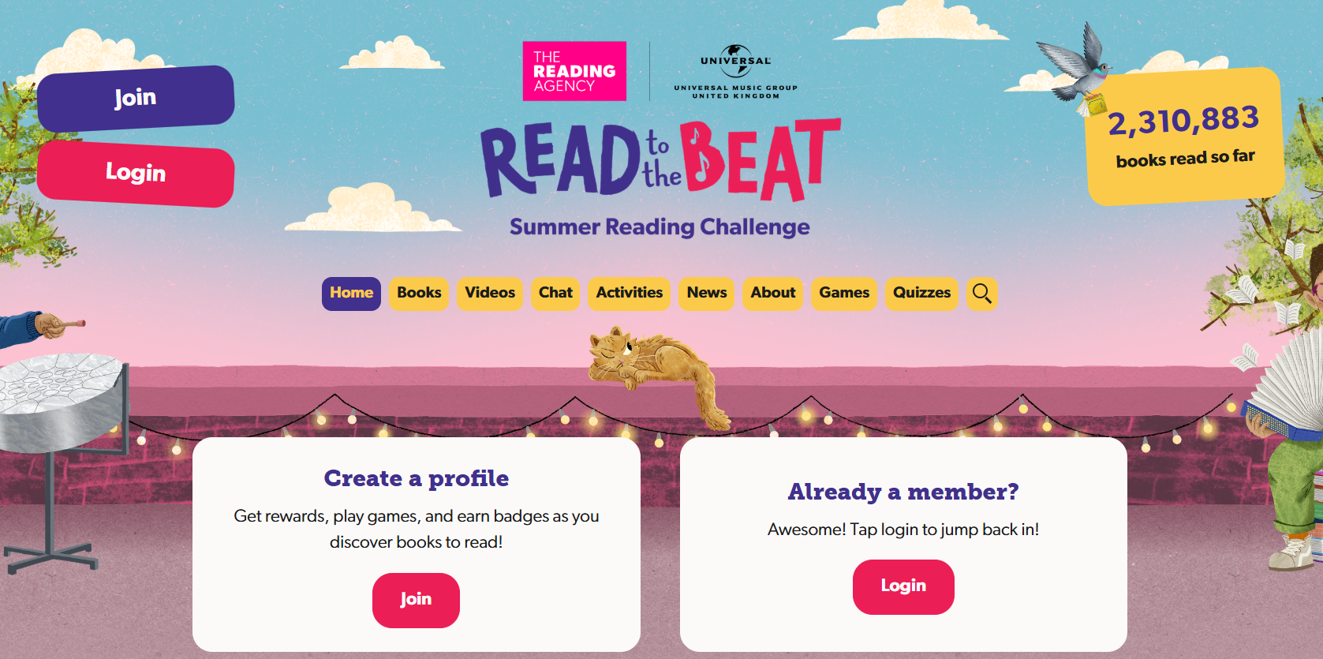


https://summerreadingchallenge.org.uk/
Assembly
Years 1, 2 & 3 – Monday 14th July 9:30am
Years 4, 5 & 6 – Monday 14th July 10:00am

Slide 27
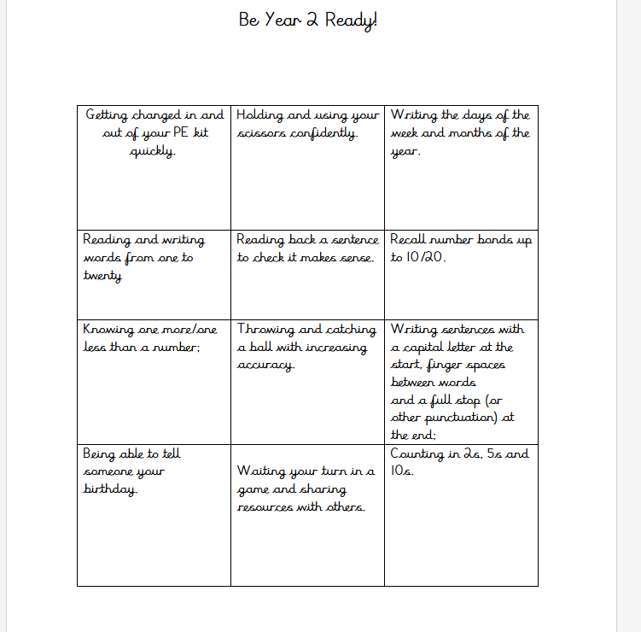

Be Year 2 Ready!
School ready words

Slide 28

School Governor

Slide 29
We look forward to welcoming you to Fairlands Primary School
Notes:
Thank you for coming. We look forward to seeing you all again in September :)

