Slide 1

Welcome to Fairlands Primary School
New to Year 1 transition meeting

Slide 2
Meet the team…

Slide 3


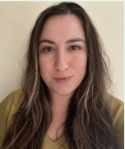
Meet our Year 1 teaching team
Mrs Karen Herron
Senior Teacher & Cherry Class Teacher
Mrs Katherine Wrangles
Chestnut Class Teacher
Miss Saffron Mansfield
Cedar Class teacher

Slide 4


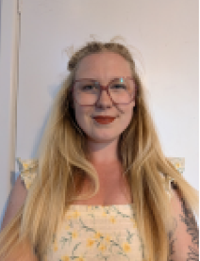
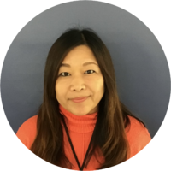
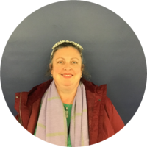
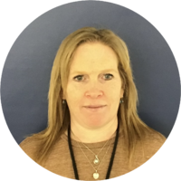


Adults we will see in Year 1
Mrs Dendy Mrs Delaparelle Miss Mitchell
Mrs Okawa Miss Veal-Halpin Mrs Askri
Mrs Barkley Miss Boon Mrs Kandola

Slide 5
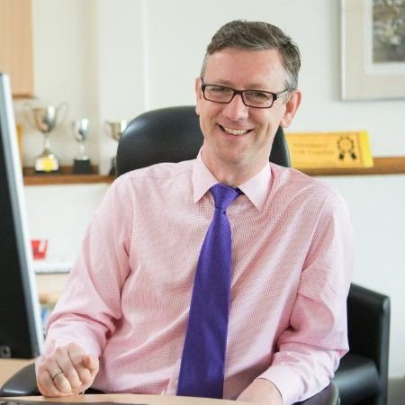
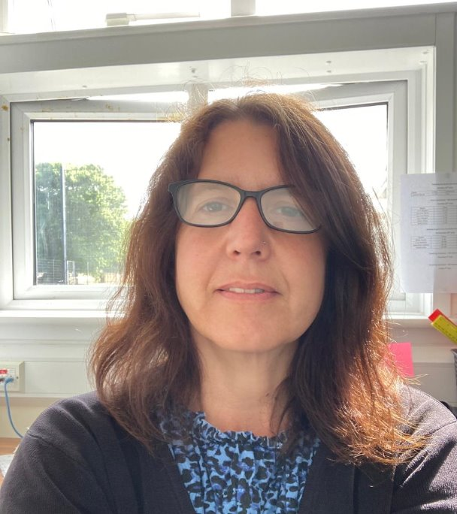
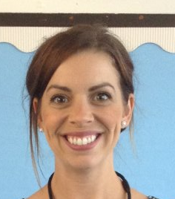
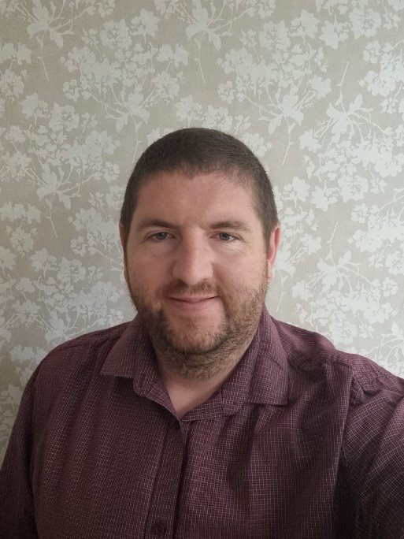
Meet the leadership team
Mr Robert Staples
Headteacher
Miss Michelle Bridge
Senior Deputy Headteacher
Mrs Natalie Sembi
Deputy Headteacher
Mrs Sharon Mullan
Assistant Headteacher and SENDco
Mr Chris Holgate
Assistant Headteacher

Slide 6
Drop off and collection

Slide 7
Start and end of the day.
The gate is unlocked at 8:40 am
Children enter via their external classroom doors and start a learning activity straight away
Urgent messages can be passed on to teachers who will be welcoming the children in at the external door
Initially, parents/carers will be able to walk children to their classrooms, but as the children become more confident they will be able to walk themselves in from the gate
The gate is locked at 8:50 am
Children arriving after 8.50am are late!
The gate will be unlocked at 3.15pm
Collect children from the external classroom doors
Year 1 children will only be released to adults named on the yellow sheets
Notes:
Alongside the Early Years Foundation Stage curriculum, we use the characteristics of effective learning.
The characteristics of effective learning describe behaviors children use in order to learn.
The focus of these is on how children learn rather than what they learn.
Effective learning must be meaningful to a child, so that they are able to use what they have learned and apply it in new situations

Slide 8


  Morning
  Gates open at 8:40 am
  Gates close at 8:50 am
  After this time, children need to be dropped off at the lower office.
  Afternoon
  Gates open at 3:15pm
  Gates close at 3:30pm
  After this time, children need to be picked up from the lower office.
  Your child may have been taken to after-school club (you will be charged for this)
  Breakfast Club
  7:45am (upper hall)
  Staff will bring children down to their classrooms
  Bookable via Arbor
  After-school club
  Anytime until 6:15pm
  (lower hall)
  Run by familiar adults in the lower building.
  Bookable via Arbor

Slide 9
Safeguarding
Notes:
FAYE

Slide 10
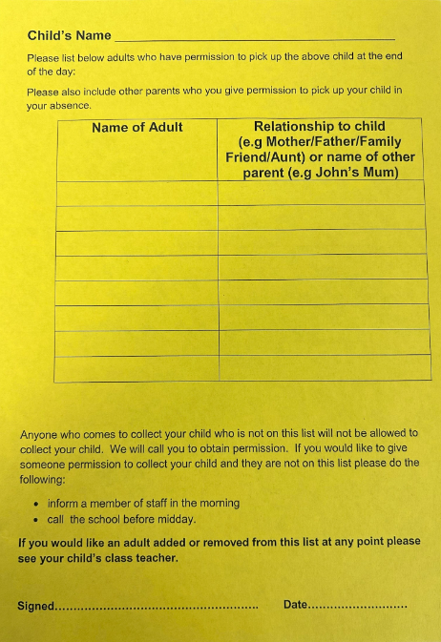
  Yellow collection forms
  Prior to starting in this school, you would have been asked to fill in a Yellow collection form.
  We will release to only those that are on this list.
  If there are any changes, please let us know ASAP.
  You can add/change/delete at any time.
  If someone comes to collect that is not on the yellow form, we will phone the first two contacts on Arbor.

Slide 11
Year 1 Yellow forms – Please Iet us know when someone new is collecting your child
Please do not use mobile phones in the school/classroom/on trips
Children should not bring phones to school. Children below the age of 13 should not have access to social networking sites
Park buggies outside of the classroom
We welcome scooters/bikes but please do not ride them on the school grounds

Slide 12
What will my child be learning?

Slide 13
Curriculum – Core Subjects
Phonics (and reading practise) | English (including handwriting)
Maths | Science
Computing | PE

Slide 14
Curriculum – Foundation Subjects
RE | Music | PSHE
Geography | Art and DT | History

Slide 15
Home learning

Slide 16
Home Learning
Weekly Homework
Homework will be added to the weekly email.
This will contain information on:
•The phonic sounds they have been looking at in their classes to practice at home.
•Maths - Might include 'Learn-it' facts to learn or a problem-solving challenge based on classroom learning.
There will also be half-termly project which will link to an aspect of the class learning.

Slide 17

Reading
Every child will be given a school reading book.
Children should read at home at least 3 times per week and complete their reading record.
Reading records and reading books should be brought to school every day and signed by parents/carers weekly.
Summer Reading Challenge: All Hertfordshire schools are promoting the importance of reading throughout the holidays. You can pick up a pack from any library from the middle of July. Your child will be challenged to read 6 books and receive rewards on the way to their goal!

Slide 18



https://summerreadingchallenge.org.uk/
Assembly
Years 1, 2 & 3 – Monday 14th July 9:30am
Years 4, 5 & 6 – Monday 14th July 10:00am

Slide 19
Breaks and lunchtime.

Slide 20
Break time and lunchtime.
Year group | Break times
Year 1 | 30 minute morning break 20-30 minute afternoon break These will change as the year progresses and the curriculum develops.
Year Group | Lunch break time | Eating Time | Playing Time
Year 1 | 12:30 | 12.30-12:55 | 12:55-1.30

Slide 21
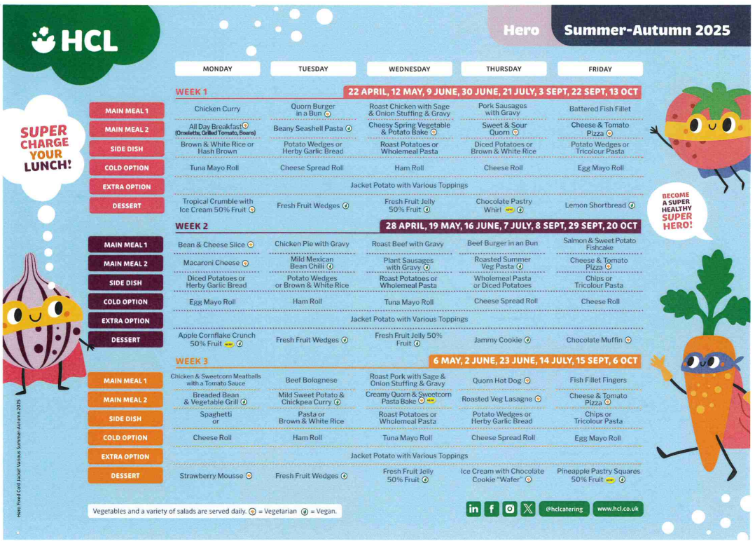
Lunchtime offer

Slide 22
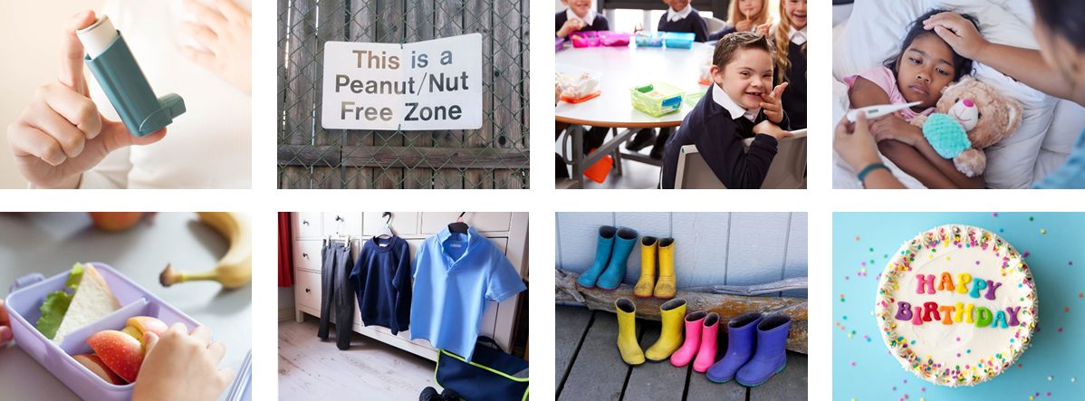

Healthy lunch
Please:
Refrain from packing too much
Start with less and add more items if they are eating all the items that you send
Let us know if they continue to eat very little
No
Fizzy drinks
Sweets
Chocolate bars
Nut products (including peanut butter and Nutella)

Slide 23


In classrooms
Daily fruit accessible throughout the day
Water – access to fresh cold water
(water bottles needed in class)
Milk provided every day

Slide 24
THINK NUT!
We are a nut aware school.
No nuts or products containing nuts on the ingredients list should be brought into school.
BE AWARE: products which have the following labels are not banned, but can still cause anaphylactic shock in some individuals with severe allergies: •may contain nuts
•may contain traces of nuts
•manufactured in a facility where nuts have been processed
BE AWARE: home-baked food has probably been made in a kitchen where nuts have been present.
Do WASH YOUR HANDS before and after eating
Do KEEP YOUR OWN FOOD TO YOURSELF – no sharing!
Do LEARN THE SIGNS of an allergic reaction:
breathing difficulty, wheezing & coughing
vomiting
swelling of tongue, lips or throat
unusual red rash
feeling faint
Do ASK if you are unsure if something is safe for you or your child

Slide 25
Communication

Slide 26



How we communicate with you
  parent workshops
  Email
Open-door policy.
  School Website
Facebook
Year 1 weekly homework flyer
Arbor App
  Parent consultations
Medical Tracker emails

Slide 27
Questions and queries.
Please speak to your child’s class teacher in the first instance. The end of the day is usually the best time to get their undivided attention.
Office staff will be able to book appointments for you if needed.
Remember, office staff have a wealth of information and can be contact via email or phone.
The school website is always up to date. Letters, diary dates and contact details can all be found here.

Slide 28
Medical Information

Slide 29


Health and medical
All accidents and administering of medicines (including inhalers) are reported to you immediately via Medical Tracker.
All health care plans, asthma care plans and information about dietary needs are held on Medical Tracker and you can update these when needed.
You will receive emails from donotreply@medicaltracker.co.uk Add this address to your email address books so the emails do not go to your spam/junk folder.
If your child has a food allergy or intolerance (diagnosed or undiagnosed), complete the consents on Arbor and inform the office. Our family worker, Mrs McCullagh will be able to help you.
All medicines must go through the school office where correct paperwork will be signed. Any brought in directly to class will result in a call home for you to come in and complete relevant forms. We must make sure that medication is stored securely and not in childrens’ bags due to allergies.
We are a NUT AWARE school and kindly remind you that no nuts or nut products are allowed onsite.

Slide 30
Uniform

Slide 31
Uniform
The school uniform policy sets out clearly the expectations.
Grey trousers / dresses / skirts / tailored shorts
White polo shirts / shirts / blouses
Navy blue sweatshirt / cardigan
Blue gingham summer dresses
PLAIN black shoes or trainers
If you child is not appropriately dressed, they will be given suitable clothing to wear. They will be told to remove jewellery, and a letter will be sent home with a reminder of school policy.

Slide 32
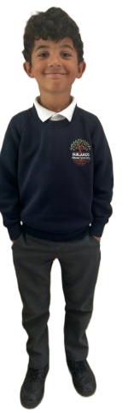
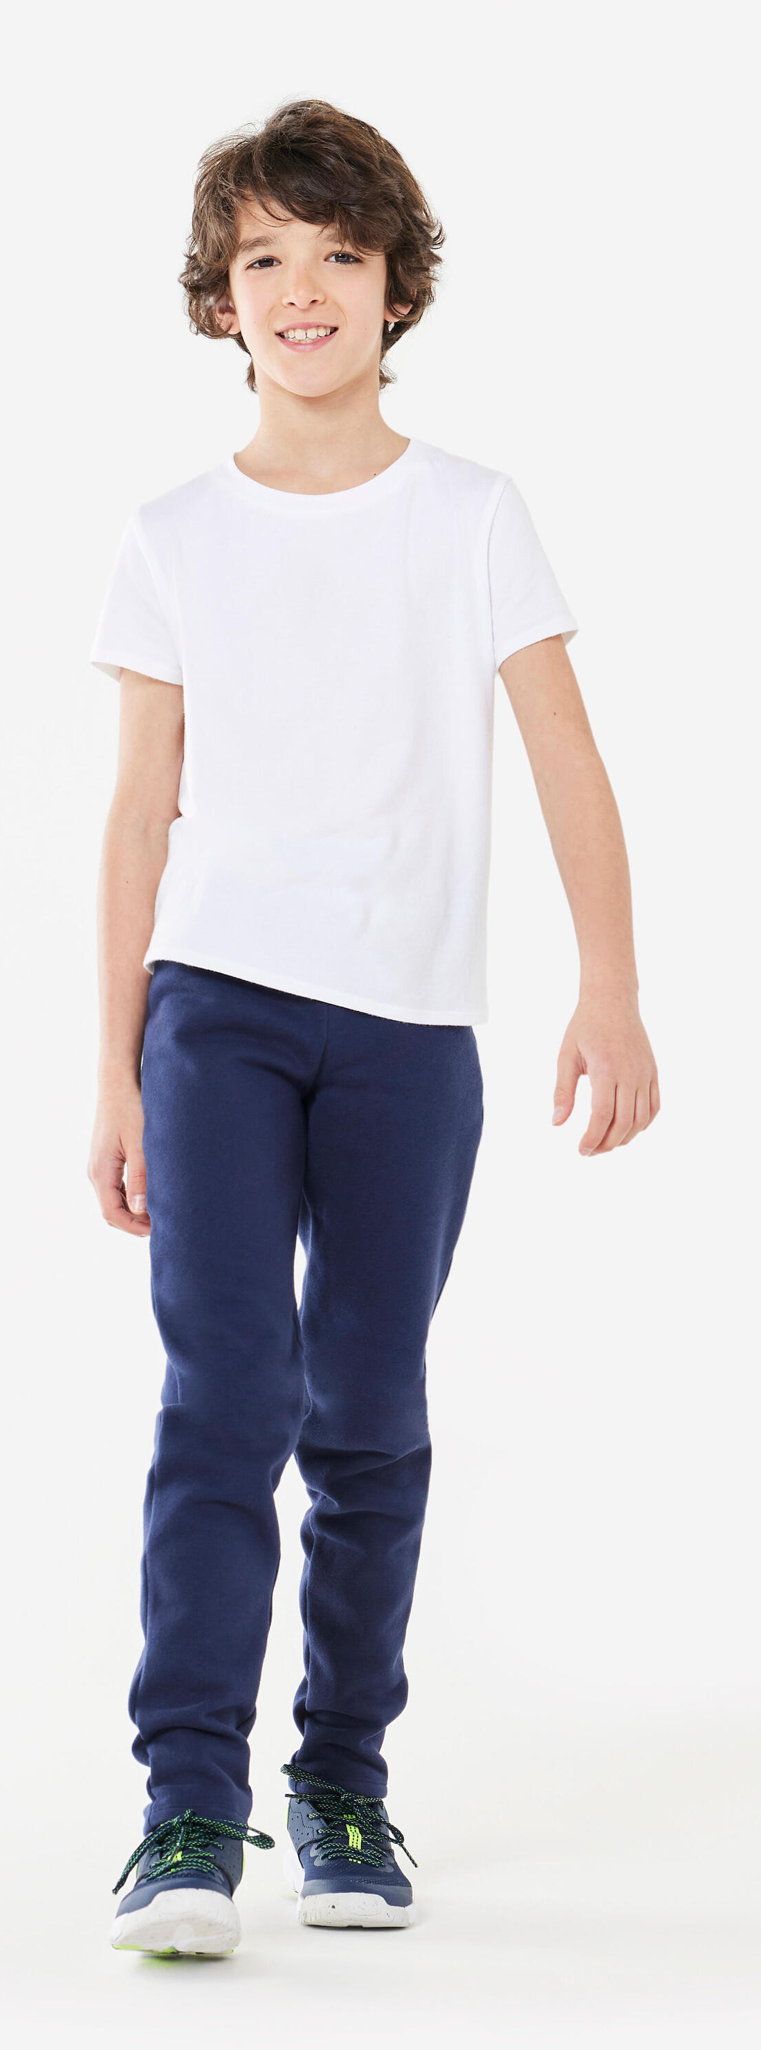
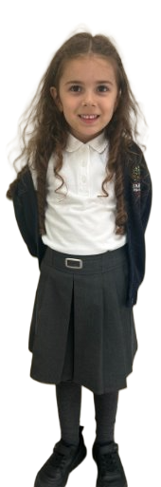

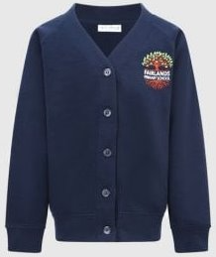
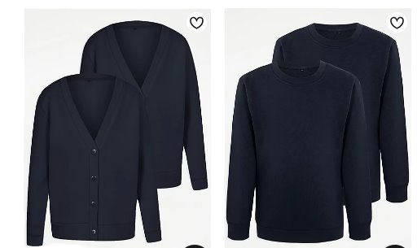
Grey trousers / dresses / skirts / tailored shorts
White polo shirts / shirts / blouses
Navy blue sweatshirt / cardigan
Blue gingham summer dresses
PLAIN black shoes or trainers
NO HOODIES!
Navy blue jogging bottoms / shorts / leggings
White t-shirt
Trainers
www.smartyschoolwear.co.uk
Notes:
School uniform
Please make sure that absolutely everything is labelled with your child’s name! (Including shoes!)
Grey trousers / dresses / skirts / tailored shorts
White polo shirts / shirts / blouses/polo top
Navy blue sweatshirt / cardigan
Blue gingham summer dresses
We will always do our best to return any belongings to the children. If they are named, it makes it easier.
There is a lost property rail in this lower hall – if there is a time where something has been misplaced. Please check here also.
PE uniform
White top, navy shorts/jogging bottoms and trainers
Children will get changed at home and come into school dressed in their P.E kit.
Please also note that your child’s uniform will get messy at some point! Playing with paint, mud and other sensory materials is great for your child’s brain development and aprons/all in one waterproofs are never perfect.
It is fine to send your child to school in uniform that has been washed but has stains ☺

Slide 33

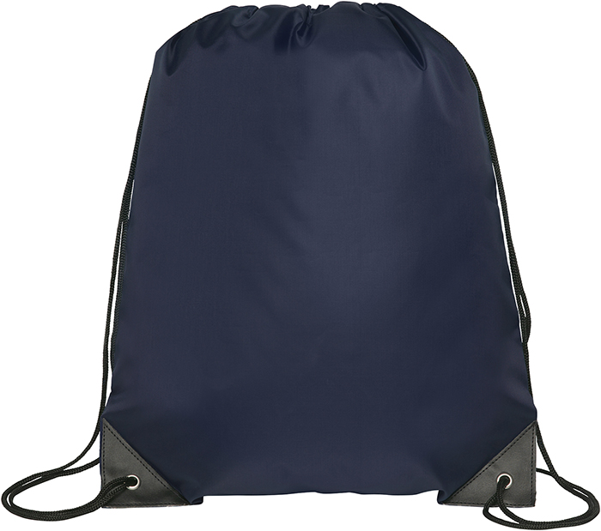


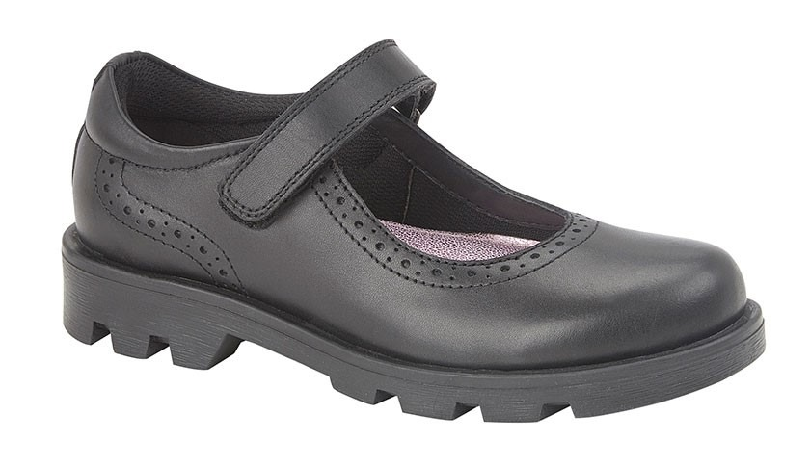
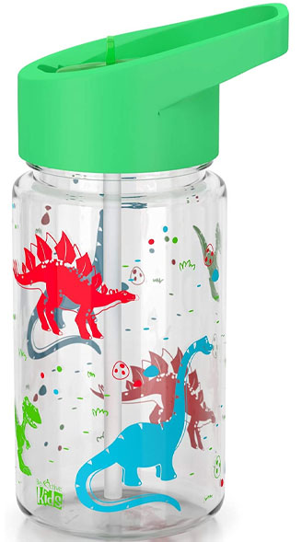
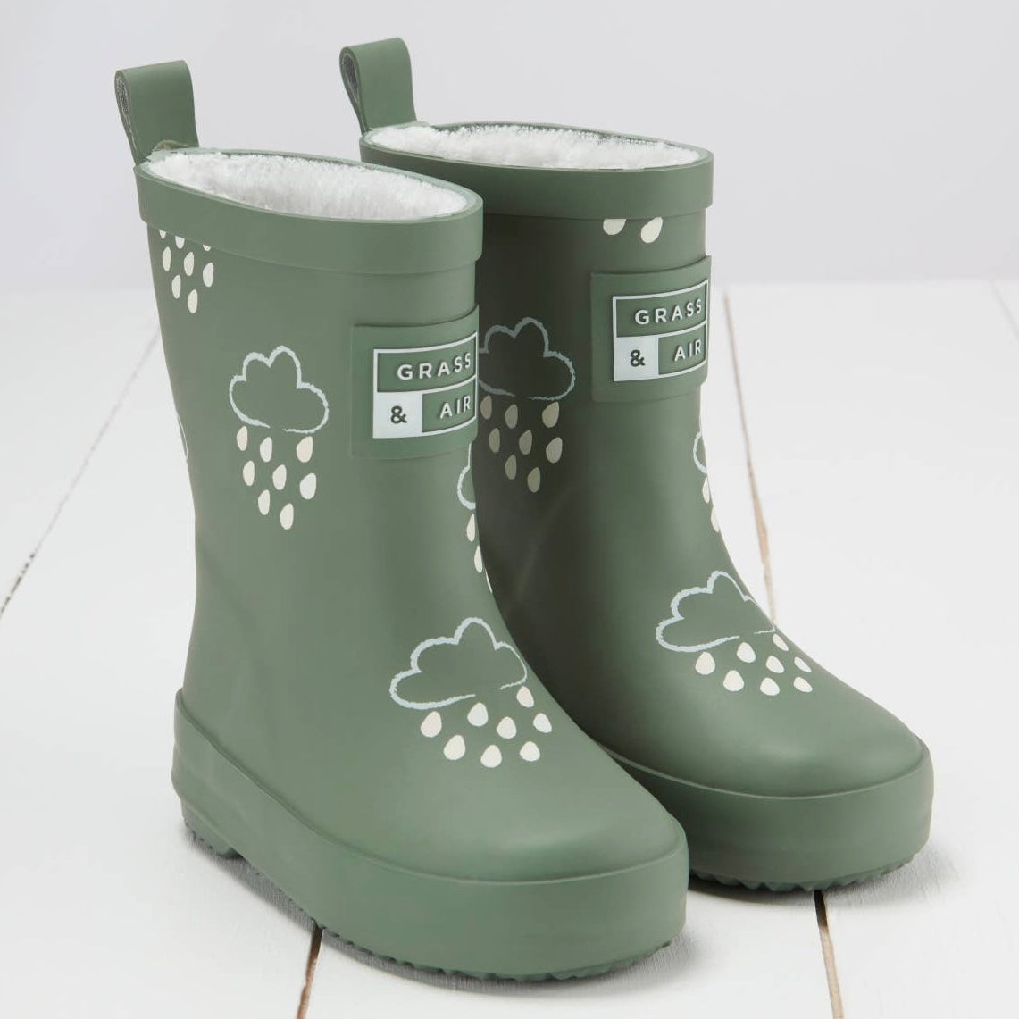
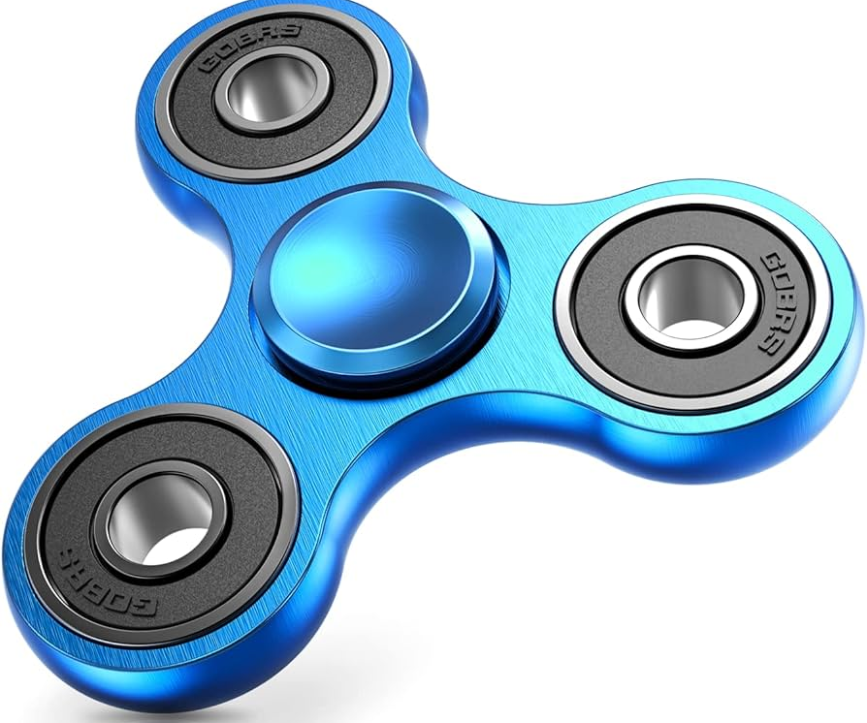
Please remember...
Long hair should be tied back at all times, with a simple, plain band – no large bows
If wearing earrings, only 1 pair of simple studs is permitted
Watches may be worn, but no other jewellery is permitted
Please provide appropriate clothing to access the outside area each day – a waterproof coat is essential!
We have limited storage space. Please do not send your child to school with a large bag containing equipment from home. A simple book bag is all that is needed.
Notes:
Please remember to bring:
A book bag everyday – for letters, accident forms, drawings, reading books etc.
A pair of wellies that can be kept at school for the days where it is raining.
Sturdy shoes with velcro if possible please.
Coat everyday
Sun hat on the days where it is hot.
No toys to be brought to school
Water bottles - just water (no juice)
You will be given a blue drawstring bag. We ask that a spare change of clothes is put into this bag and kept on your child's peg. If your child has an accident or gets wet/muddy outside – we will use these clothes and send home the wet ones.

Slide 34
Equality, Diversity and Inclusion

Slide 35


Values
PSHE
VALUES
EDUCATION
Responsibility
Rights
Tolerance
Unity
Democracy
Understanding
Courage
Quality
Passion
Confidence
Pride
Respect
Happiness
Peace
Friendship
Love
Kindness
Politeness
Resilience
Freedom

Slide 36

No Outsiders
No one wants to feel left out; like they don’t belong; like they are not wanted.
We all want our children to feel wanted and included. To feel like they belong. This needs to be taught.
‘No Outsiders’ addresses the protected characteristics of the Equality Act in an age appropriate way. It aims to teach that difference is not a barrier to friendship but is something positive that make us all unique. It aims to help children to explore differences and enable them to feel proud of who they are, to know that they are accepted without judgement, and to realise that they do not have to change in order to ‘fit in’.

Slide 37
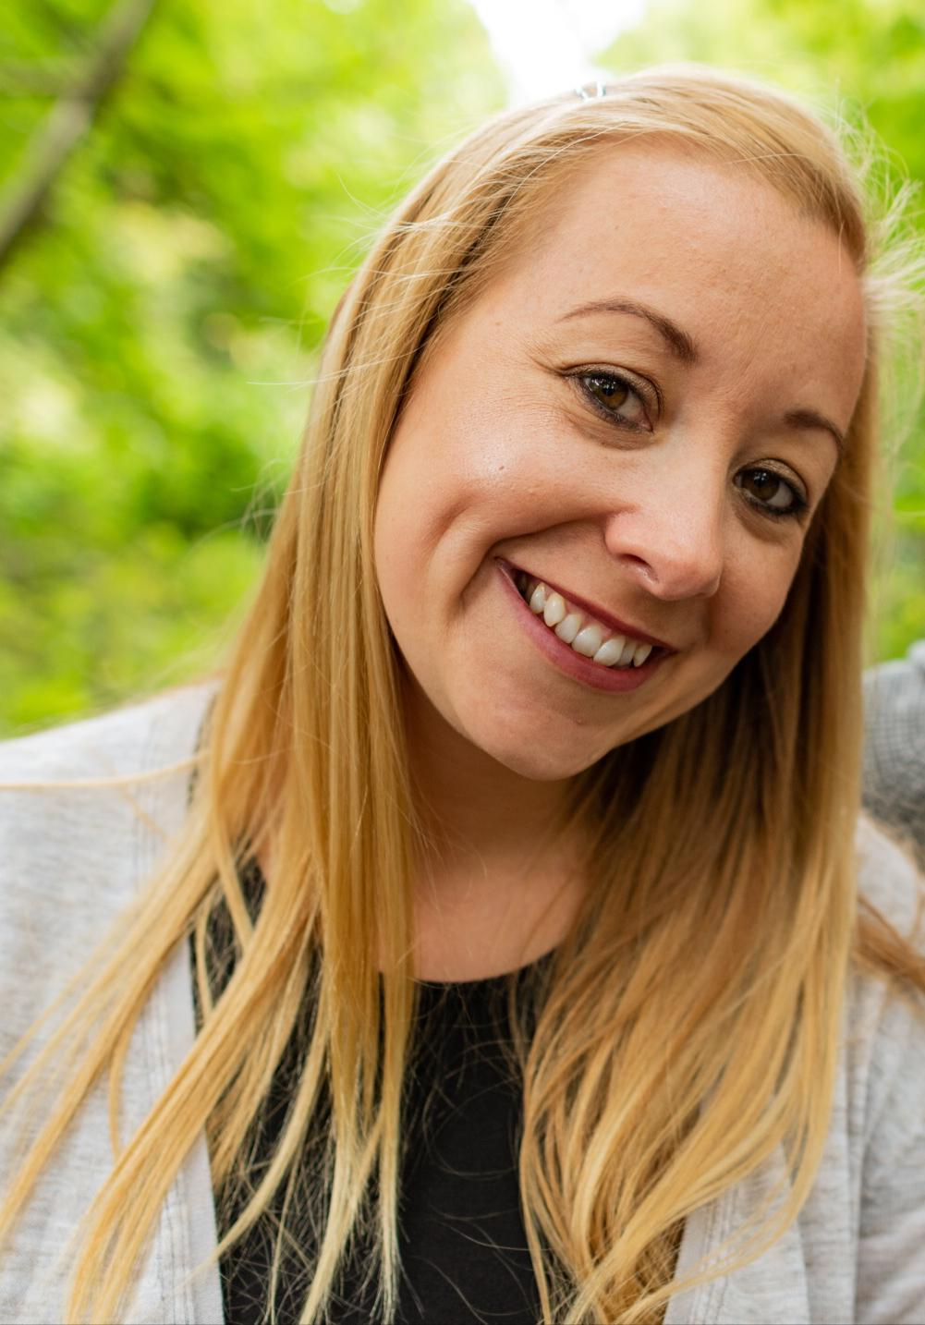
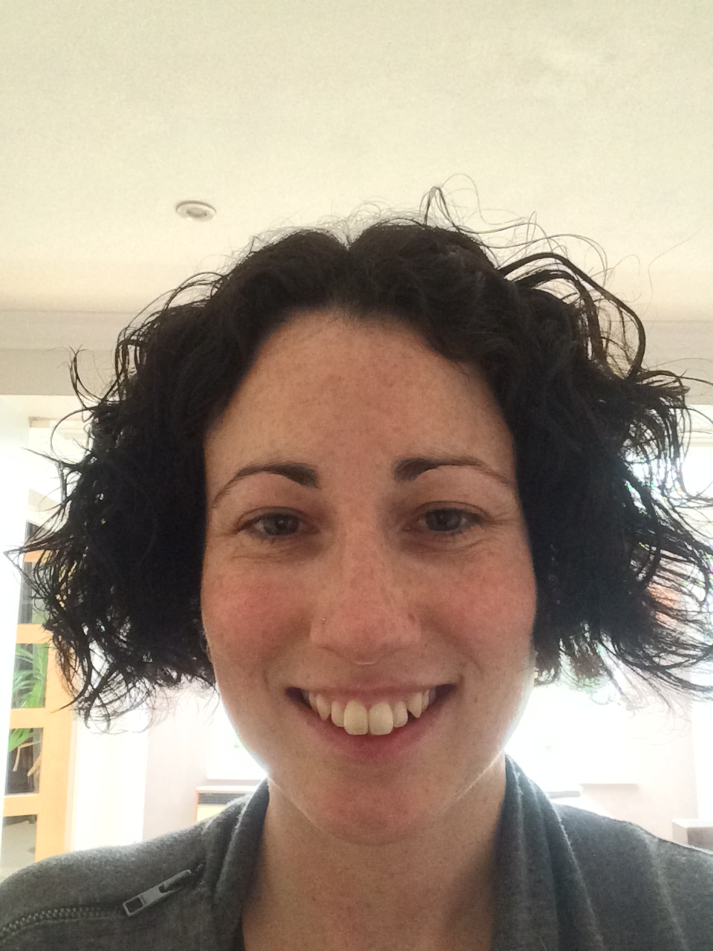
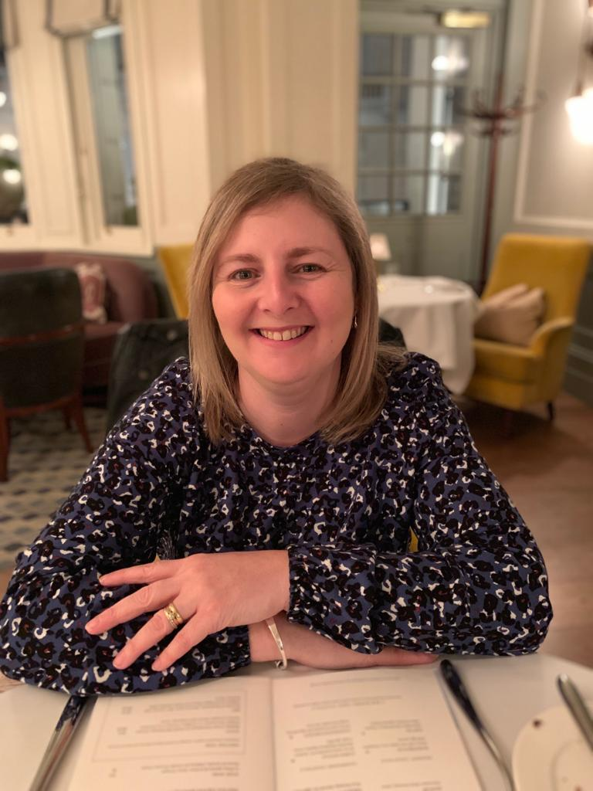
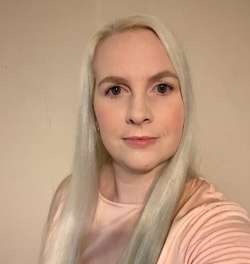
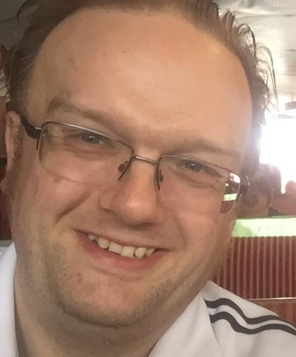
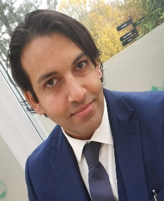


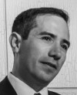

Have you considered being a school governor?
Would you like to help shape the future for the next generation?
Do you have a valuable/professional skill you can offer?
Are you committed to contributing to your local community?
If you answer YES to any of the above, please get in touch
We are keen to recruit governors who reflect our diverse community and the school
We welcome anyone who is interested in school governance, but especially those with skills and expertise in health & safety, communications, social care and education.
All new governors with full training and support
Please get in touch for a virtual coffee chat
Claire.Peacock@Fairlands.herts.sch.uk

Slide 38
We look forward to welcoming you to Fairlands Primary School

